Slide 1
Advancing Civic Excellence in Florida’s Communities
https://www.floridacivicadvance.net

Slide 2
Florida Civic Advance Advancing Civic Excellence in Florida’s Communities
Florida, the 3rd largest state, ranks among the lowest states in terms of civic health:
50th in nation in volunteering among 50 states (2015)
49th in belonging to a civic organization (2013)
50th in donating to charity (2015)
50th in helping neighbors fix a community problem (2015) and
50th attending public meetings (2015)
https://www.floridacivicadvance.net

Slide 3
Florida Civic Advance Advancing Civic Excellence in Florida’s Communities
Our mission is to advance and improve the civic health and resiliency in Florida Communities. The Florida Civic Advance, Inc. (FCA) is committed to improving these measures of civic health.
Our vision is to serve as the premier Florida resource for civic advance that inspires communities and individuals to champion civic health and resiliency and build communities where everyone feels at home.

Slide 4
Florida Civic Advance Advancing Civic Excellence in Florida’s Communities
Florida Civic Advance Membership
We welcome organizations and individuals to join as FCA members with this new nonprofit membership network dedicated to increasing civic practices and advancing civic excellence in Florida’s communities
https://www.floridacivicadvance.net/join_fca

Slide 5
Florida Civic Advance Advancing Civic Excellence in Florida’s Communities
In Case You Missed Past FCA First Fridays Programs
Visit our website: https://www.floridacivicadvance.net

Slide 6
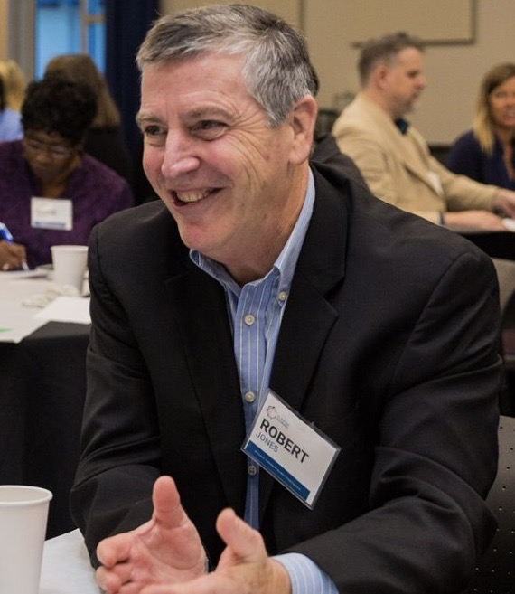
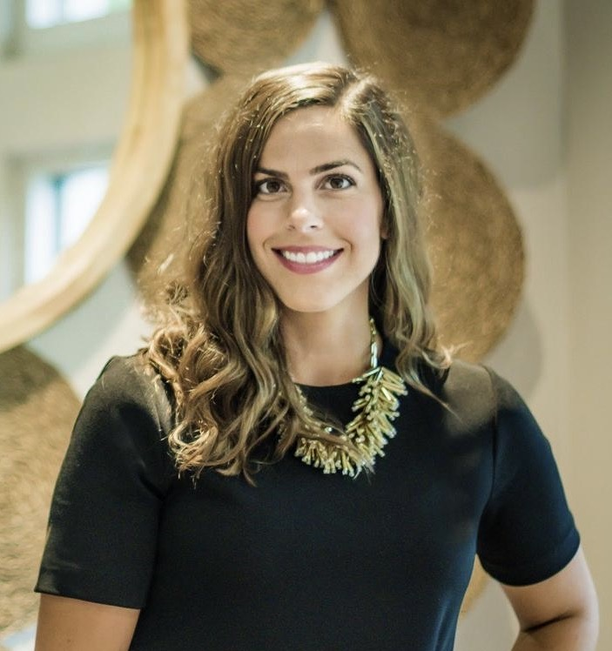
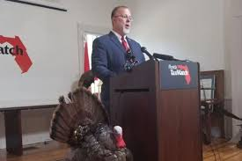
Florida Civic Advance Advancing Civic Excellence in Florida’s Communities Introducing the “Counting on the Census” Speakers
Bob Jones, Moderator
FCA Board Member,
Ashley Dietz, CEO
Florida Philanthropic Network
Tony Carvajal, Executive Vice President, Florida Tax Watch

Slide 7
Florida Civic Advance Advancing Civic Excellence in Florida’s Communities
FCA Website
https://www.floridacivicadvance.net
Membership Benefits and Application
https://www.floridacivicadvance.net/join_fca

Slide 8
Florida Civic Advance Advancing Civic Excellence in Florida’s Communities
FCA Third Thursdays- Next Webinar
October 20, 2022, 12-1 pm, EDT
”Building Trusts and Community Partnerships: The Allegany Franciscan Ministries’ Common Good Initiative in Overtown Miami"
See FCA Website for registration
https://www.floridacivicadvance.net

Slide 9
Florida Civic Advance Advancing Civic Excellence in Florida’s Communities
https://www.floridacivicadvance.net

