Slide 1
Advancing Civic Health in Florida’s Communities
FCA Third Thursday 2023 Webinar Series
https://floridacivicadvance.com

Slide 2
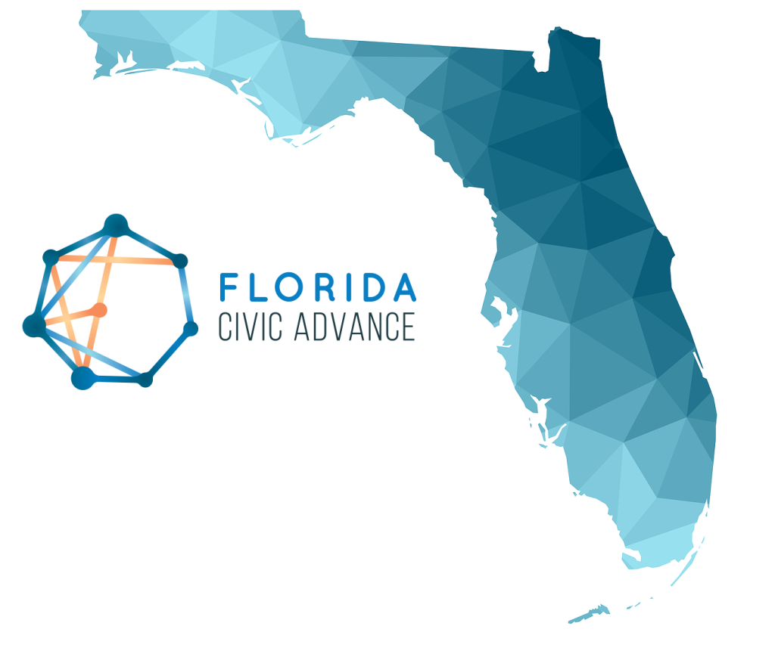
Florida Civic Advance Advancing Civic Health in Florida’s Communities
FCA Third Thursdays Webinar
Thursday, July 20, 2023, 12-1:00 pm, EDT
Engaging Youth in Civic Health:
CAPE (Community Action Projects for the Environment) UF-IFAS

Slide 3
Florida Civic Advance Advancing Civic Health in Florida’s Communities
THE CIVIC CHALLENGE
Florida, the 3rd largest state, ranks among the lowest states in terms of civic health. We want to change that.
50th in nation in volunteering among 50 states (2015)
49th in belonging to a civic organization (2013)
50th in donating to charity (2015)
50th in helping neighbors fix a community problem (2015) and
50th attending public meetings (2015)
https://floridacivicadvance.com

Slide 4
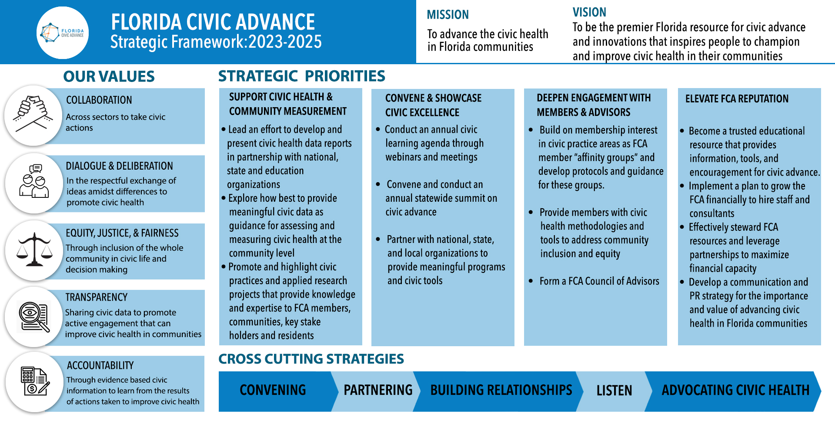
Advancing Civic Health in Florida’s Communities

Slide 5
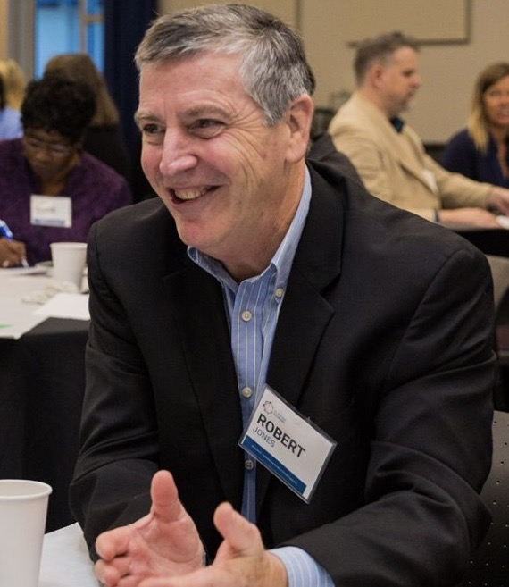
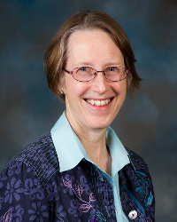
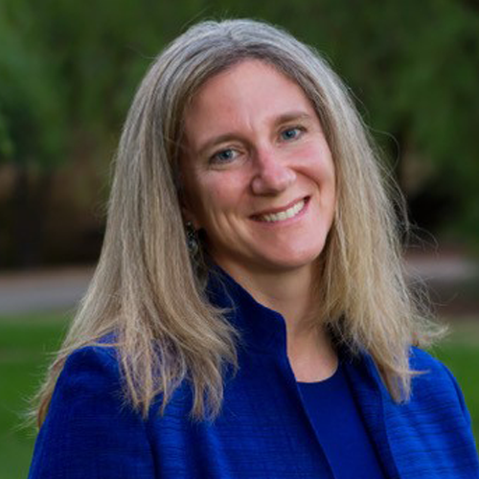
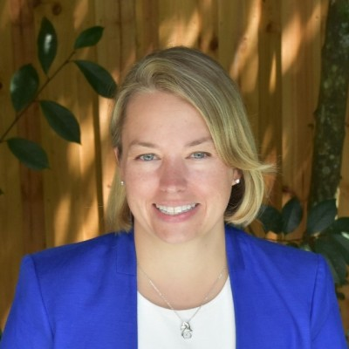
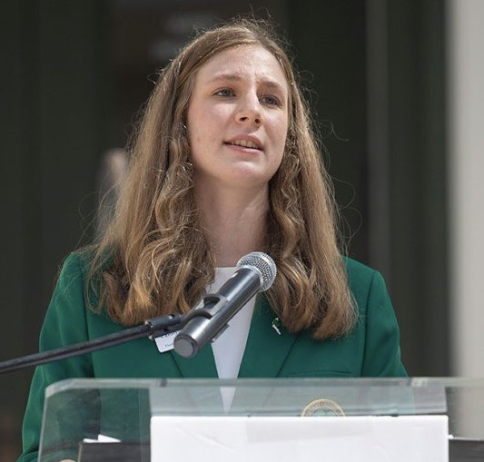
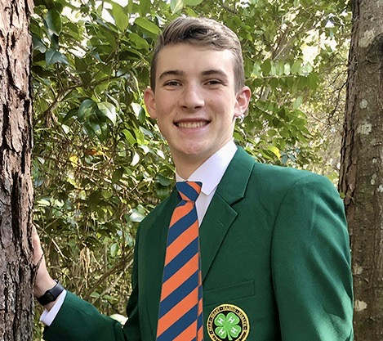
Florida Civic Advance Advancing Civic Health in Florida’s Communities Introducing the Presenters “Engaging Youth in Civic Health: CAPE”
Bob Jones
Moderator
FCA Board Member
Martha Monroe Professor, Environmental Education, UF IFAS Extension
Sarah Wolking
Senior Lecturer,
and Senior Legal
Skills Professor,
UF Law
Megan Ennes
Director, UF Thompson Earth Systems Institute
Carolyn Wolking
Florida 4-H State
Council President
(2022-23)
Benjamin Wolking
Bates College
incoming freshman,

Slide 6
Florida Civic Advance Advancing Civic Health in Florida’s Communities “Engaging Youth in Civic Health””
What do you want to Learn From Today’s Webinar?
Who: UF IFAS, Florida 4-H, CAPE, The Florida Civic Advance
What: The CAPE model for youth engagement. More information on youth voice. What has been successful, best practices, lessons learned.
How: How do these efforts assure that there is a racial diversity of participants? What metrics are used and have there been longitudinal studies conducted?
How to engage youth in proactive, community focused advocacy that resonates with their age group. How to get youth in rural areas encouraged to participate in shaping their communities.

Slide 7
Community Action Projects
for the Environment
Megan Ennes, Martha Monroe, Sarah Wolking, and
4-H members Benjamin and Carolyn Wolking
Notes:
Bob

Slide 8
Welcome and Agenda
Introduction to CAPE
What it is, how it works, what’s coming up
An example from Gainesville
How you can be involved
Support youth groups in your region
Borrow activities for your program
Lead a CAPE group
Notes:
megan

Slide 9
And who are you?
Do you work with youth younger than 18?
Who works with undergraduate students?
Who works with community groups?
Who is interested in civic engagement?
Notes:
Megan

Slide 10
Introducing CAPE
Community Action Projects for the Environment
Funded by USEPA through partnership with NAAEE called ee360+
Helps youth groups identify and explore an environmental concern in their community, then develop and implement a community project that results in asking a decision maker to make a change that benefits everyone.
Notes:
Megan Explain the essence of CAPE – helping youth work together in groups or clubs to learn about their environment, select an important problem/concern for them, learn about the potential solutions, and request that a decision maker make a change. This could be as simple as asking a grocery store manager to post the places where produce was grown or a school principal to consider authorizing a compost pile for lunchroom food waste. But of course to make their request successful, they will have to learn a bit more. What are the barriers to this change and what should the decision maker know to approve the change? They could also learn about their community governance and ask a mayor or county commission to put more bike lanes in the city budget, with survey data on where people would ride if it were safe, or how many people ride in other communities.
And here is what kids say about their experience….

Slide 11
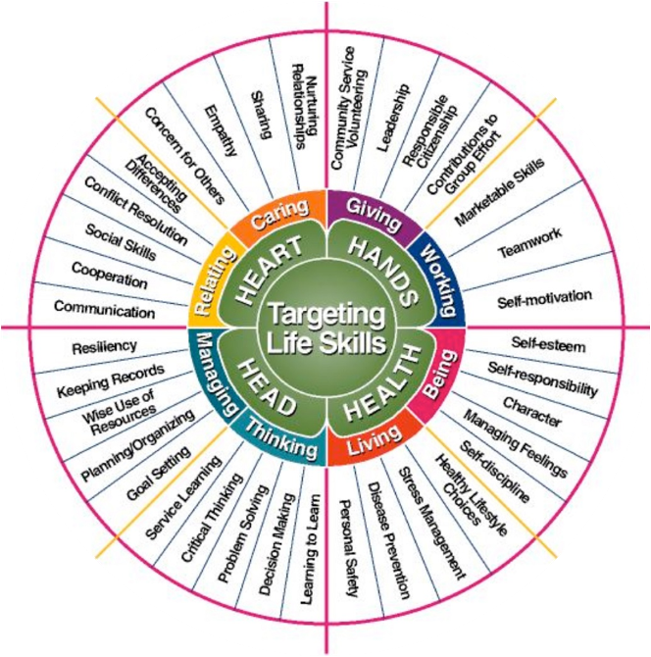
4-H: Cooperative Extension Service’s Youth Program
In every state with land grant university
Clubs led by volunteer parents
Meet 1-2x/month
Learn by doing
Build life skills
Problem solving
Critical thinking
Community service
Leadership
Responsible citizenship
Notes:
Martha 4-H is a particularly good partner for this work, since they have a tradition of community service projects and civic education. 4-H projects are designed to build life skills. Most of these are also goals of environmental education programs: teamwork, leadership, responsible citizenship, concern for others, critical thinking, problem solving, cooperation, communication…
4-H clubs are led by volunteers and many only meet once a month. So our leader guide was written for volunteer leaders and the Earth Force program was condensed into 8 meetings.

Slide 12
Who is CAPE for?
Youth groups, ages 11-18
4-H, after-school, Scouts, school clubs, classrooms, homeschools, etc.
Who tends to be successful?
Youth who are familiar with each other
Passionate about the environment
Creative thinkers
Ready for a challenge
Skilled leader
Notes:
Ailee CAPE can be used by any group of youth, in any organization, but we’ve learned a lot about the characteristics of groups that might contribute to their success.
Some of these criteria put some groups at an advantage – like having worked together before and being committed to work for environmental protection. It is also ideal if the youth are mature enough and creative enough to think outside the box, to work with adult partners and organizations, and to speak to decision makers. Of course it helps if the leader knows something about group process, is comfortable with ambiguity, and can lead without directing.
None of these criteria are necessary and they can all be overcome. But if a group is young and new and hasn’t done any community activity before, it could be a huge challenge. And it may be a good idea to give them an easier task and wait until next year.

Slide 13
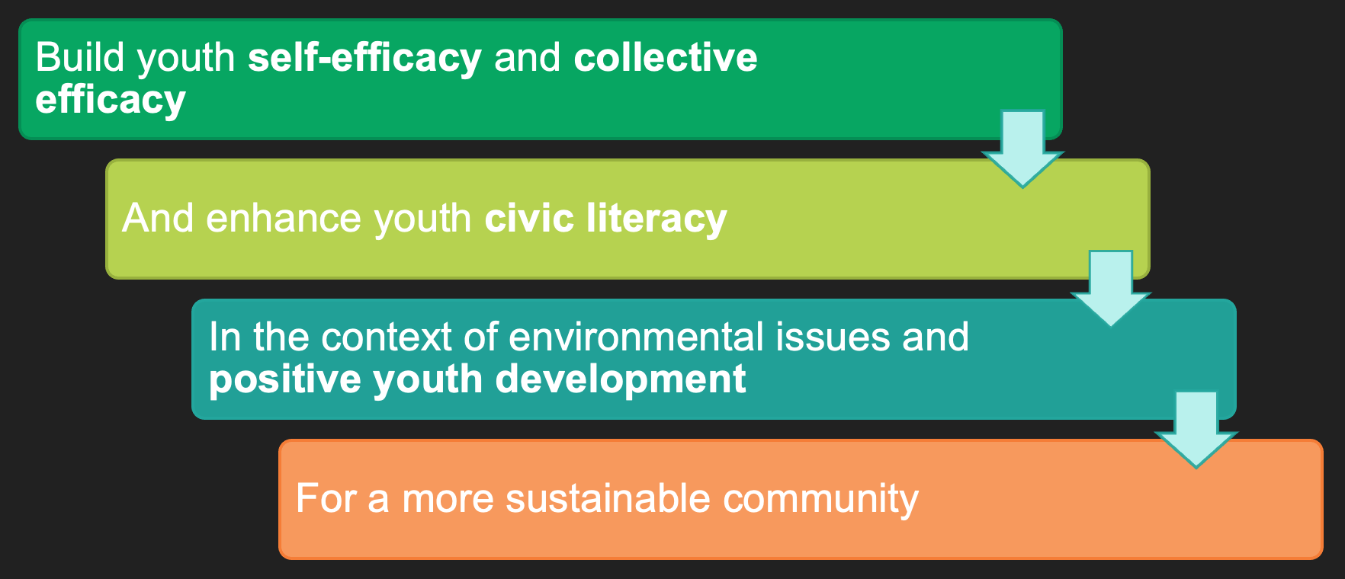
CAPE Objectives
Notes:
Martha

Slide 14
Let's hear what the youth have to say about CAPE.

Slide 15
It’s a Process
Not just community service
…doing a service project in the community
Not a short “one and done” activity
Through CAPE kids learn about governance as they explore the issue
Who is the decision maker?
How are decisions made?
What could help make the situation better?
CAPE enables youth to be engaged in civic life
Notes:
Martha Many organizations involve youth in community service projects where they are given the idea and asked to do something. CAPE is different. Kids come up with their own project ideas AFTER learning about the problem and listening to those who have worked in this area. And since CAPE asks youth to ask for a change, they learn about the decision making process in their communities and organizations. They learn how to be responsible and active citizens.

Slide 16
Getting to a community issue
Individual Action | Community Request | Community Activity
Plant a tree | Ask community to plant trees in communities without trees Ask community to care for urban trees | Map the tree canopy and identify gaps Organize a tree festival to provide information
Ride a bike | Request more bike racks at destinations on public property | Map existing bike racks
Avoid single use plastic | Ask for a ban on certain plastics | Demonstrate existing substitutes or ways people don’t need these plastics
Notes:
Martha If you ask kids what they can do to help the environment, they tend to focus on what they alone can do by themselves (the left column) and indeed, a lot of EE programs have been designed to encourage individuals to make individuals changes in their lifestyle.
But CAPE is all about community scale problems that communities need to work on. And that means kids make a request of a decision maker. They could also make that request more persuasive by doing an action project.

Slide 17
What could go wrong?
How CAPE avoids potholes
Kids leap to action, without considering consequences
Offend stakeholders & groups
Take on controversy
Takes too much time
Leaders not trained/skilled
Adults aren’t civically engaged!
First 4 meetings explore issues, listen to guest speakers
Partner with community group
Make a request
Consider resources before action
But it DOES take time
Find partners and resource folks who are active!
Notes:
Martha Use the animations to ask the group what could possibly go wrong and then use their suggestions to emphasize these and provide how CAPE mitigates these problems.

Slide 18
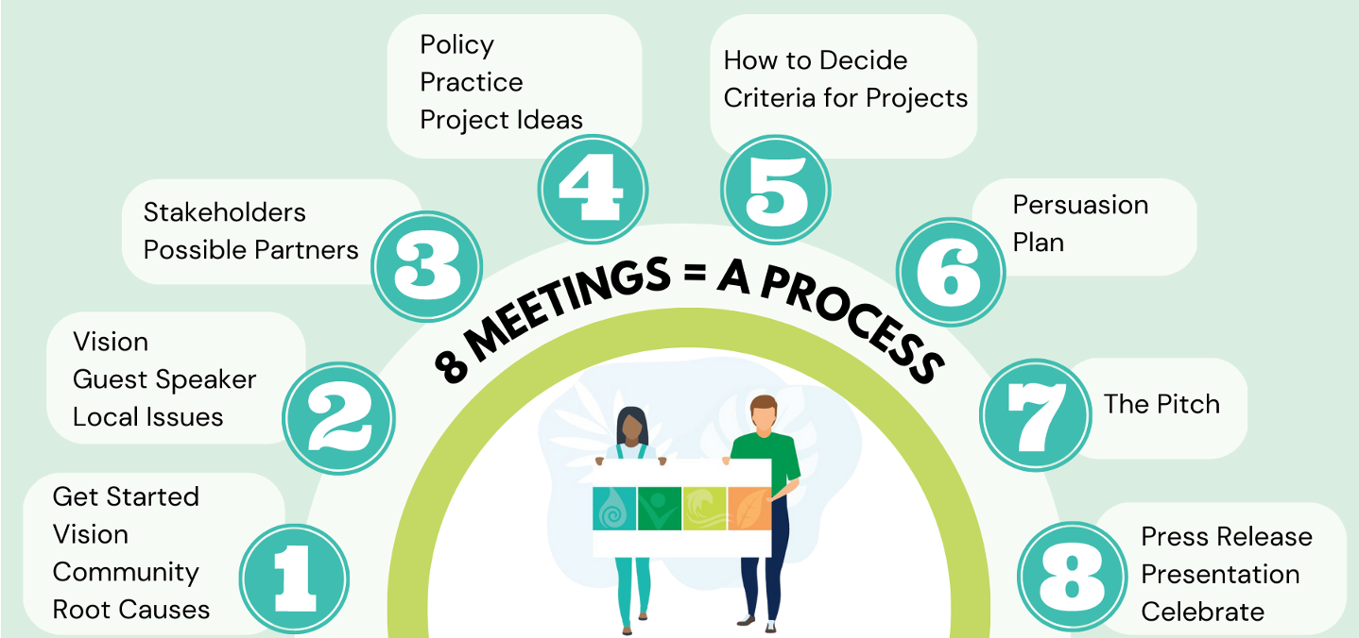
CAPE Overview
Notes:
Martha The eight meetings start with imagining an ideal community and thinking about the root causes of some of the challenges in their community. This requires asking why, several times! They ask local leaders to share their ideas about issues and problems, and think about who else is impacted by this problem. Who else might have ideas about what could be done. What else has been tired?
Eventually they start thinking about a policy they might affect and think about the resource and time they have to do a good project. With their goal in mind, they consider what will make their request most persuasive, and work with their partner to understand the system they are trying to change. They practice their request, or pitch, and celebrate their success. They might alert the media to their work and make a presentation to other youth and their parents, too!

Slide 19
Each meeting
An icebreaker activity
1-3 activities to build skills and support the process
Some with worksheets or video
Reflection page
Mission to bridge to the next meeting
Slide presentation
All available as a free PDF on the website:
https://cape.ifas.ufl.edu
Notes:
Sarah Our materials include resource for leaders to manage this process, with tips from our pilot testers. A training program on the website provides more details.

Slide 20
CAPE encourages leaders to seek resources
Since youth select their own issue, CAPE does not provide issue specific information.
Such resources already exist!
Notes:
Martha CAPE does not include background on environmental issues, but other programs do. We can facilitate workshops to obtain these materials, and some are available for purchase. Some can be downloaded for free (CLEAN activities on climate change).

Slide 21
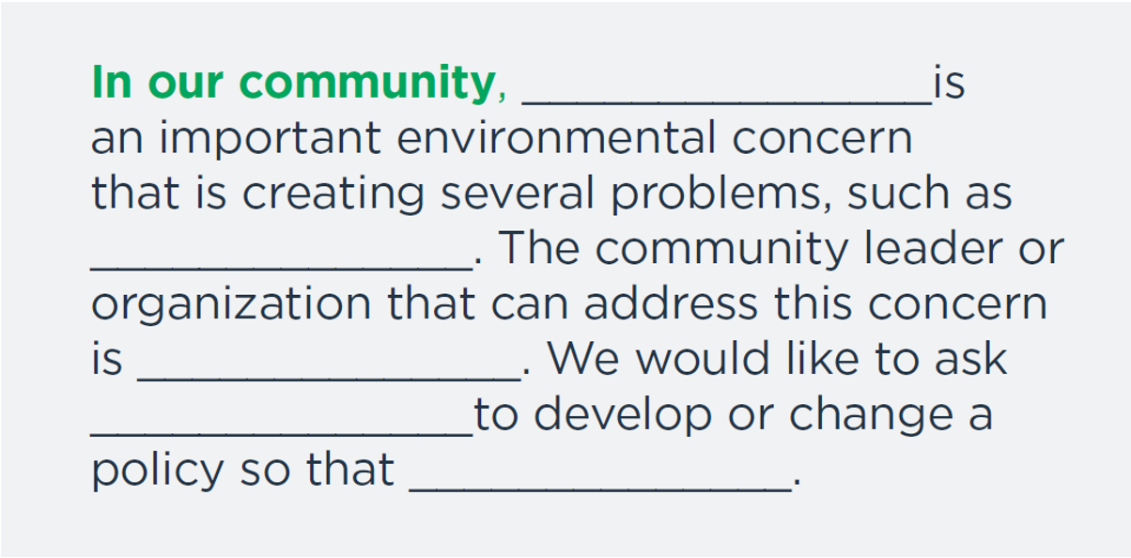
Focus on Policy
Notes:
Martha When the kids have an idea for a project, they should be able to fill in the blanks. Can you do this for an imagined concern and project?

Slide 22
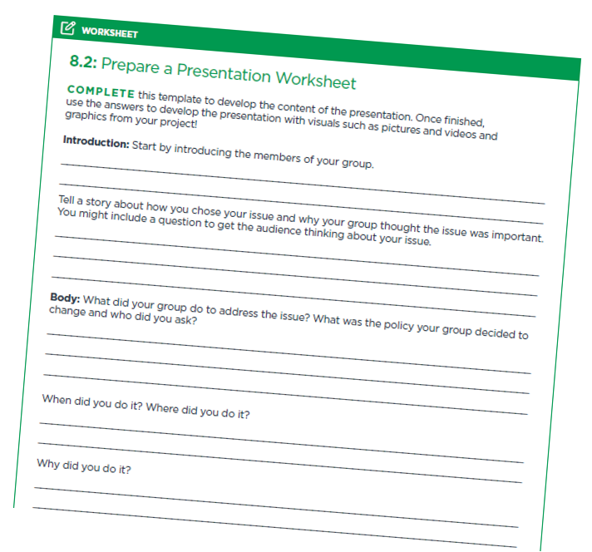
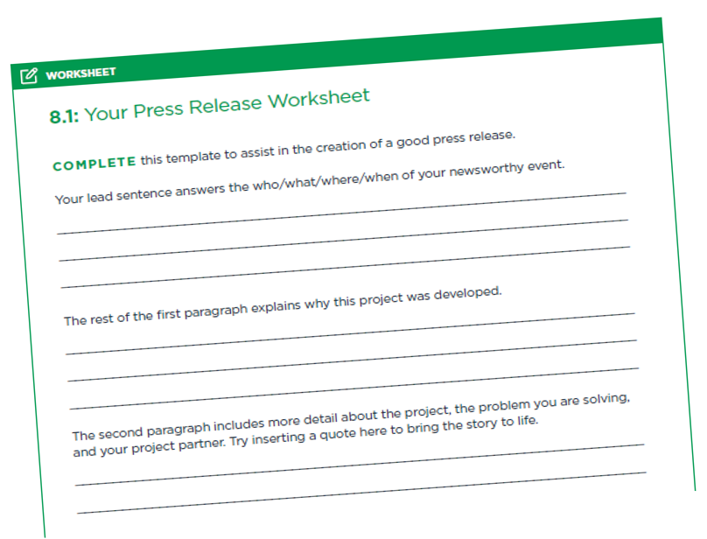
Youth can share their success with others
Notes:
Martha We have suggestions for how to develop a press release and how to give a presentation to share the project’s success with others.

Slide 23
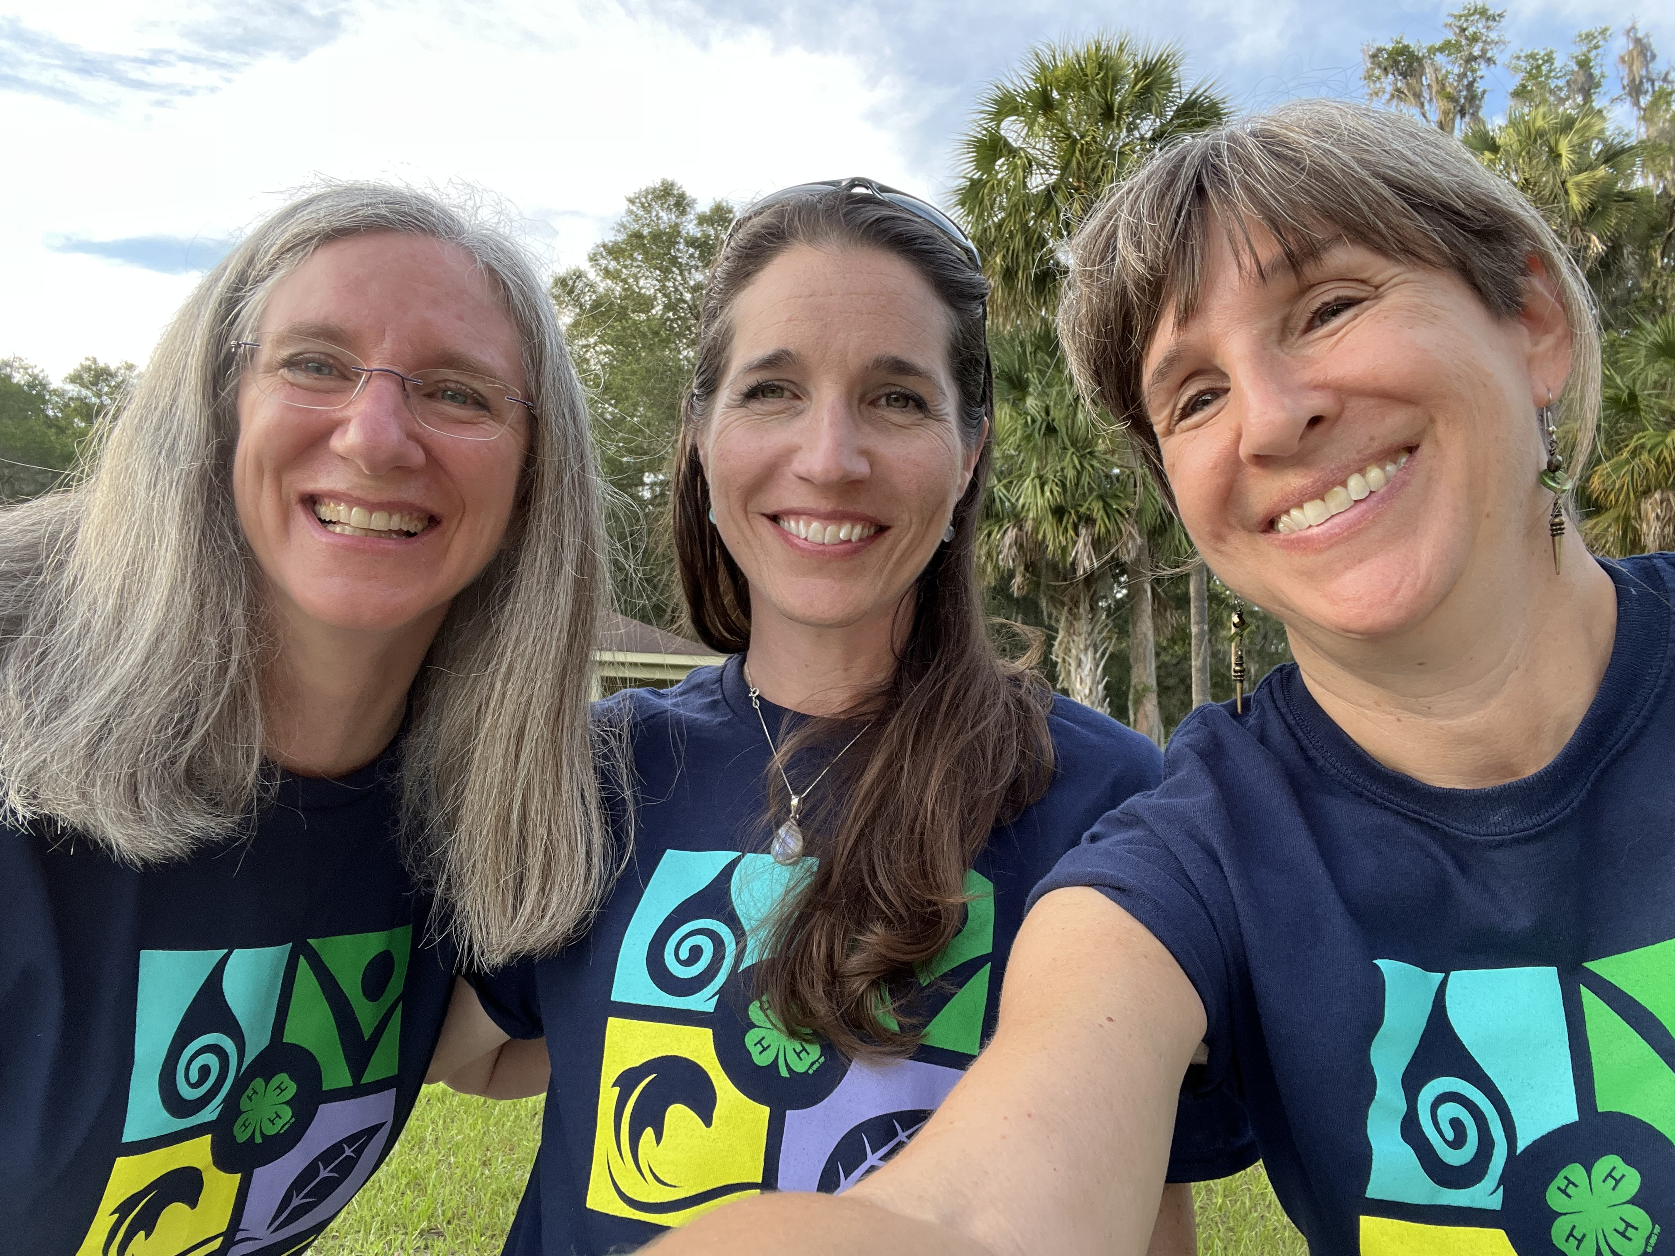
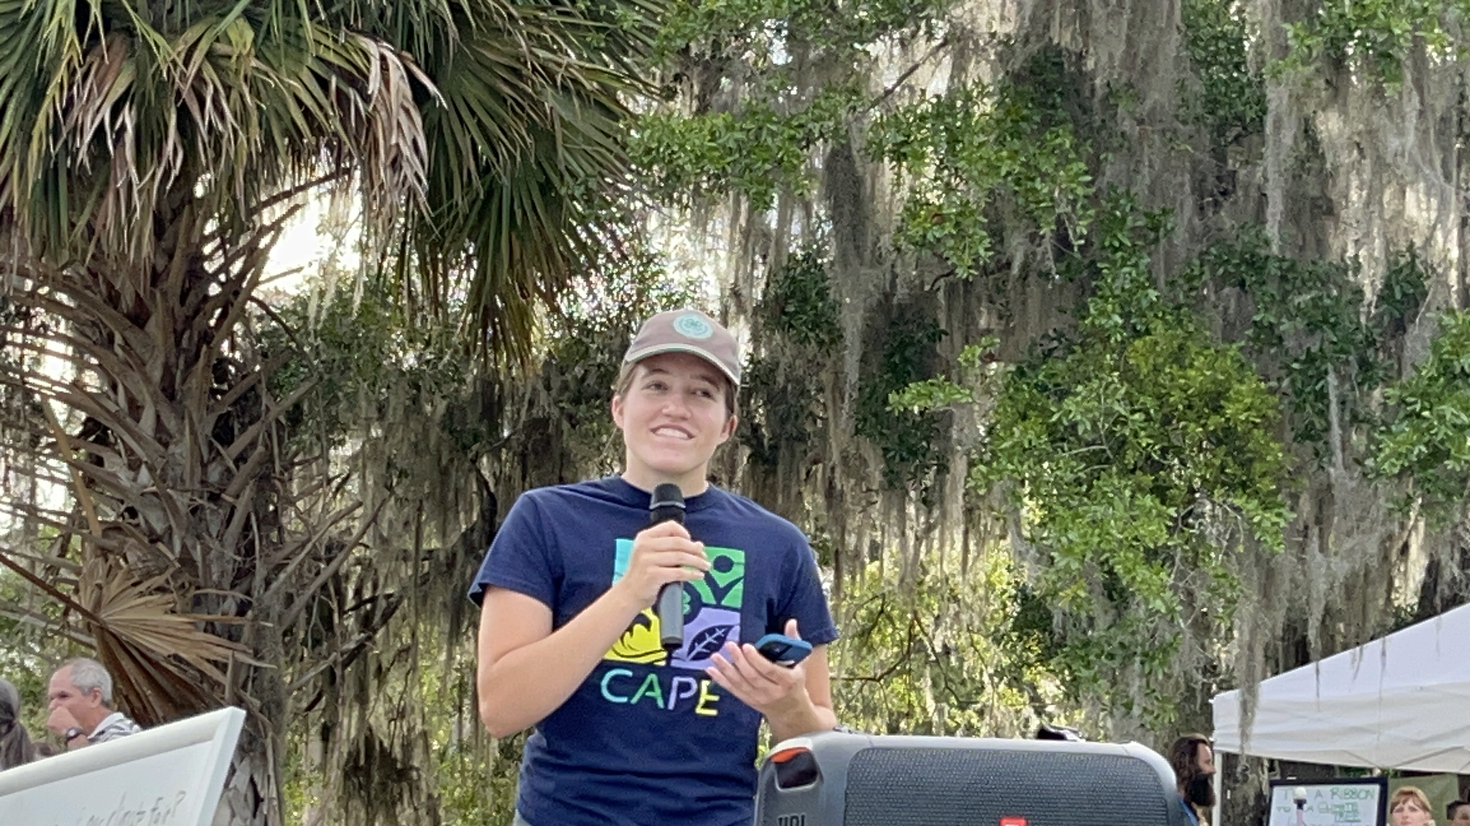
What some CAPE groups have done

Slide 24
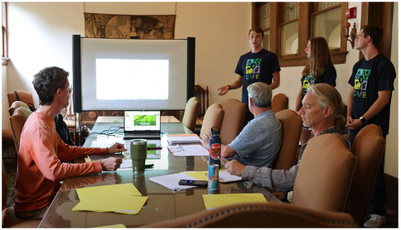
How youth became engaged in Gainesville, Florida
Tree City, USA
Canopy vanishing
Retired city arborist
Tree Mitigation Fund
Tree Advisory Board
Landscape Architect
Mayor
City Commissioners
Notes:
Benjamin and Carolyn: Tree City USA designation, but we noticed that old heritage trees were coming down and not being replaced. We met with G’ville’s retired city arborist who described the ballooning Tree Mitigation Fund which developers simply paid into and counted on as part of the cost of doing business. We learned from her about the changes to the city’s land development code and changed institutional organization and shifting positions of the people who were charged with protecting the trees….

Slide 25
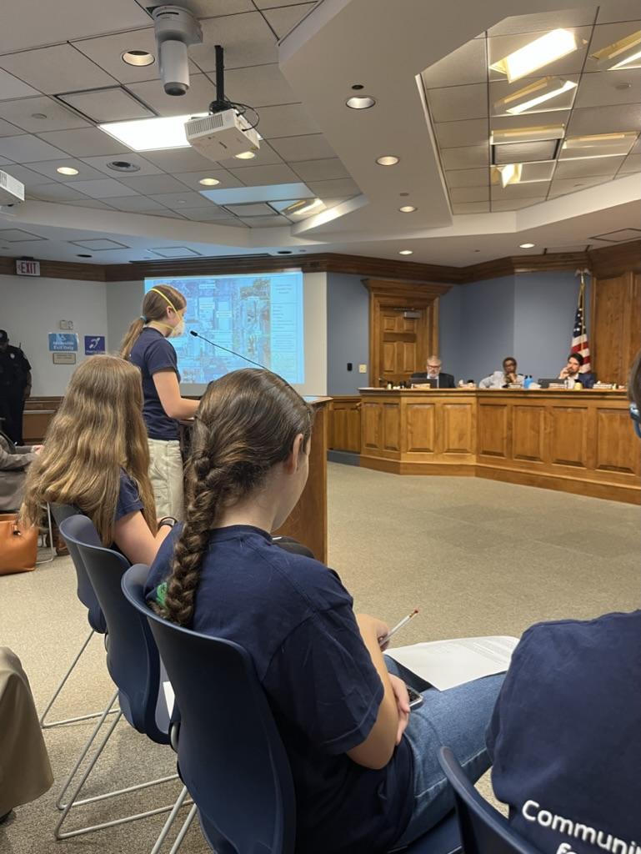
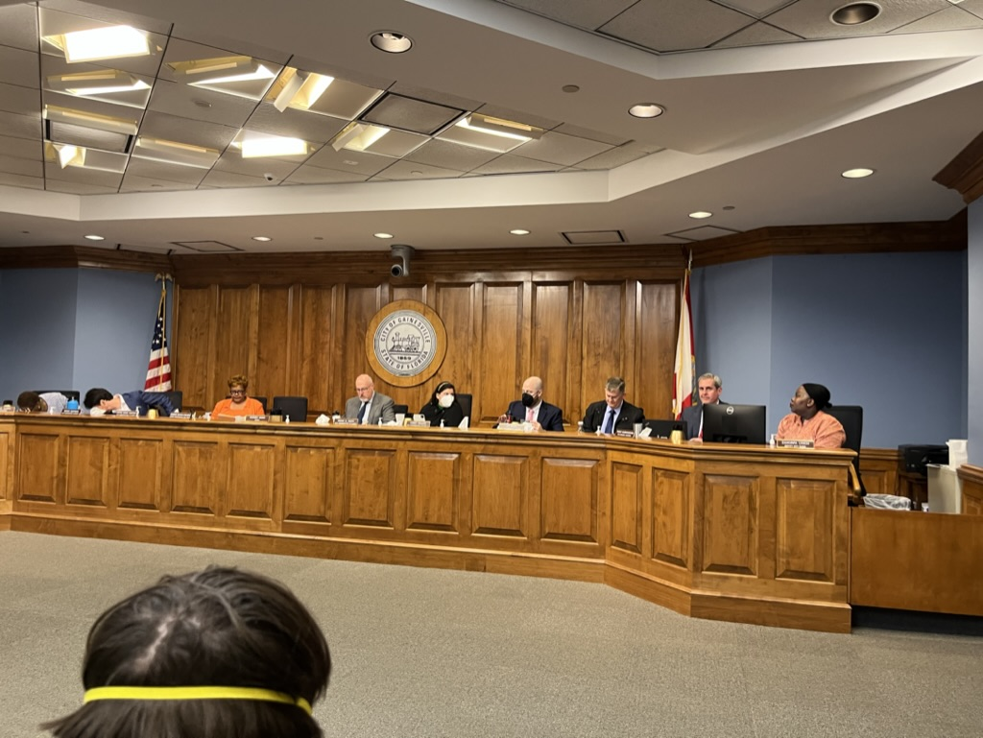
When 4 downtown oak trees were threatened, youth spoke
Notes:
Benjamin and Carolyn: Great timing and opportunity we learned about thanks to our relationships with our community partners.

Slide 26
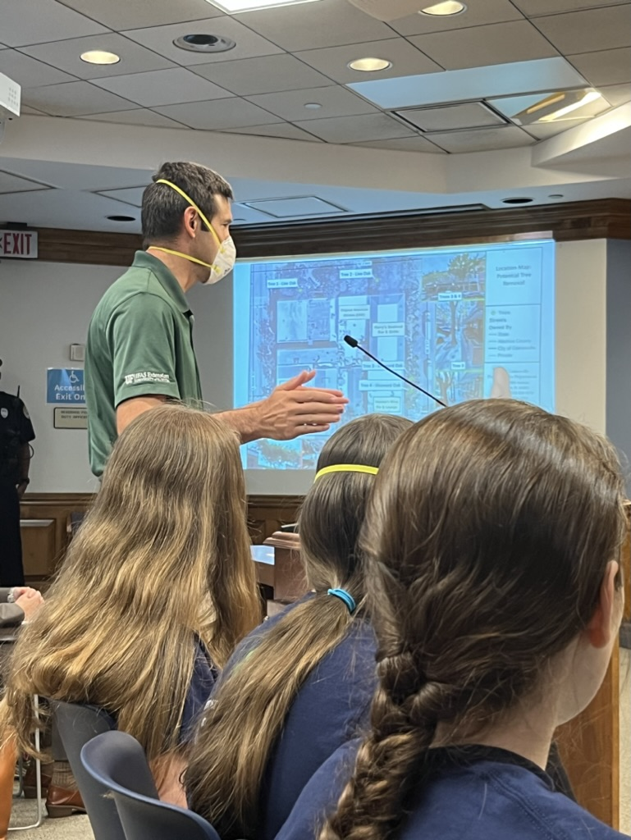
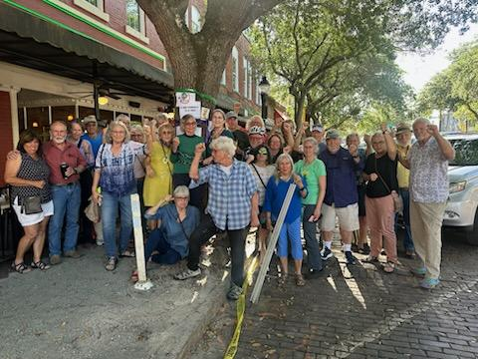
Others were also engaged
Notes:
Sarah: CAPE work here was part of a larger community effort between old and young, veterans, activists….

Slide 27
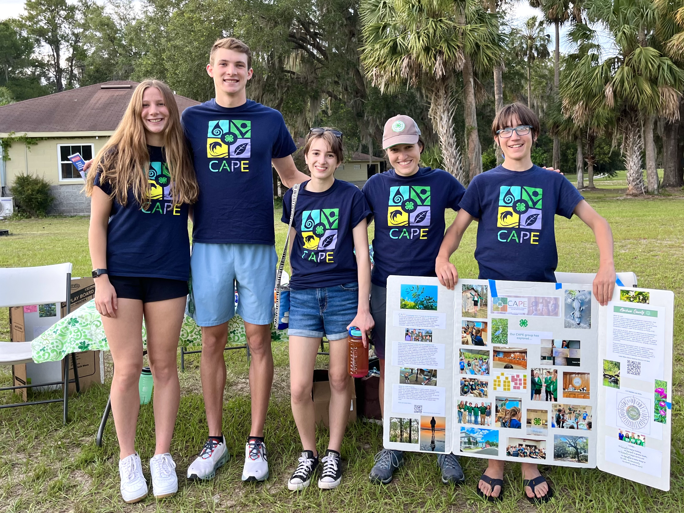
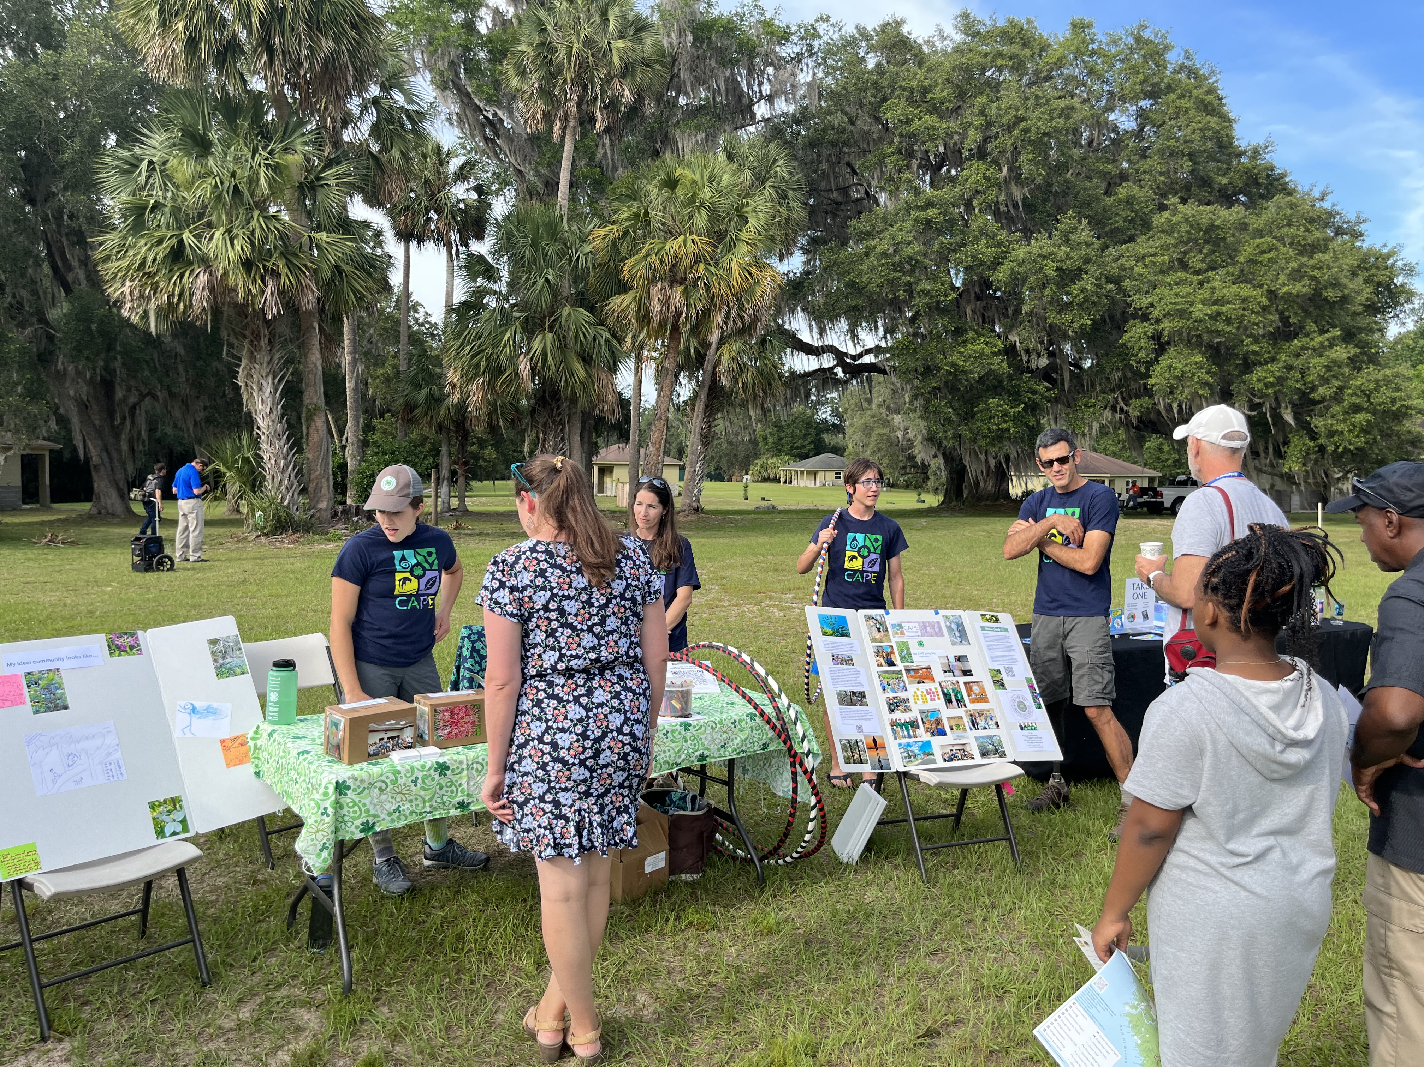
And CAPE youth continue to explore the issue
Graduating seniors still involved
Environmental issues persist
We want the same outcomes!
Clean water, fresh air, trees…
Notes:
Benjamin, Carolyn, Sarah

Slide 28
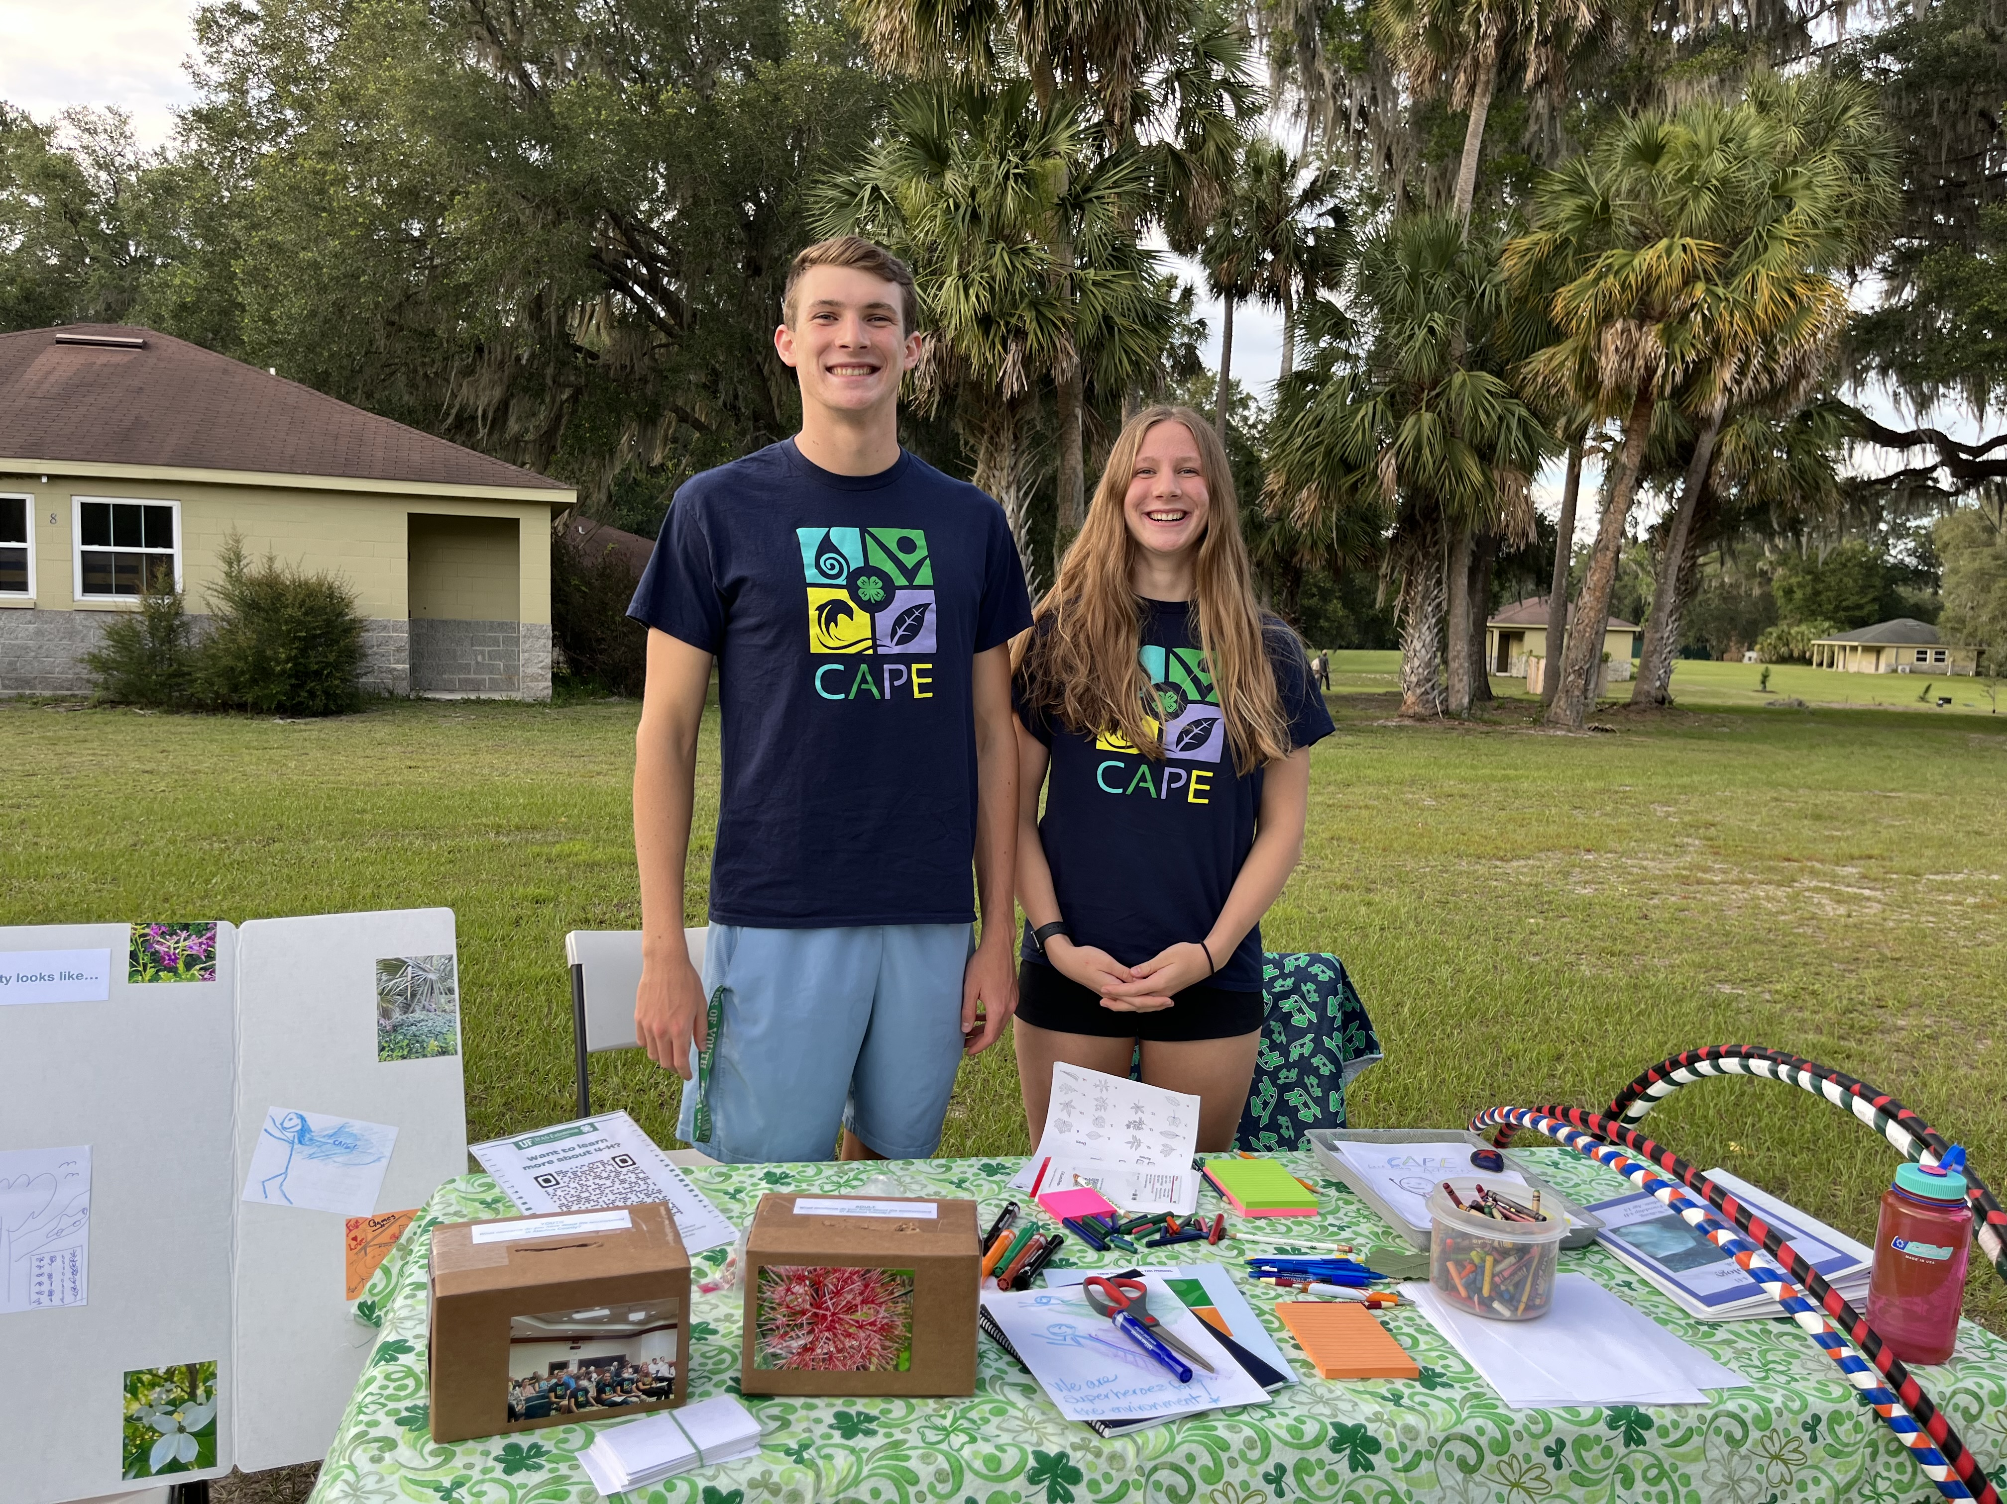
How CAPE is growing this coming year

Slide 29
Developing hubs to support groups
Each hub will be led by a museum/zoo
Launched at a workshop with youth group leaders
Share resources, materials, and support
You are welcome to join!
Brevard Zoo: August 24, 9-11:30
Jacksonville Zoo: September 9, 9-12
Frost Science Center In Miami: September 11, 9-12
Orlando Science Center: September 30, 1-4
Notes:
Megan

Slide 30
Youth groups and leaders often need ideas
Who are the relevant community leaders?
Who are the decision makers?
What has been done on this issue?
What are the relevant regulations and policies?
Why is there a problem?
What would decision makers find compelling?
What could youth ask for?

Slide 31
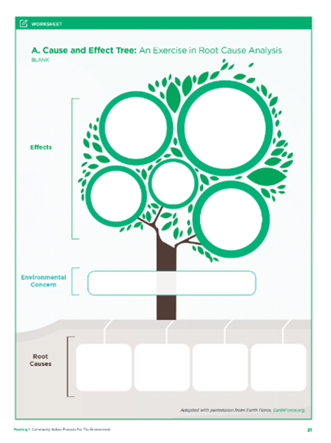
CAPE activities can be used by anyone
Describe an environmental champion
What are the root causes of this issue?
Make a stakeholders map
Is it a policy or a practice?
Five ways to decide

Slide 32
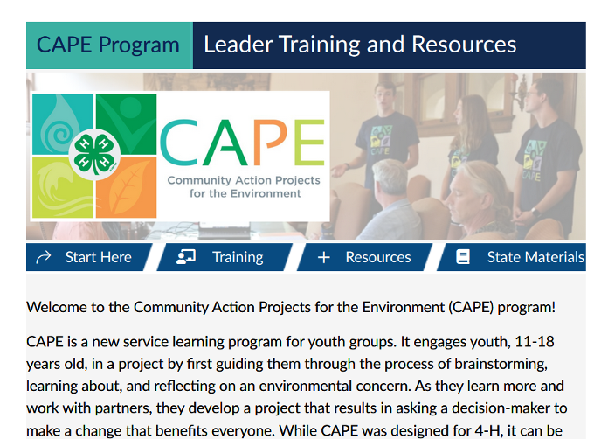
CAPE Website
https://cape.ifas.ufl.edu
Includes examples of what groups have done
Training with 5 modules for certificate
Resources to download
State resources for workshops, evaluation
This is the Canvas page, which requires a login. Access is from the website.
Notes:
Ailee

Slide 33
Questions?
Notes:
Megan

Slide 34
Thank You!
For more information and access to materials, please visit the CAPE website https://cape.ifas.ufl.edu.
Additional questions can be directed to megan.ennes@ufl.edu
Notes:
Megan

Slide 35
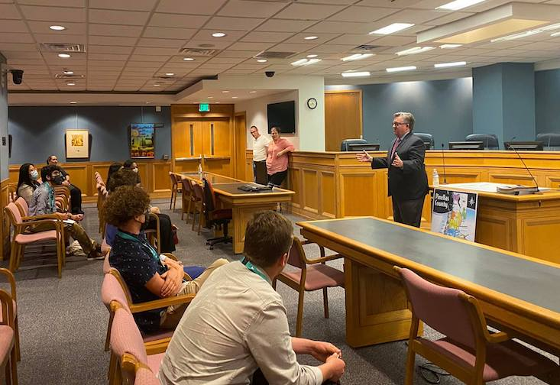
Florida Civic Advance Advancing Civic Health in Florida’s Communities
FCA Third Thursdays Webinar
Thursday, August 17, 2023, 12-1:00 pm, EDT
Engaging Youth in Civic Health:
The USF St Petersburg & Florida YMCA
Civic Fellows and Civic Institute
See FCA Website for registration:

Slide 36
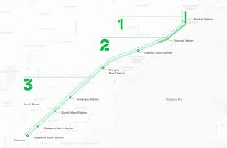
Florida Civic Advance Advancing Civic Health in Florida’s Communities
FCA Third Thursdays Webinar
Thursday, September 21, 2023, 12-1:00 pm EDT
The Miami Underline Conservancy:
Reimagining the Civic Commons and Advancing Civic Health
Transforming public places into civic assets for the whole community the Underline this 120-acre, world-class linear park spanning 10-miles below Miami’s Metrorail that will transform regional mobility and celebrate diversity, equity, culture, and lifelong learning.
See FCA Website for registration:

Slide 37
Florida Civic Advance Advancing Civic Excellence in Florida’s Communities
SAVE THE DATE
Where: Center for Health Equity,
St Petersburg, Florida
Register Online Now

Slide 38
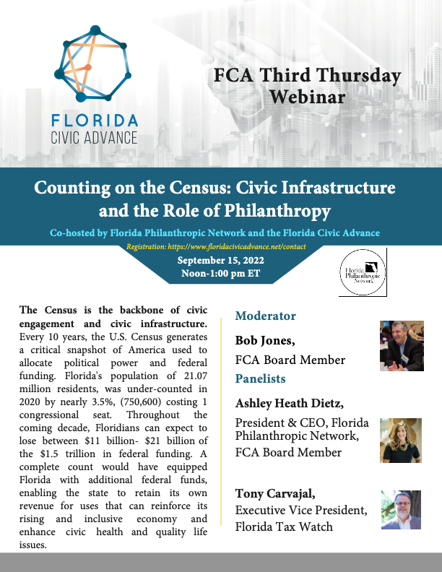
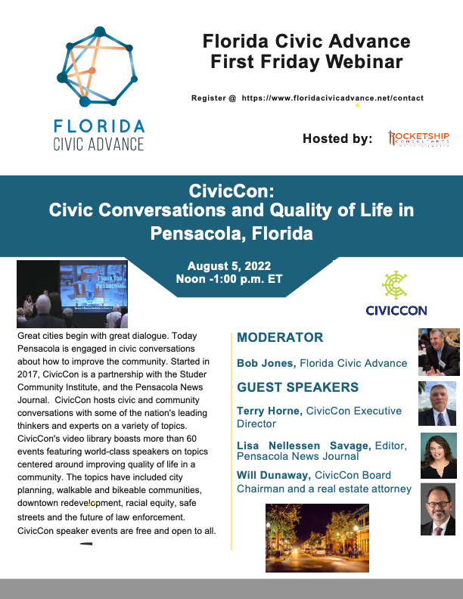
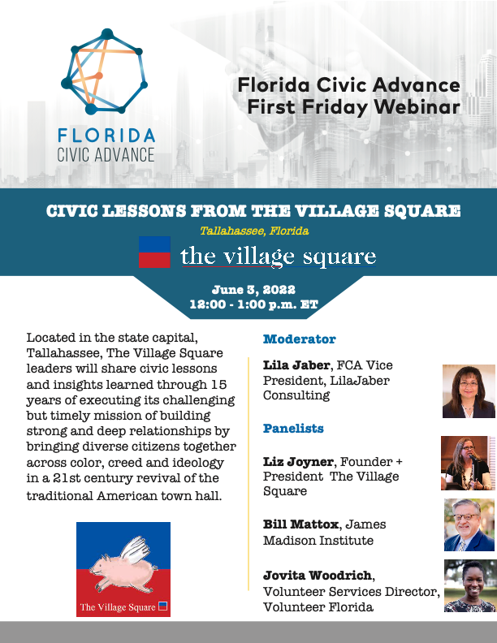
Florida Civic Advance Advancing Civic Excellence in Florida’s Communities
In Case You Missed Past FCA Civic Excellence Webinars
Visit our website: https://www.floridacivicadvance.net

Slide 39
Florida Civic Advance Advancing Civic Health in Florida’s Communities
Join us in advancing civic health in Florida’s communities!
Florida Civic Advance Membership
We welcome organizations and individuals to join as FCA members to build together a new nonprofit membership network dedicated to increasing civic practices and advancing civic health in Florida’s communities
https://floridacivicadvance.com/membership/

Slide 40
Florida Civic Advance Advancing Civic Excellence in Florida’s Communities
FCA Website
https://www.floridacivicadvance.com
Membership Benefits and Application
https://floridacivicadvance.com/membership/

Slide 41
Florida Civic Advance Advancing Civic Health in Florida’s Communities
https://www.floridacivicadvance.com

