Slide 1
Engaging Youth in Civic Health The USF St. Petersburg YMCA Civic Fellows Program
Ms. Chelsea Coombes
Florida State Alliance of YMCAs
State Director, Civic Engagement and Teen Initiatives
Dr. Judithanne Scourfield McLauchlan
USF St. Petersburg, Duckwall Professor of Florida Studies; Director, Center for Civic Engagement; Lead Instructor, Civic Fellows Program
Ms. Emily Vigil
USF St. Petersburg YMCA Civic Fellow
Florida Civic Advance Webinar Series
17 August 2023

Slide 2
Florida YMCA Youth In Government (YIG)
Founded in 1957, Florida YMCA Youth In Government (YIG) is a youth-run, youth-led program focused on developing leadership and life skills through active civic engagement and community service.
HB807/SB1480: Student hours in YIG are Bright Futures eligible.
Youth In Government teaches students to debate ideas and not people.
Builds confidence and public speaking.
Creates a space for understanding.
National YMCA program with local, sate, national and global opportunities for Gen-Z.

Slide 3
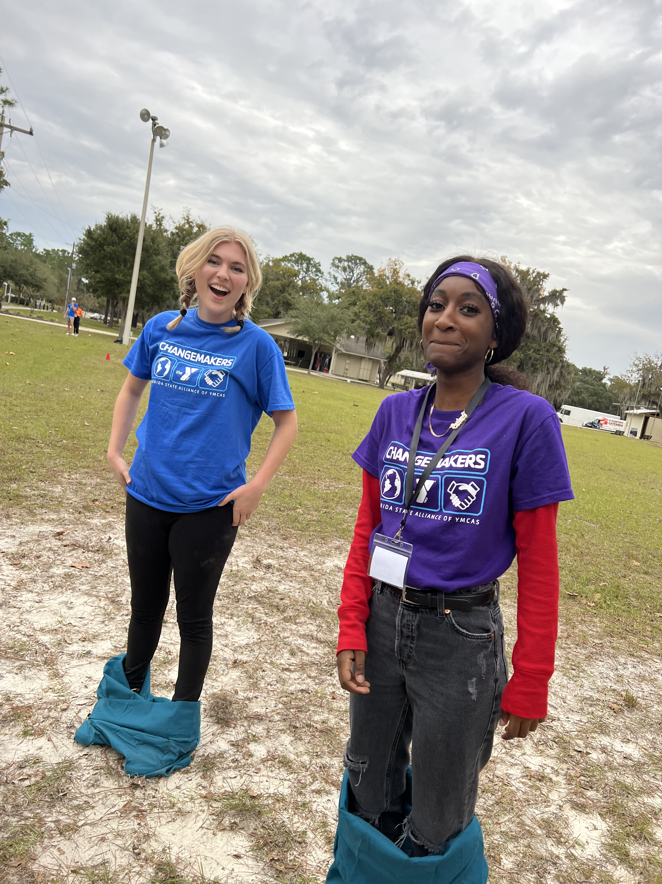
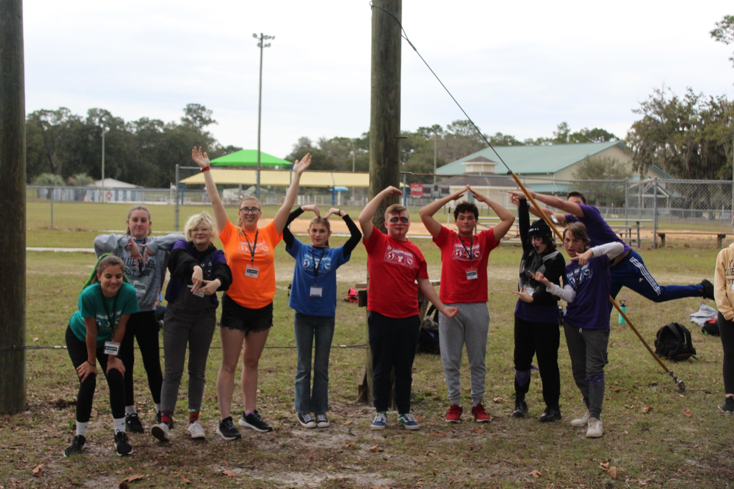
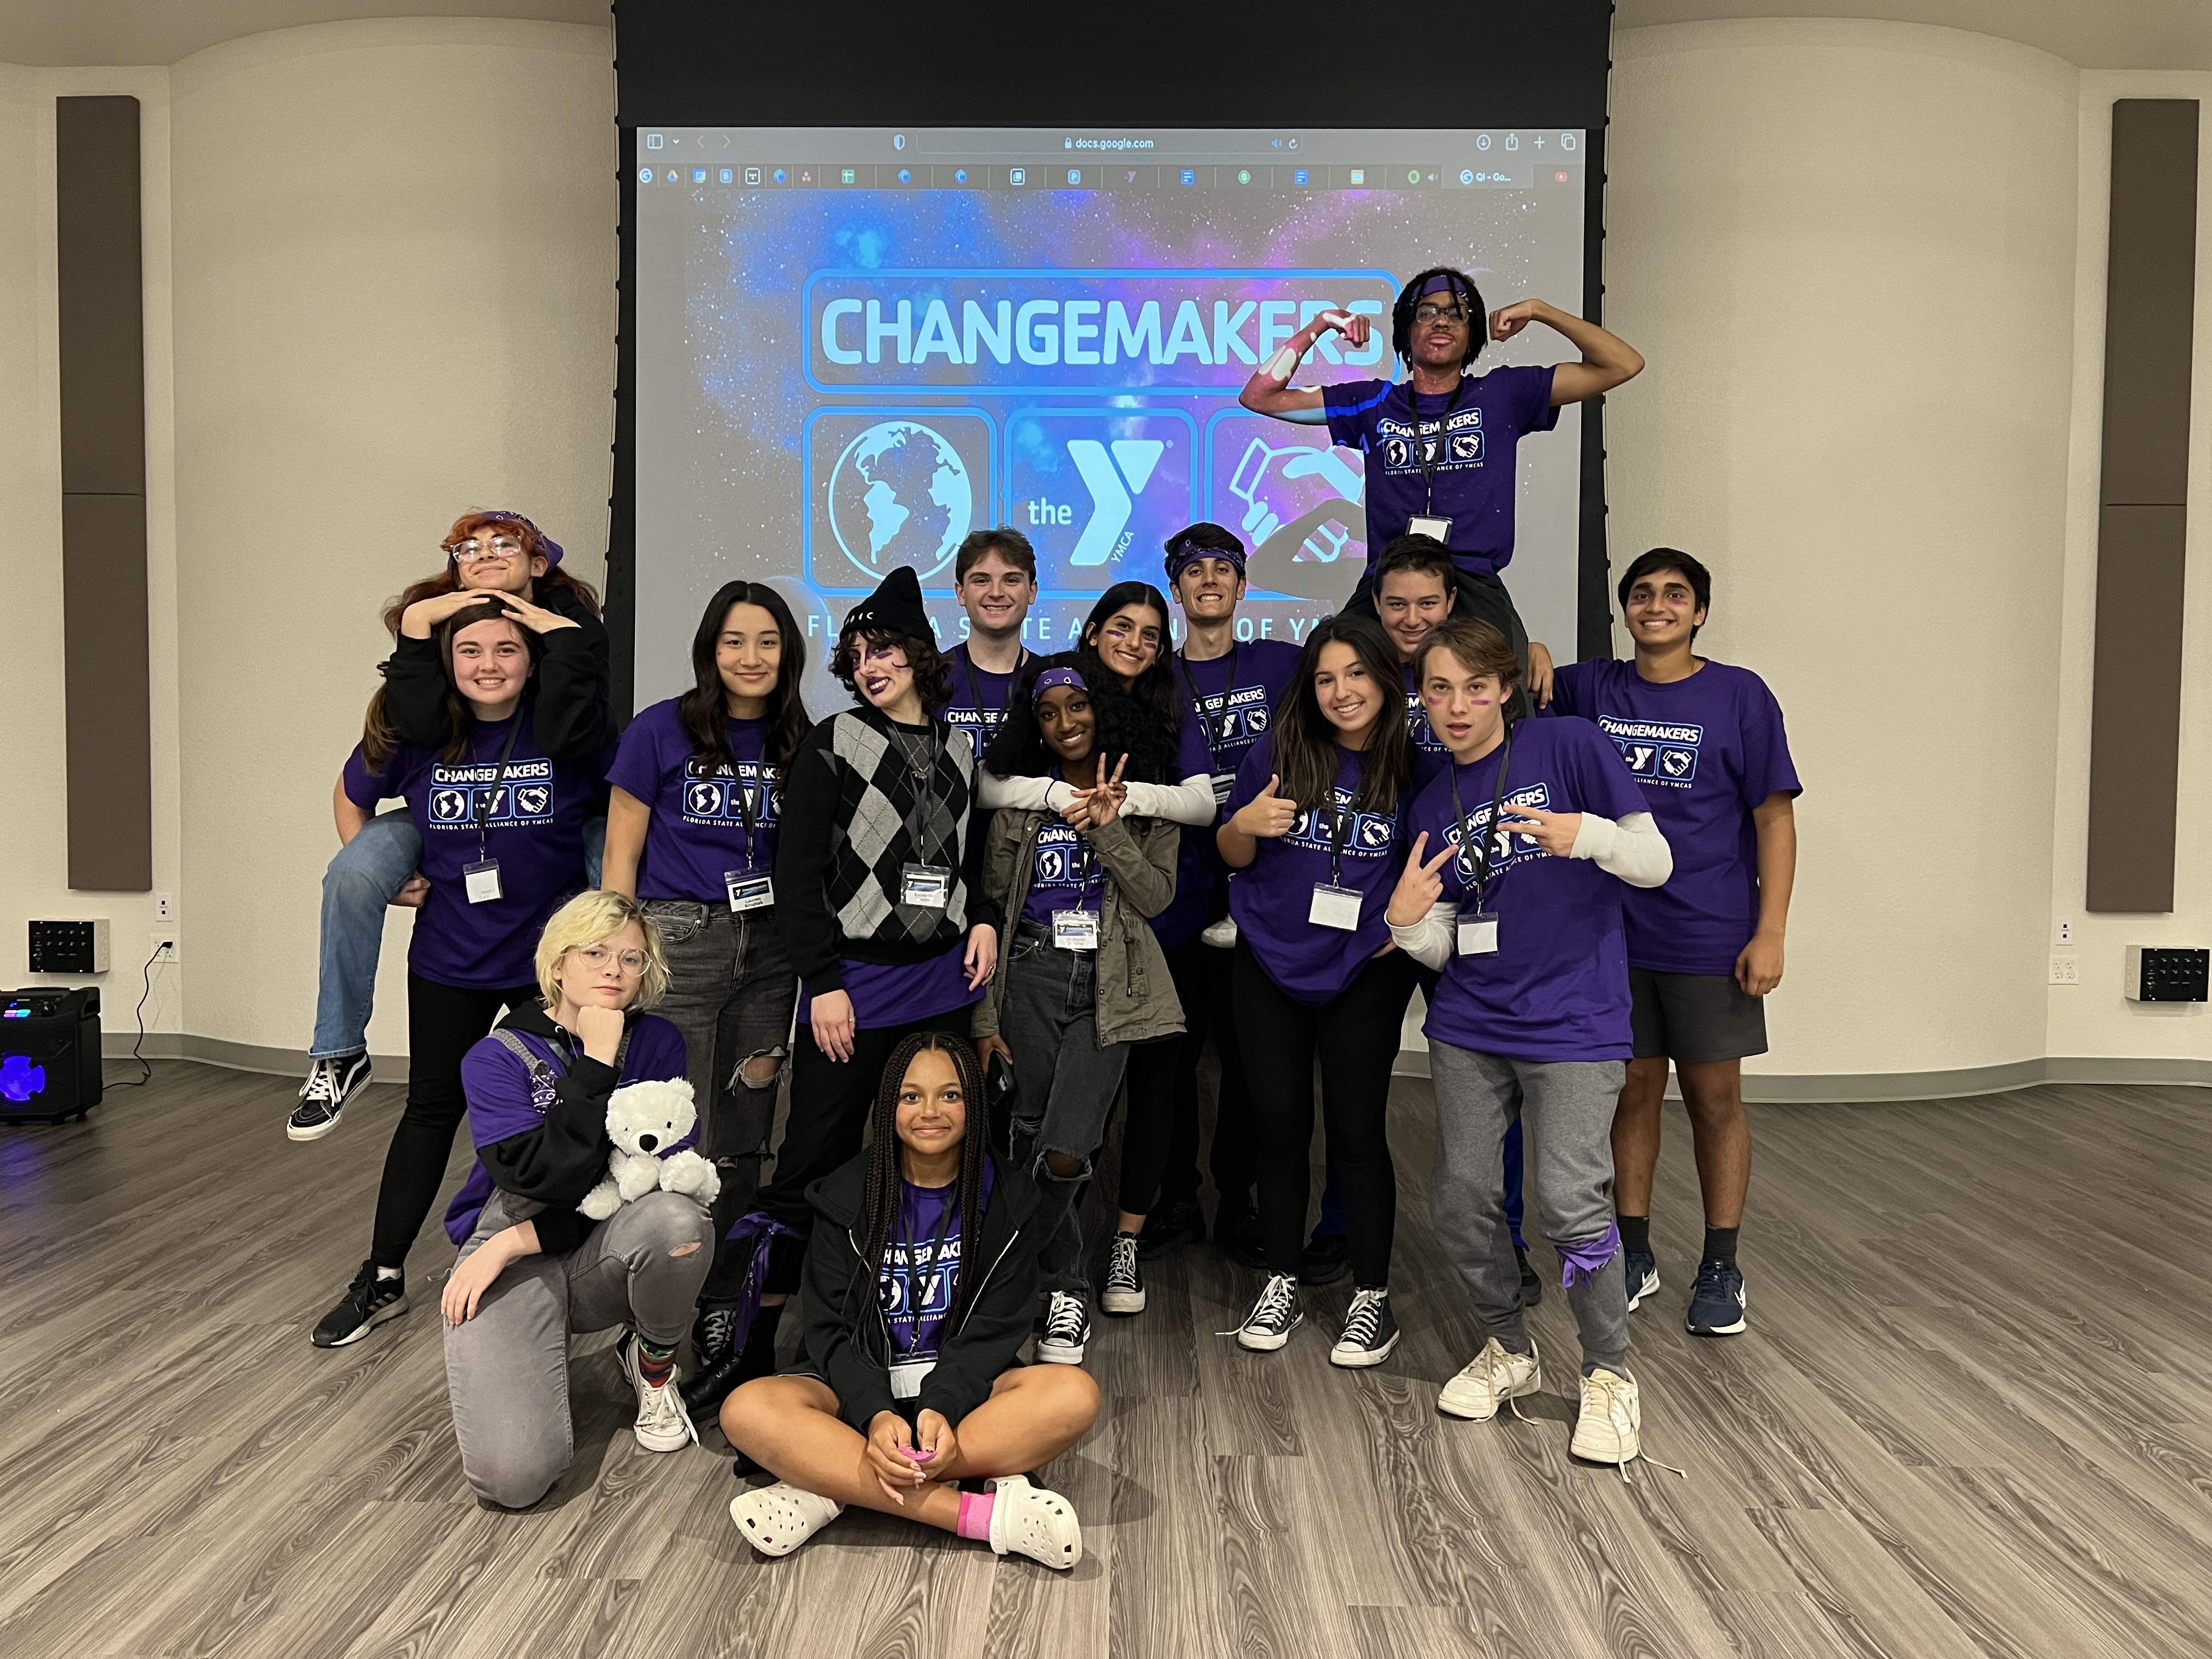
v
Changemakers Summit
As part of the YMCA State Alliance, teen changemakers summit offers Gen-Z leaders from all YMCA programs to attend workshops on leadership development, character development and civic engagement.

Slide 4
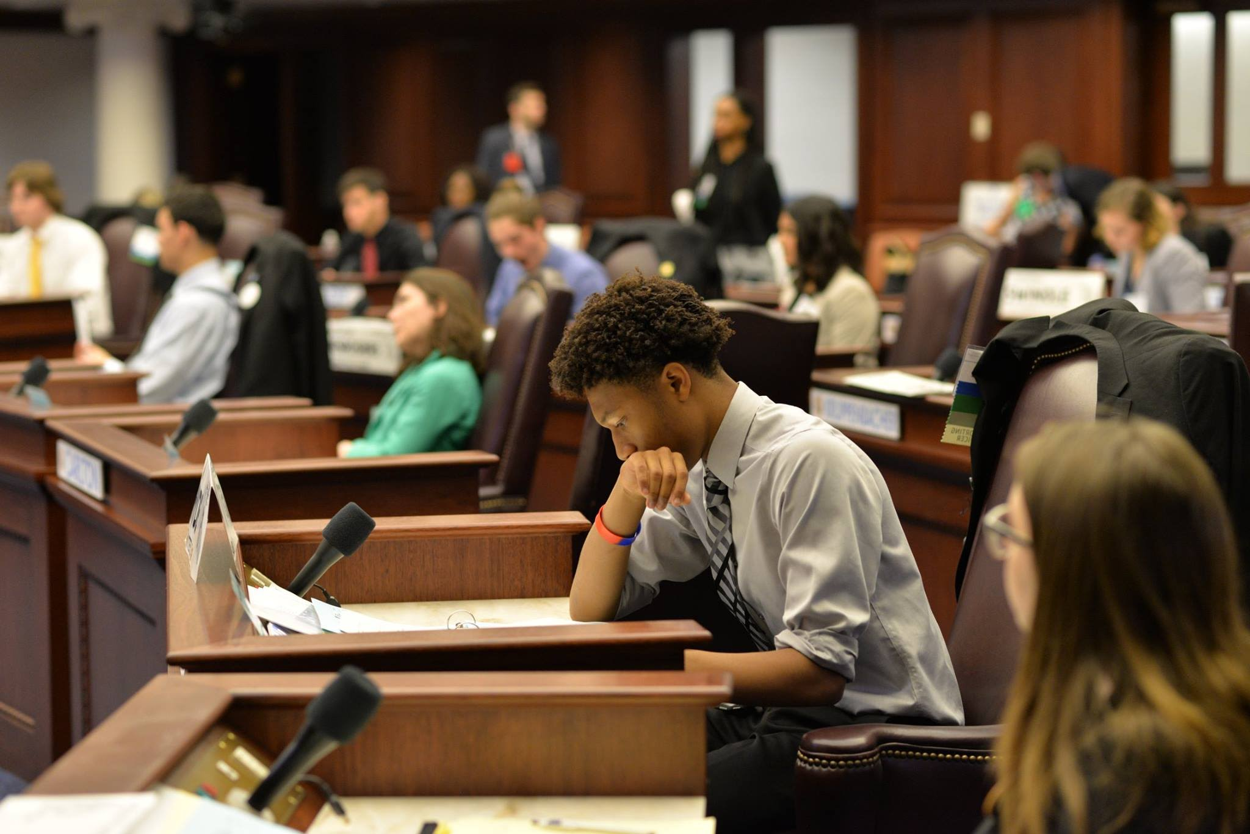
v
State Assembly Conference
Simulations are proven to be one of the best ways to learn, especially for civics. Each year, Youth In Government’s high school students participate in an immersive state government simulation hosted in the Florida Capital.
186 High School students from across Florida February2023.
38 Middle School students in attendance.

Slide 5
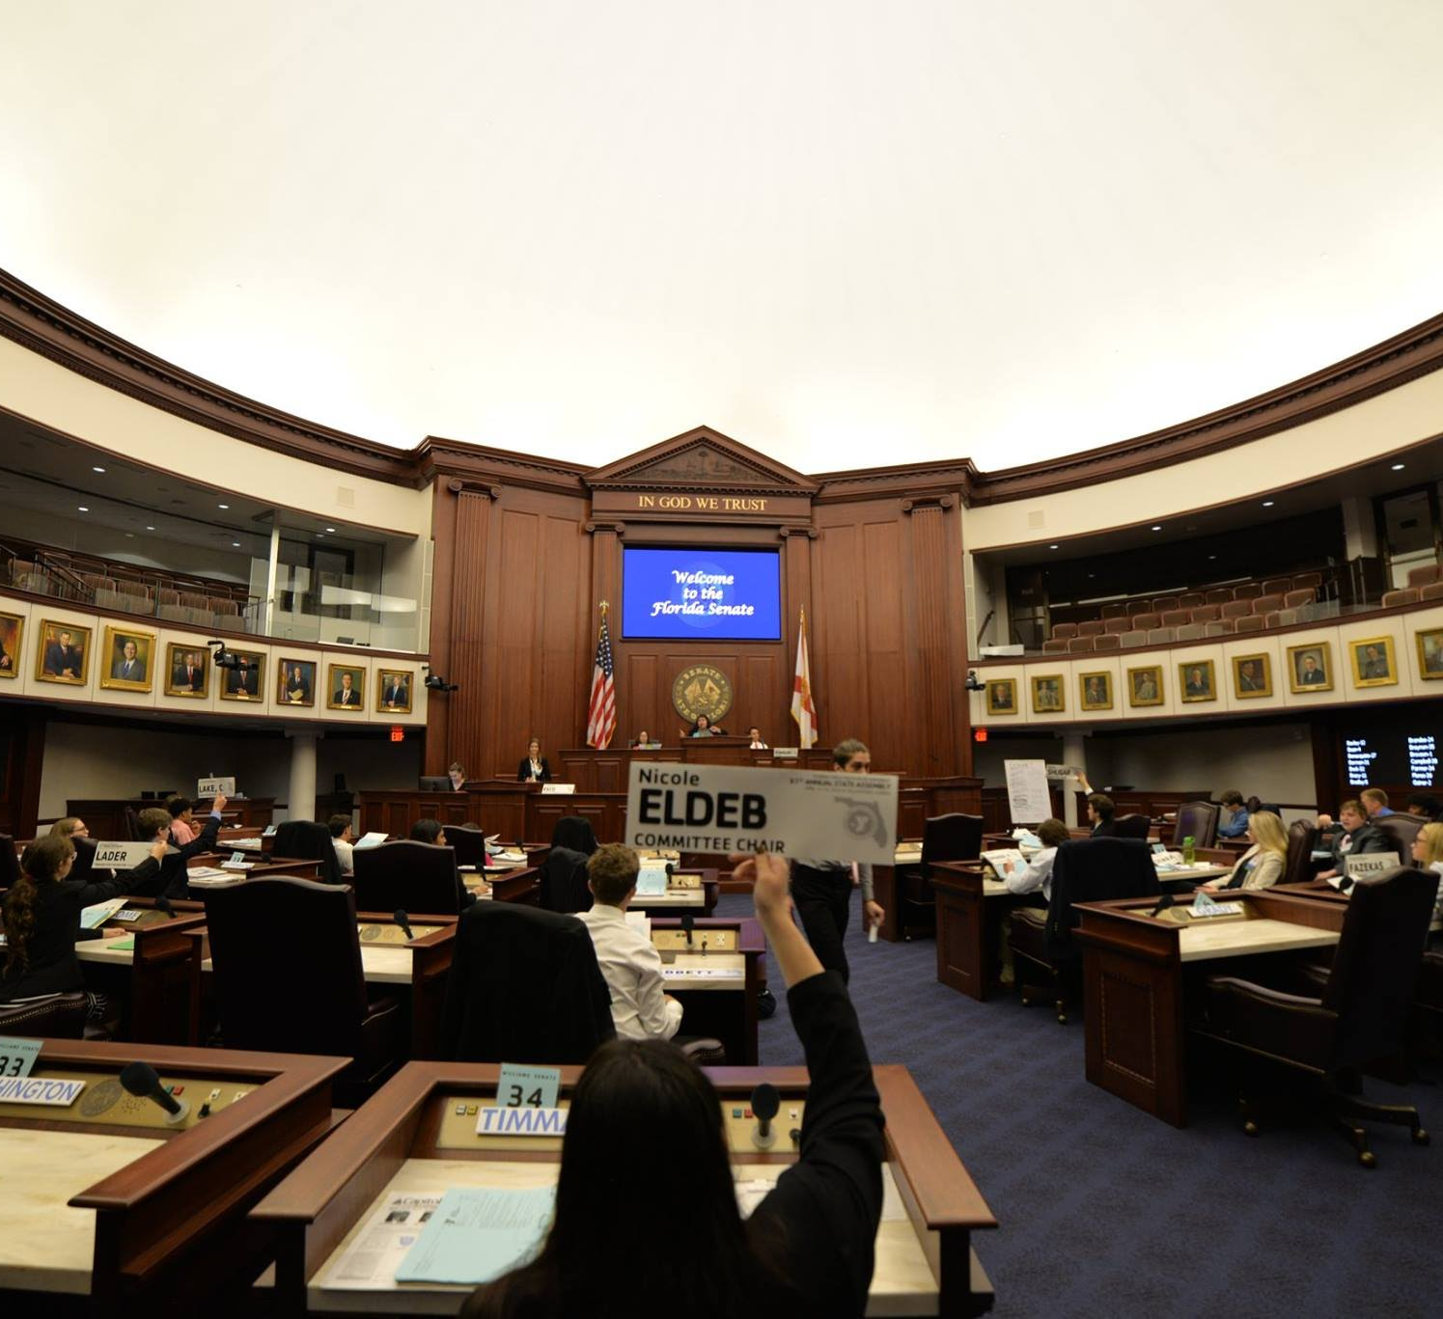
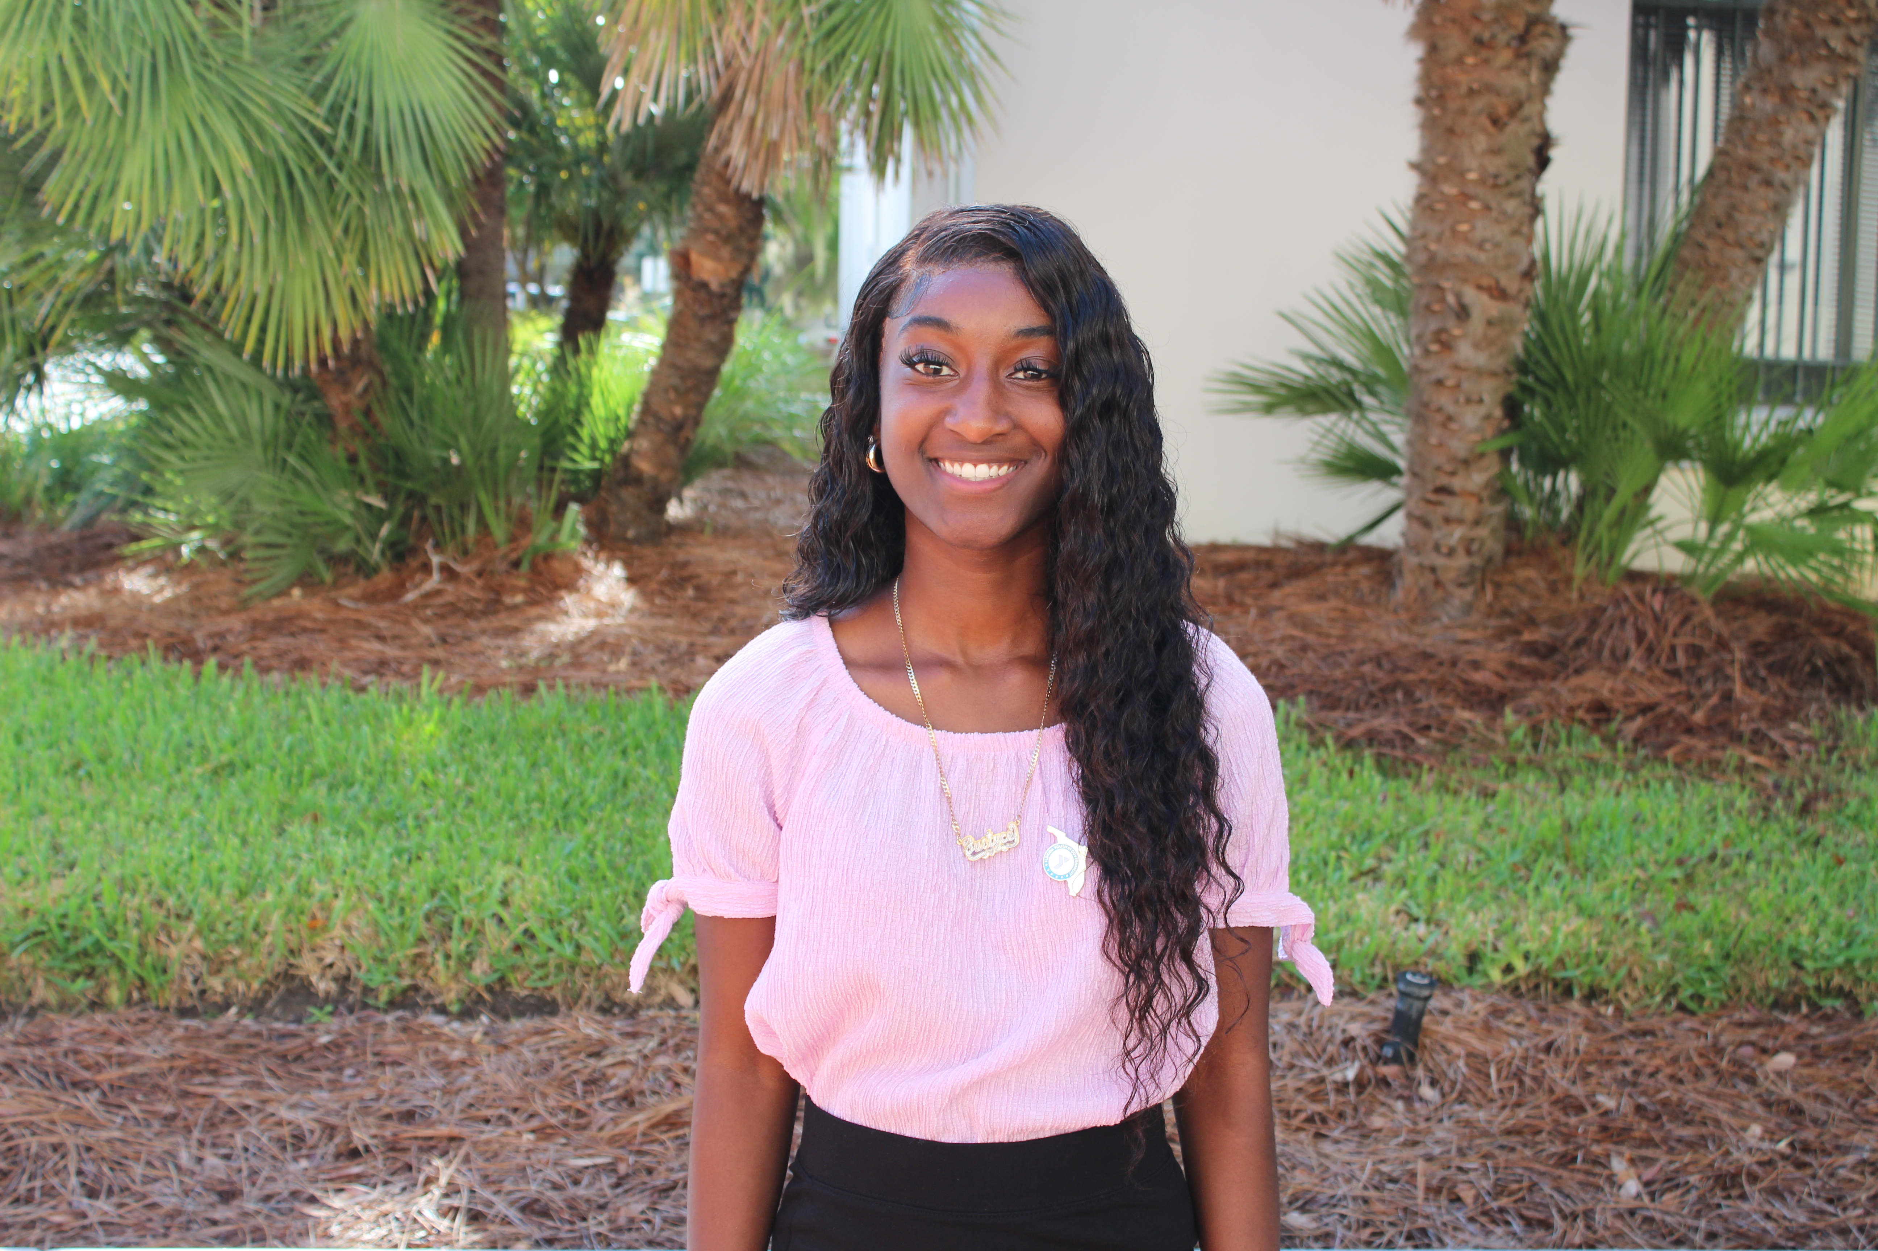
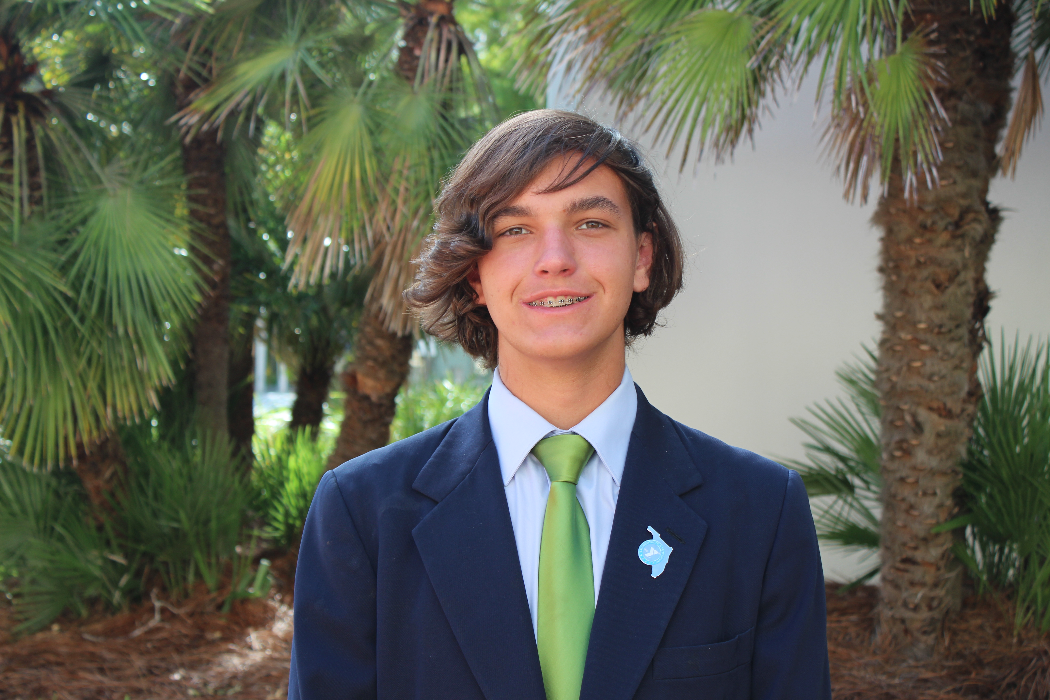
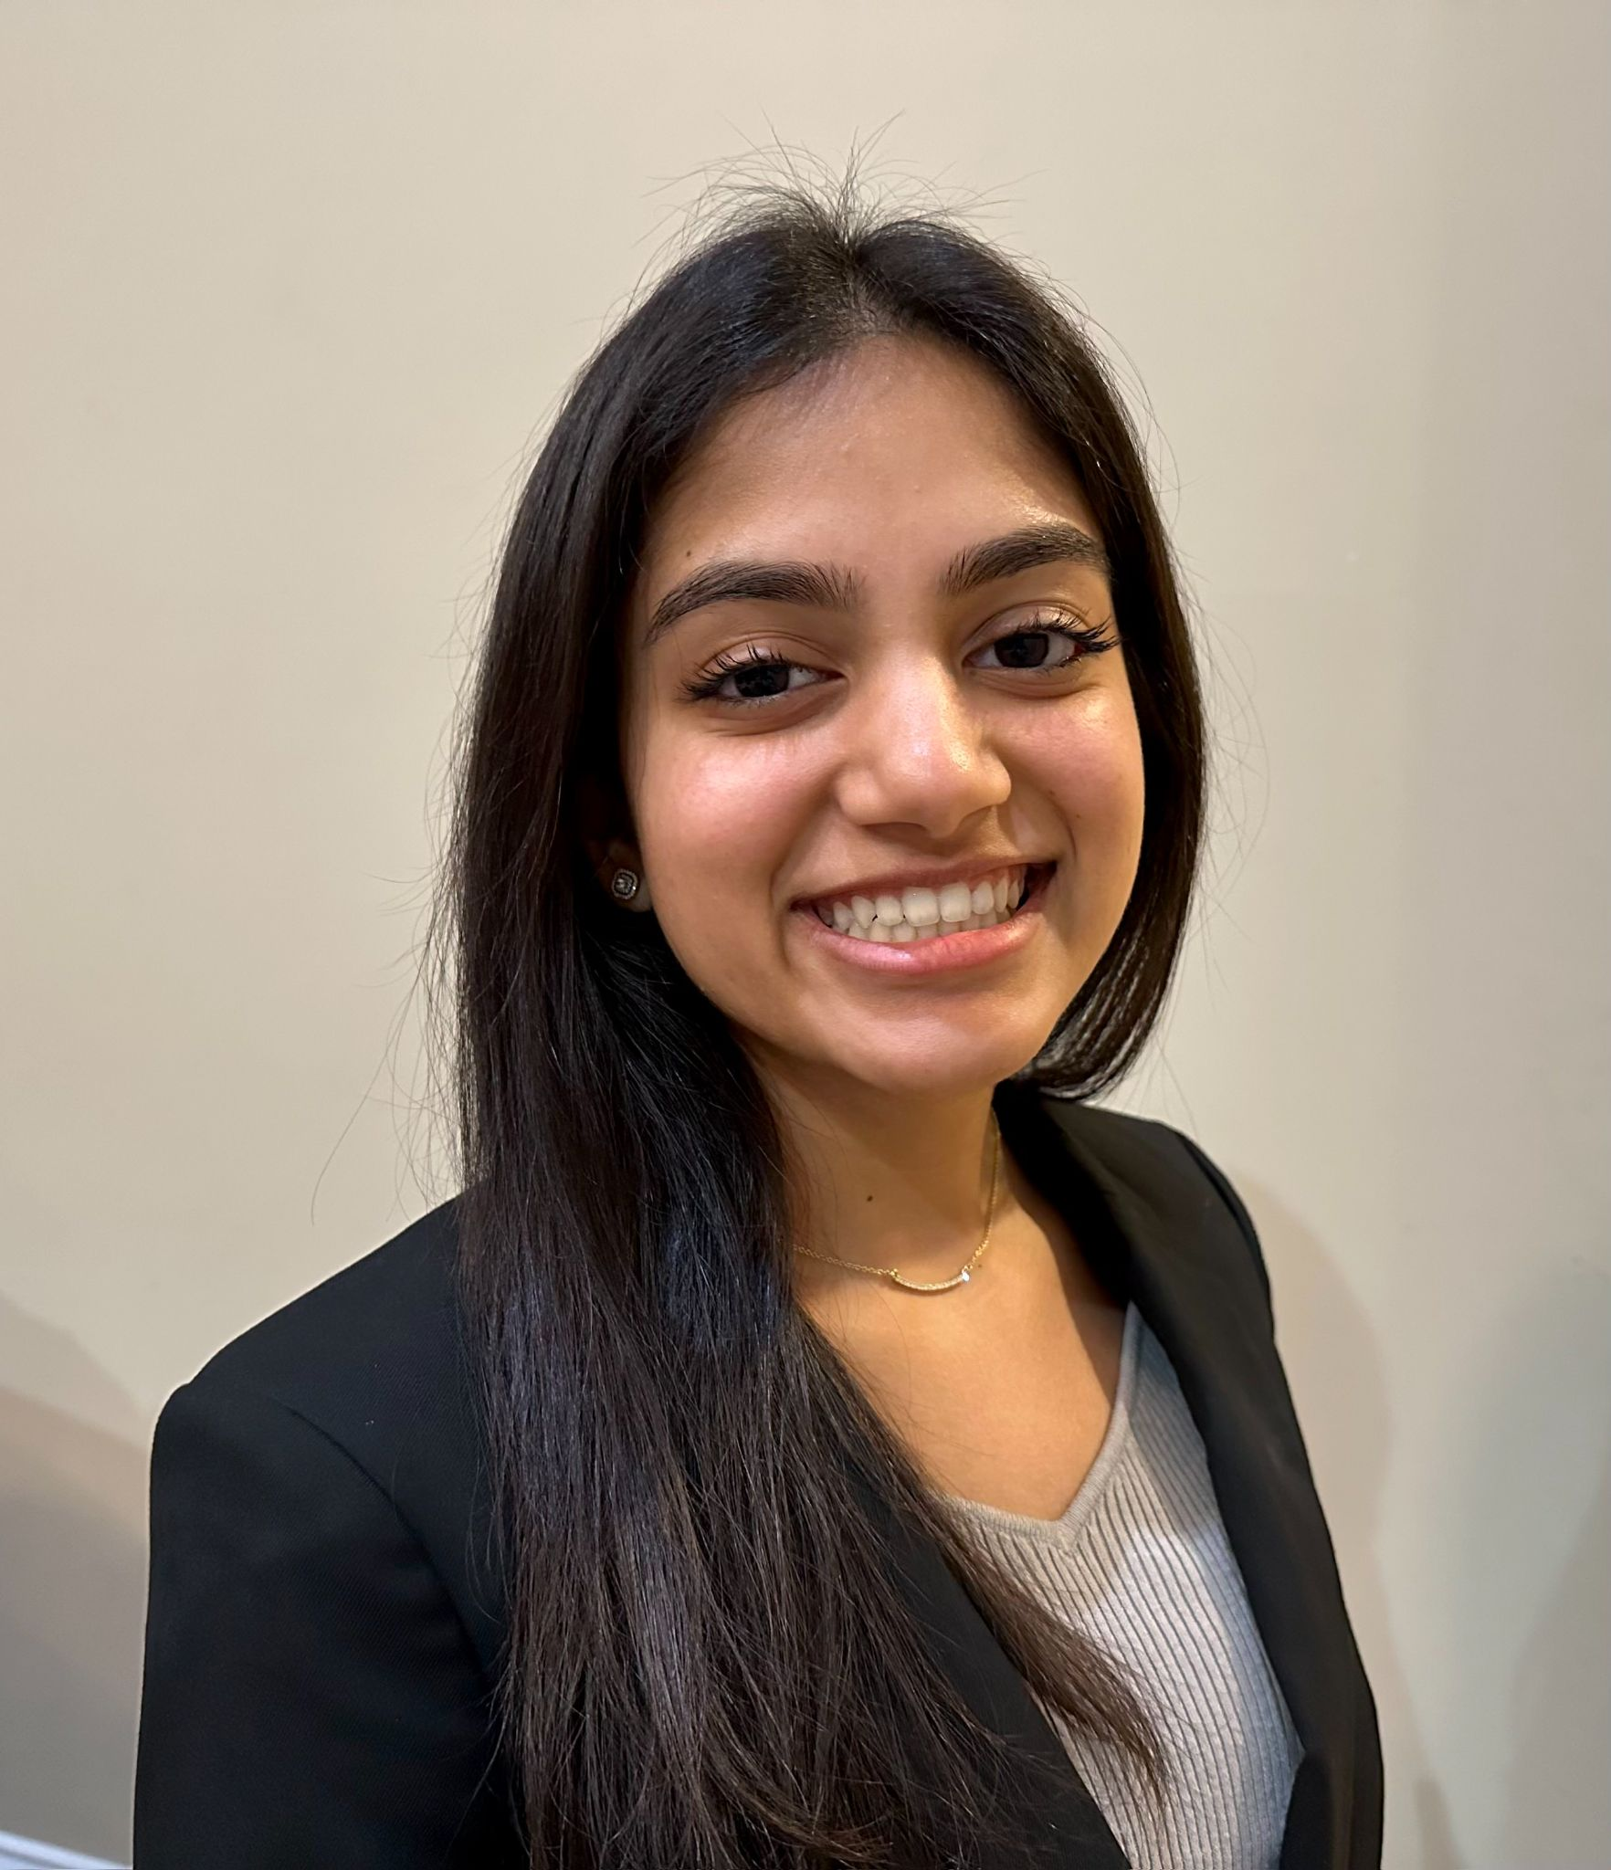
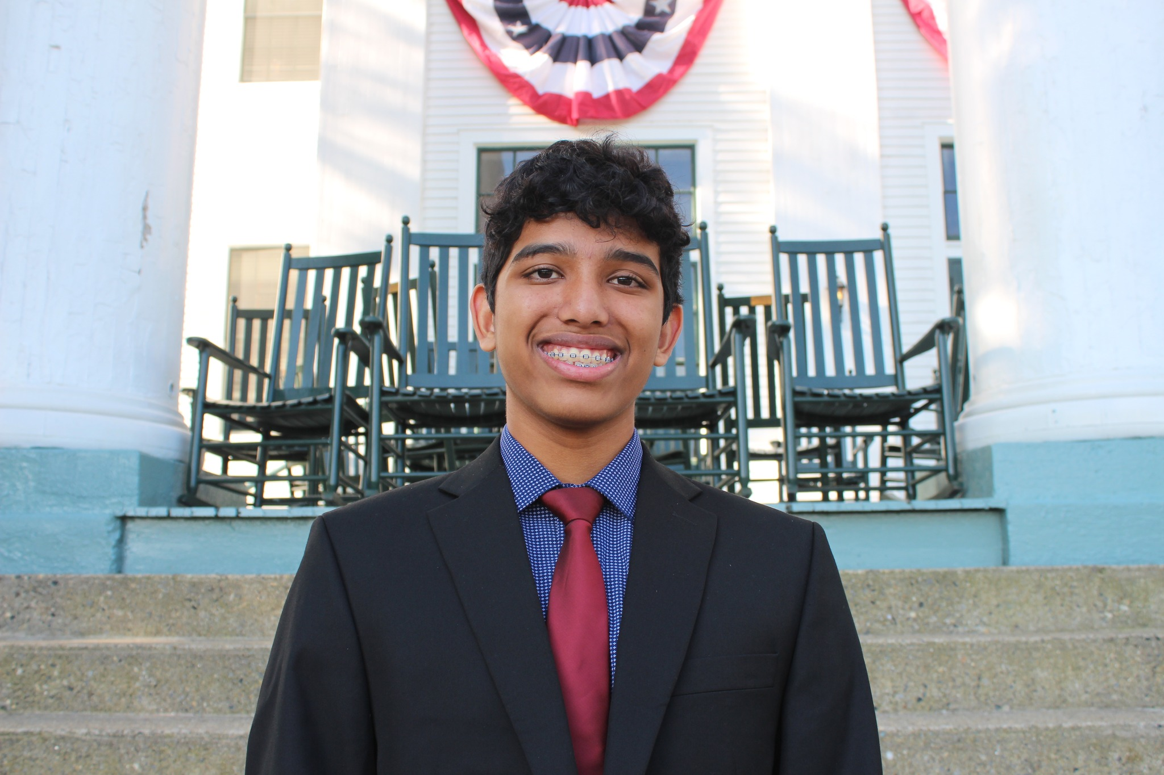
Model Legislator
Williams Senate President
Williams House
Speaker
Students in the legislative program arrive at State Assembly with a written and researched bill
Sullivan House
Speaker
Sullivan Senate
President

Slide 6
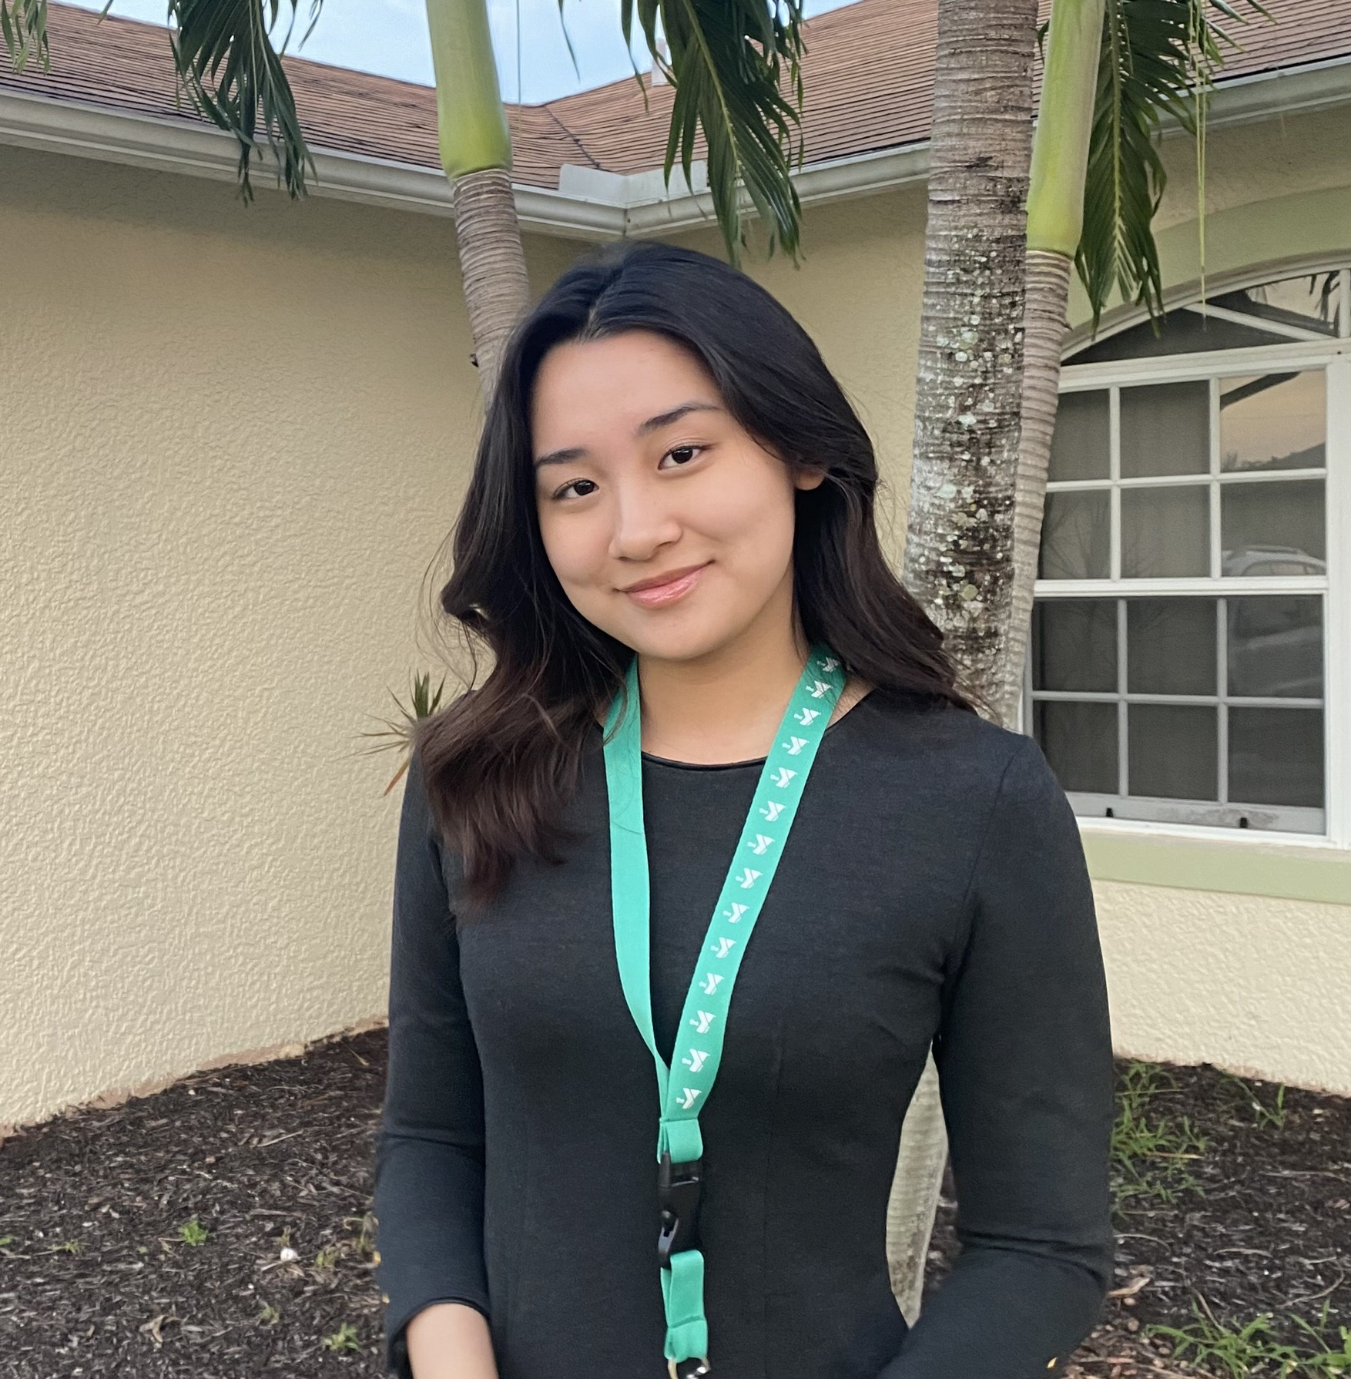
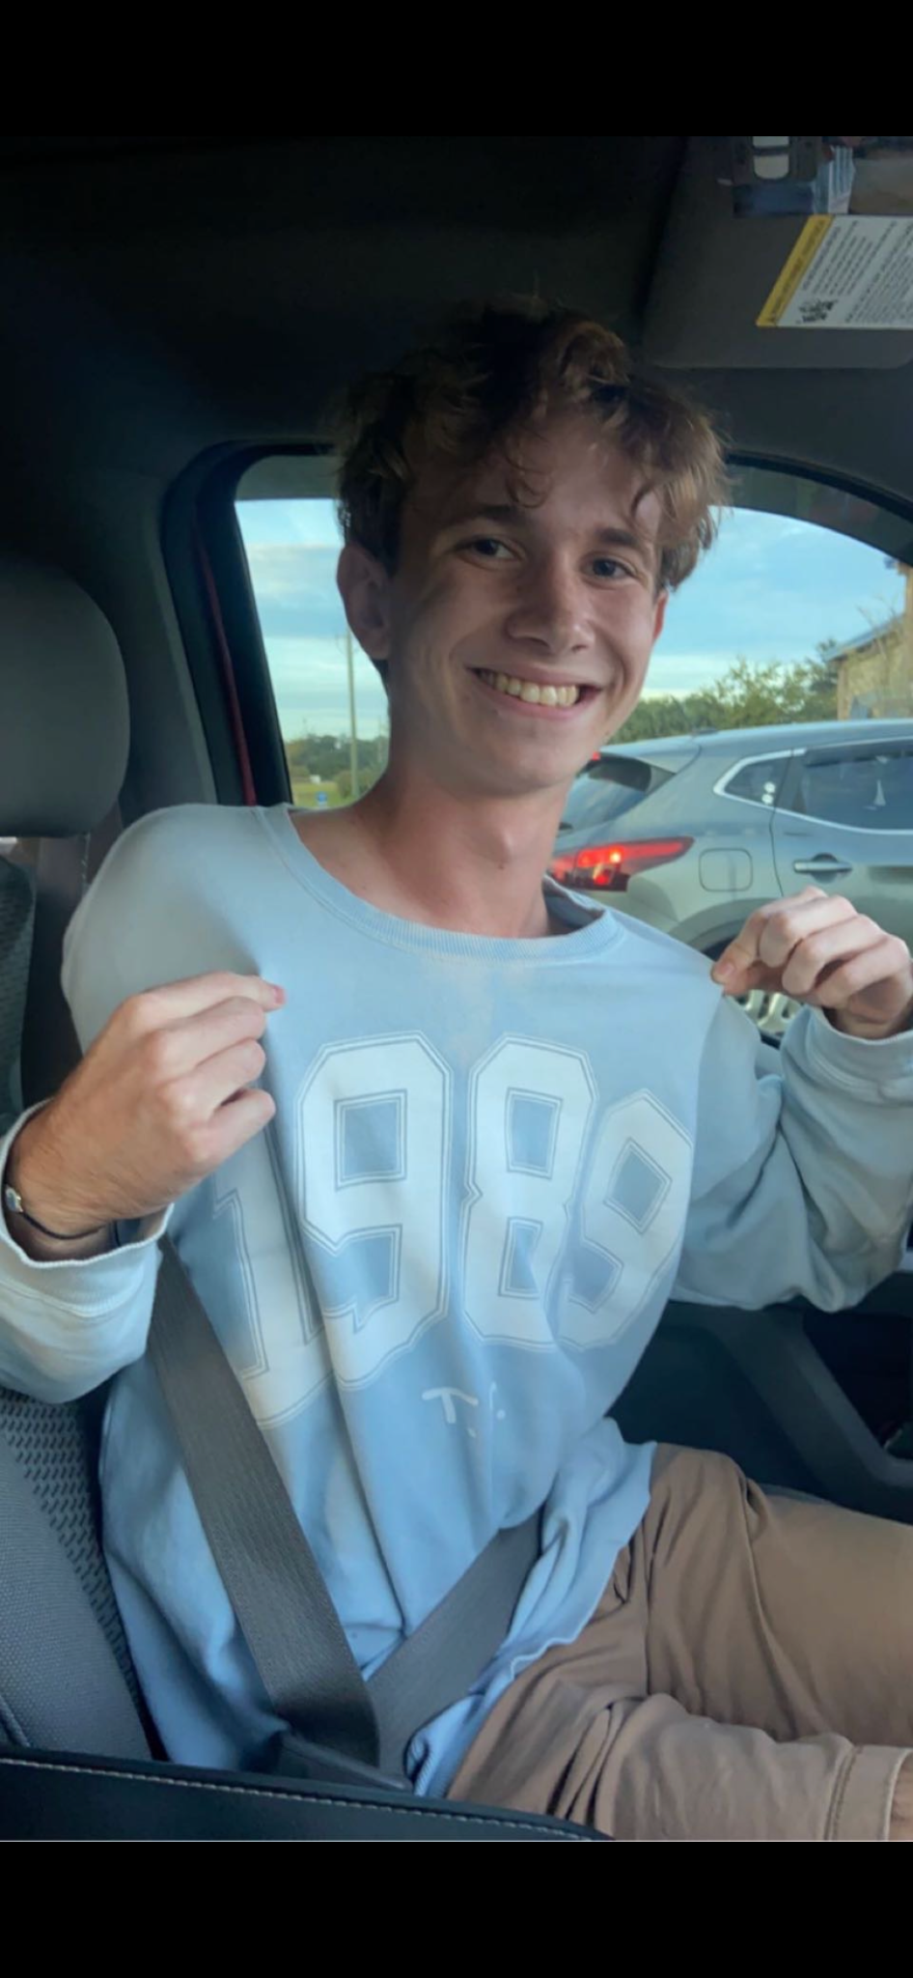
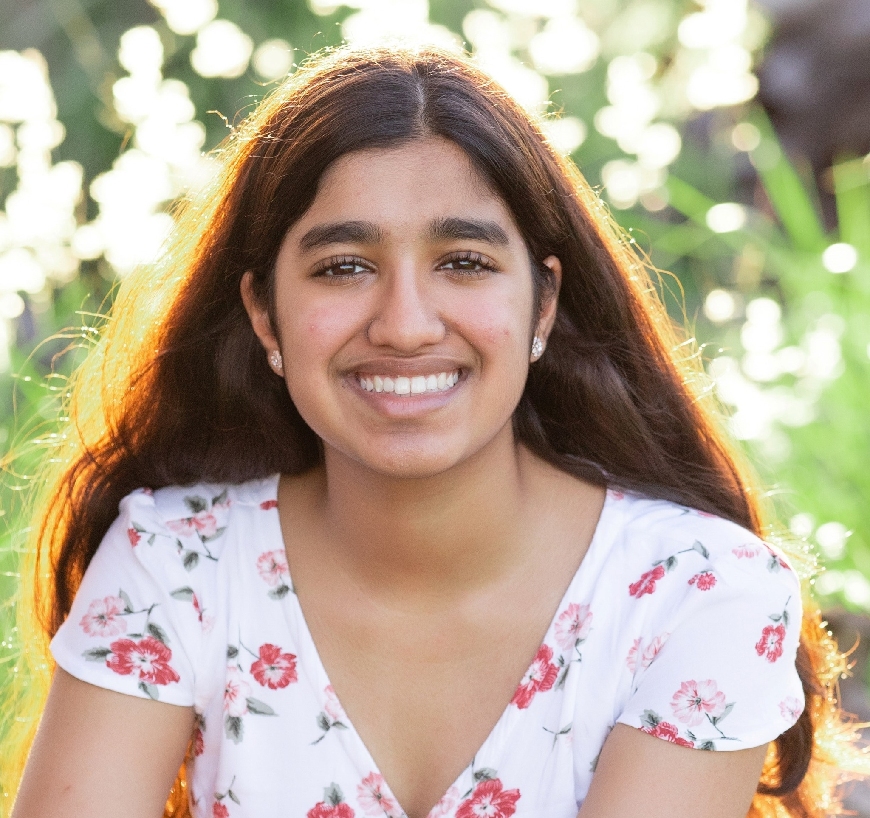
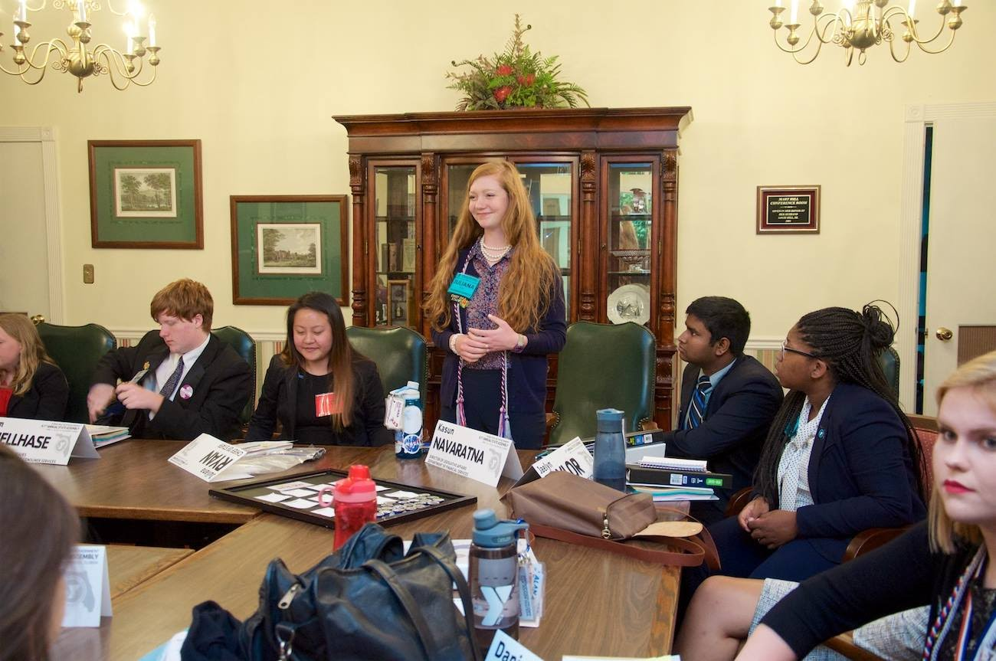
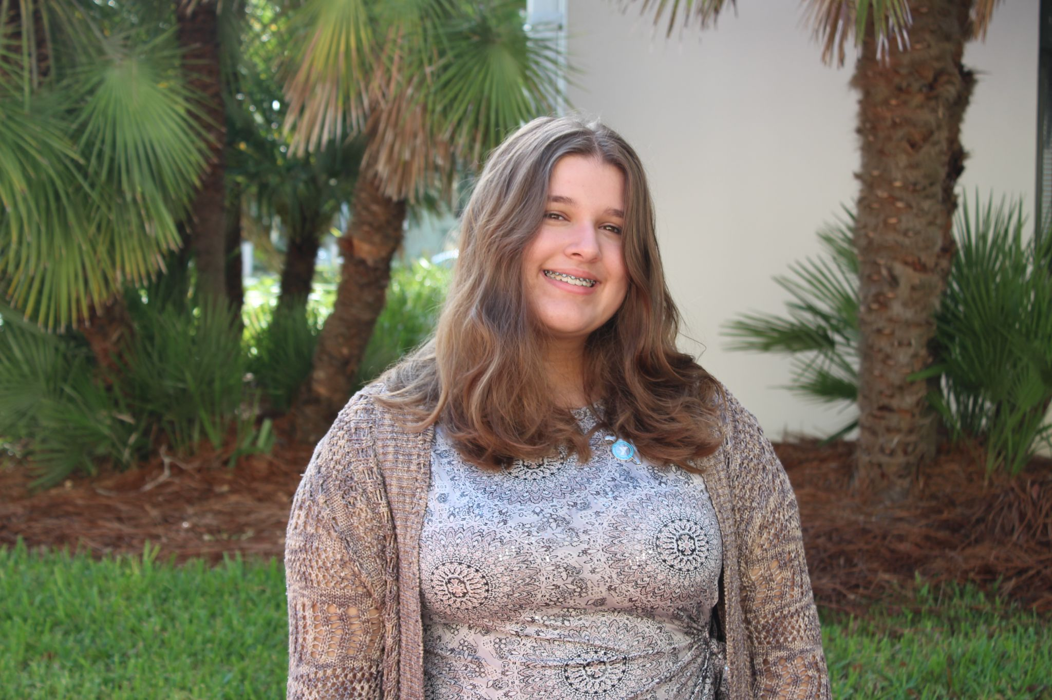
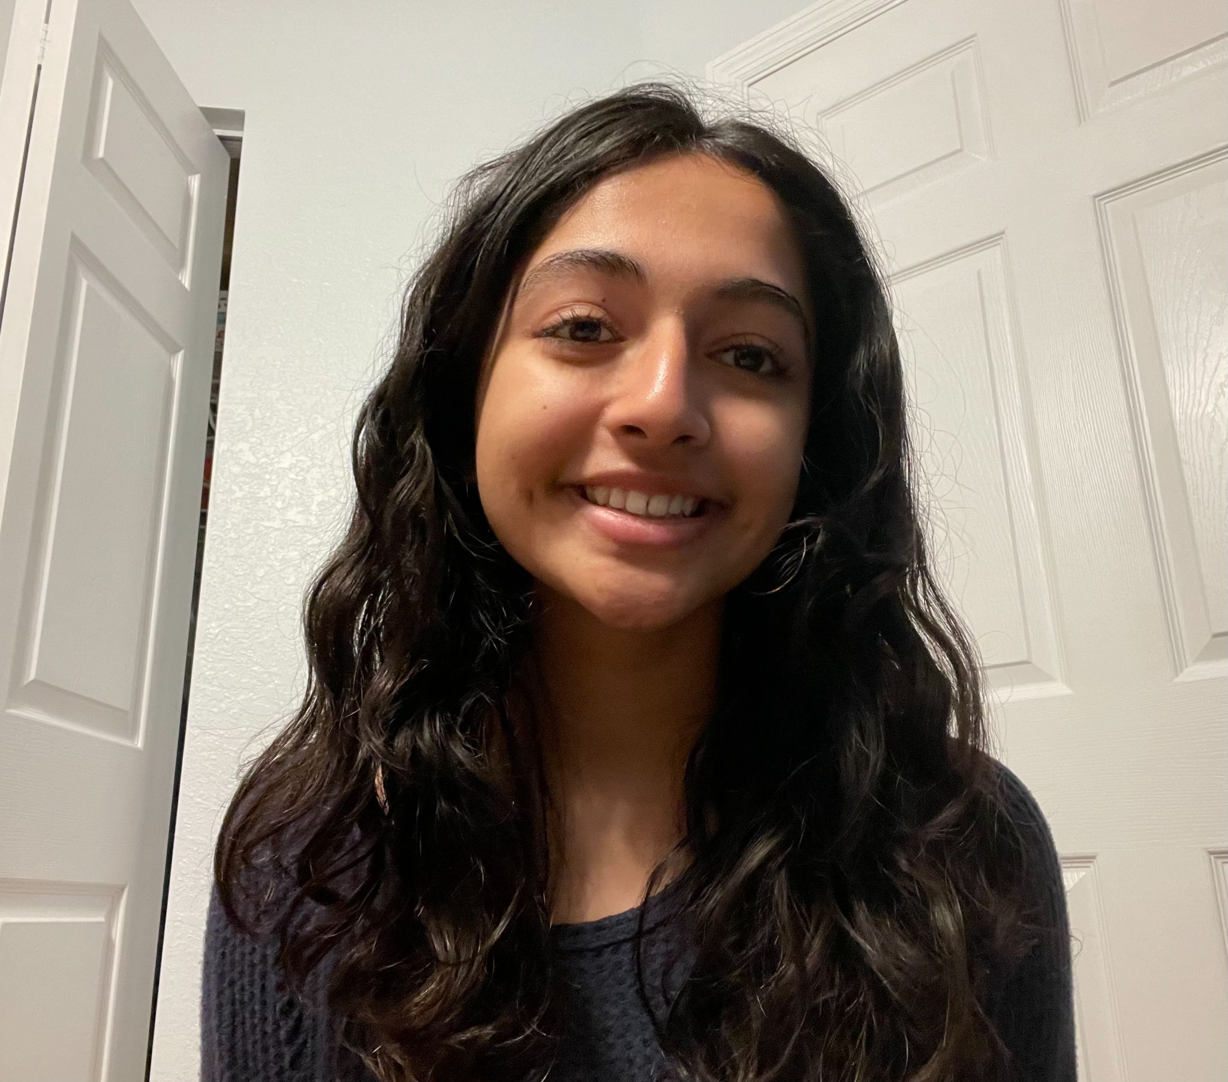
Executive Officers
Youth Governor
Lt. Governor
Chief of Staff
Students are part of the elected cabinet members, who hear top bills from the legislative branch and work with their department heads to research policy.
Chief Financial Officer
Commissioner
of Agriculture

Slide 7
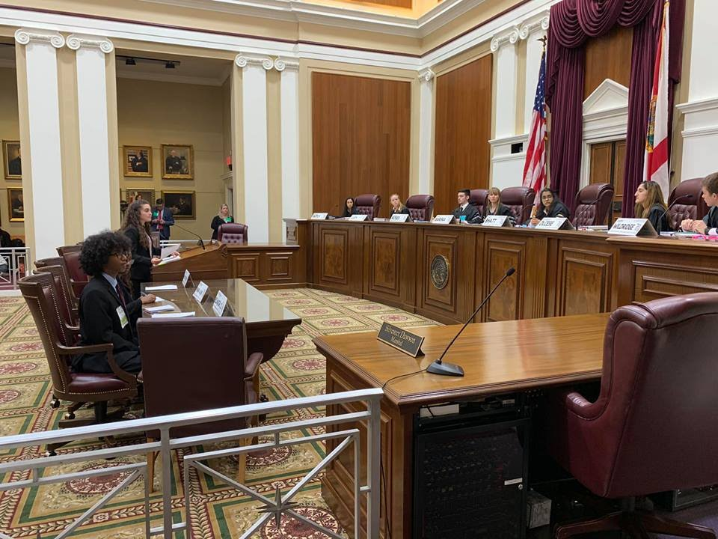
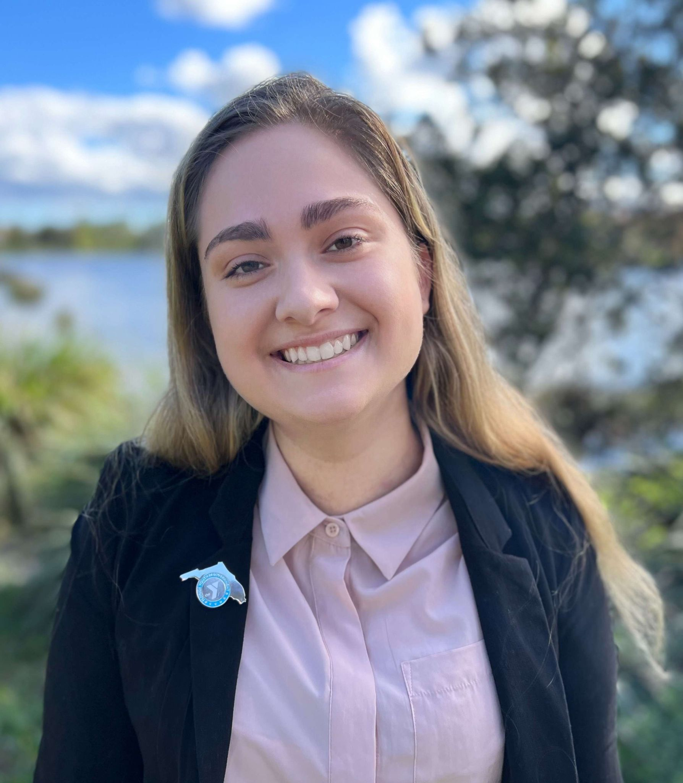
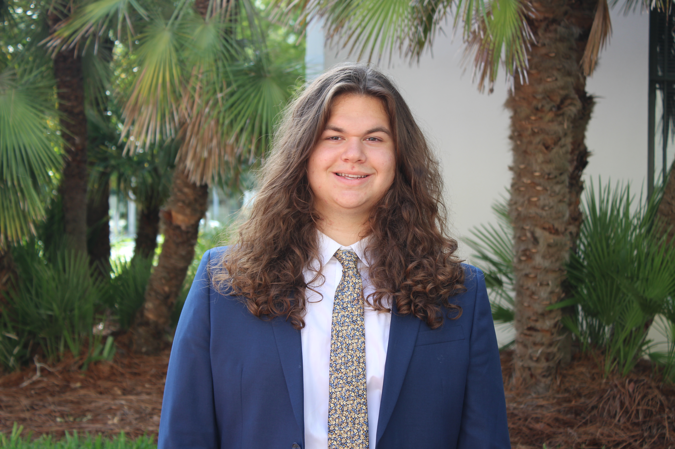
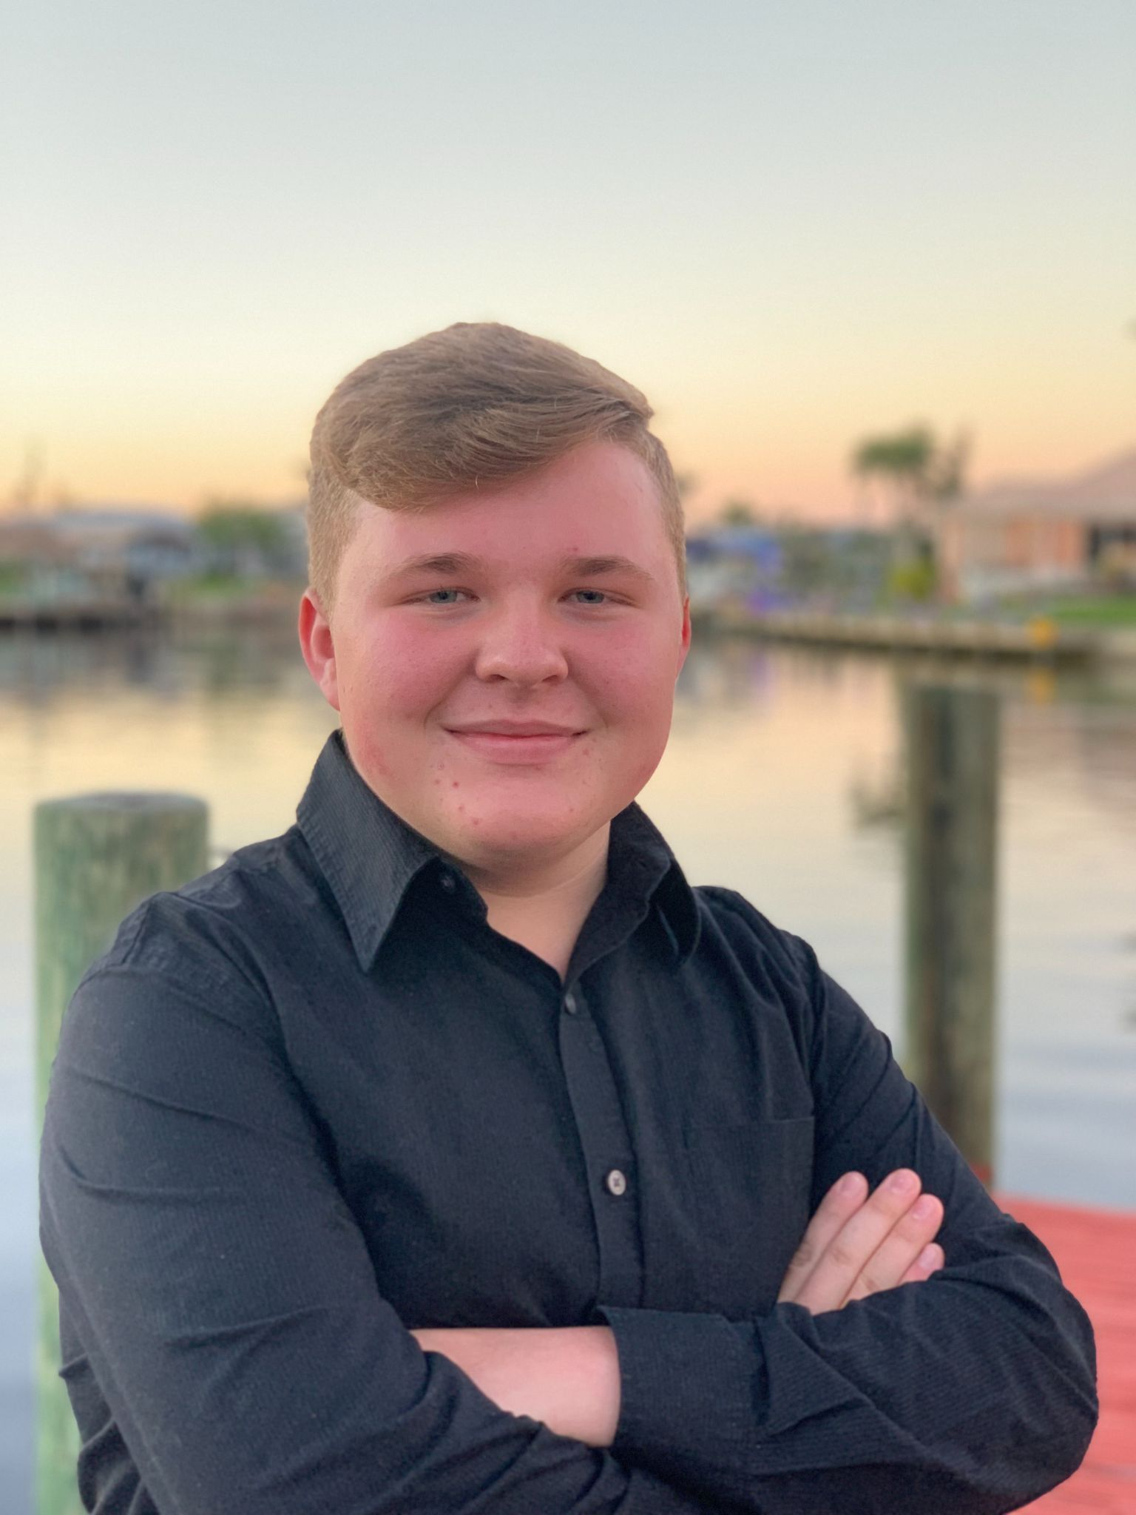
Judicial Program
Chief Justice
Senior Justice 2022
Attorney General
Students act as Attorneys and Delegate Justices. They will learn to argue for both sides of the case and apply applicable legal precedents and principles. They will find issues within the cases and argue for petitioner and/or respondent.

Slide 8
Improving Civic Education in Florida
Sandra Day O’Connor Civics Education Act in 2010, the Legislature mandated civic education in K-12, including a mandatory civics course for 7th graders that includes an end-of-course assessment.
In 2017, Florida statute (1007.25), the legislature extended the civic literacy requirement to Florida Colleges and Universities, mandating that entering students (beginning 2018-2019) must demonstrate competency in civic literacy; in 2021 the statute was amended requiring students in 2021-22 or to complete a U.S. Government course and an assessment to demonstrate competency in civic literacy.
In 2019 student hours in YMCA YIG (along with other civics education programming) became Bright Futures eligible.
In 2018, the legislature invested in a new partnership between USFSP and the YMCA to develop the USFSP YMCA Civic Fellows Program.

Slide 9
USFSP YMCA Civic Fellows Program
Funded by a legislative appropriation, this is an academic year-long program, for which selected YMCA Youth In Government students earn six (6) credits at USFSP for participation in the program.
POS 3182 Florida Politics and Government
LDR 3263 Community Leadership Practicum: Civic Fellows Program
Students participate in the Weekly Chapter Meetings at their local YMCA, the Youth Changemakers Summit in November, the State Assembly in Tallahassee in February/April, and the USFSP YMCA Civics Institute at the University of South Florida in St. Petersburg in June.
The overall goals of the Civics Fellows Program include the following:
Deepening understanding of government and its impact
Improving civic engagement by the next generation of leaders
Increasing rates of youth participation in important societal institutions including volunteering, voting, and school events
Providing hands-on experiences in government and public service
Introducing college life to high school students through a summer institute program

Slide 10
Curriculum Development for Civic Fellows Program
At the Civics Institute the YMCA students learn about Florida Politics and Government and participate in leadership development workshops while experiencing life on a college campus.
Two 3-credit courses:
POS 3182 Florida Politics and Government
LDR 3263 Community Leadership Practicum: Civic Fellows Program

Slide 11
Summer Civics Institute at USF St. Pete
Seminars and Lectures
Workshops
Field trips (e.g. Pinellas County Supervisor of Elections, Criminal Justice Center, city halls, County Commission, School Board)
guest speakers (e.g., the Governor, Lt. Governor, Speaker of the Florida House and other State Representatives, State Senators, County Commissioners, Mayors, City Council Members, judges, attorneys, lobbyists, journalists)
service-learning opportunities (beach clean-ups, food pantry, literacy programs)
cultural activities in Tampa Bay (Dali Museum, James Museum, Tampa Bay Rays MLB, Museum of Fine Arts, Florida Holocaust Museum, Clearwater Marine Aquarium, Pinellas County Parks)

Slide 12
LDR 3263 Community Leadership Practicum Student Learning Outcomes
Explore their personal leadership characteristics and be able to use this self-knowledge to enhance their leadership
Apply and test leadership knowledge, skills, and abilities and be able to modify practices to increase leadership effectiveness
Recognize that community development depends on countless acts of altruistic leadership, large and small, and be able to formulate a plan for personal contributions to community building and social action.
Research community needs and draft legislation in response to those need
Develop oral and written communication skills while preparing for the simulation
Become fluent in legal, legislative, and statutory terminology from Florida’s governmental process in written and in oral communication

Slide 13
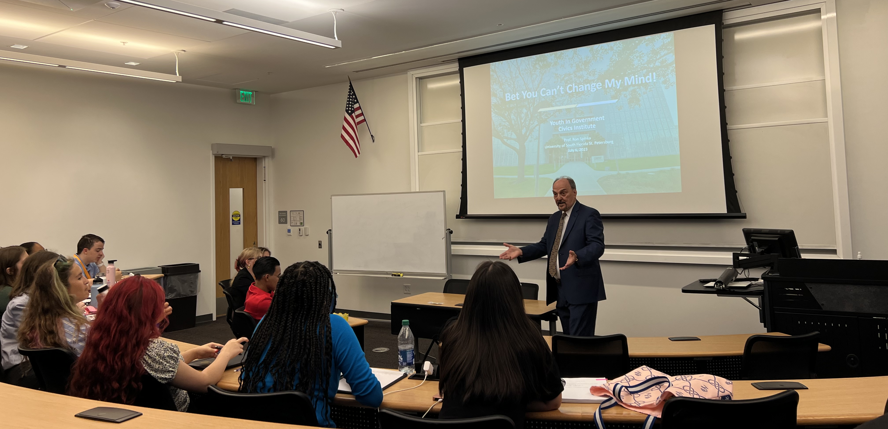
LDR 3263 Community Leadership Practicum: Civic Fellows Program
Leadership Assessments
Workshops, such as
What it means to be a T.E.A.M. - Together Everyone Achieves More
Leadership and Ethics: An Introduction
Communication
Conflict and Communication

Slide 14
POS 3182: Florida Politics and Government: Student Learning Outcomes:
Demonstrate working knowledge of the Florida Constitution
Discuss Florida’s political culture
Describe the organization of Florida state government
Describe the functions and processes of the three branches of the Florida government
Explain key features of campaigns and elections in Florida
Describe the development of public policy in Florida in three key areas (as debated at State Assembly)
Explain the relationship between state and local government
Recognize the relevance of state and local government in their lives

Slide 15
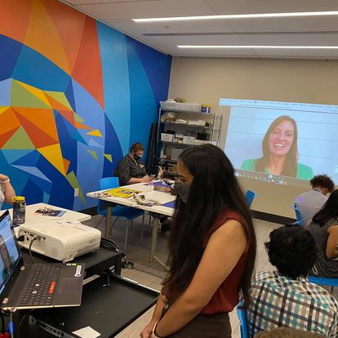
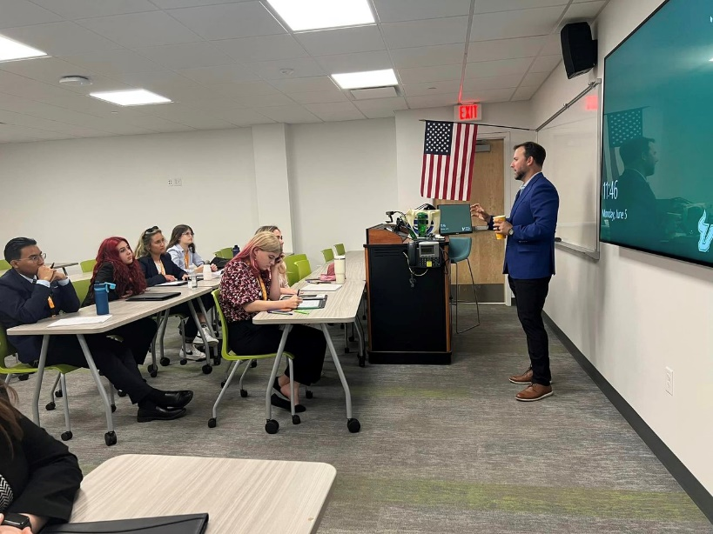
Summer Civics Institute at USF St. Pete
POS 3182 Florida Politics and Government
Lectures delivered by Lead Instructor
Intro to Florida Politics and Government
The Florida Constitution(s)
Florida Political Culture
Florida Judiciary, Crime & Punishment in Florida
Power, Money, and Influence in Florida Politics
Media in Florida Politics
Campaigns & Elections in Florida
Florida’s Role in national politics
As well as Field Trips and Guest Speakers

Slide 16
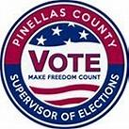
Criminal Justice Center: Judges, public defender, asst. state attorneys
Pinellas County Supervisor of Elections
Pinellas County Commission
Madeira Beach City Hall
Seminole City Hall
St. Petersburg City Hall
State Representatives and State Senators
Legislative Session Wrap-Up
Chief Justice Fred Lewis
Mayor Rick Kriseman, Mayor Leslie Waters, Mayor Ken Welch
Lobbyists Panel: “Power, Money and Influence in Florida Politics”
Reporters

Slide 17
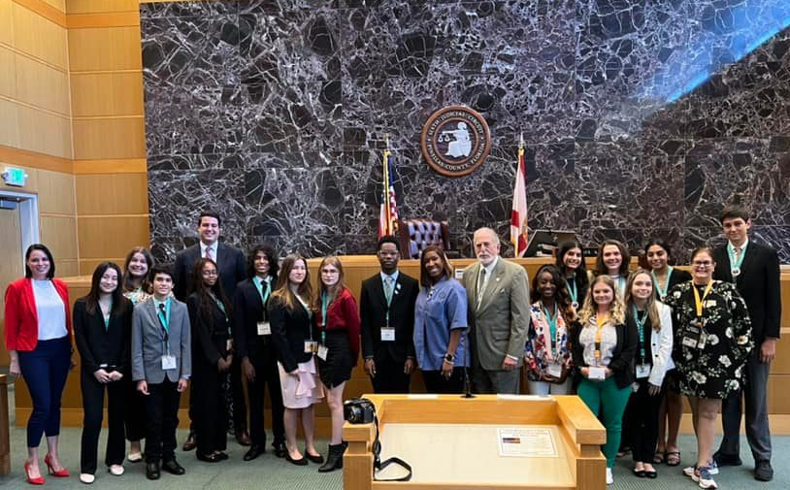
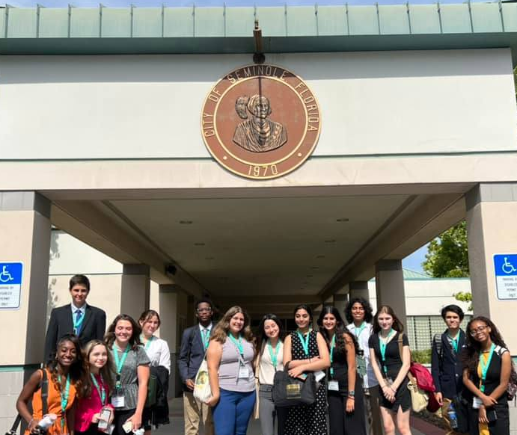
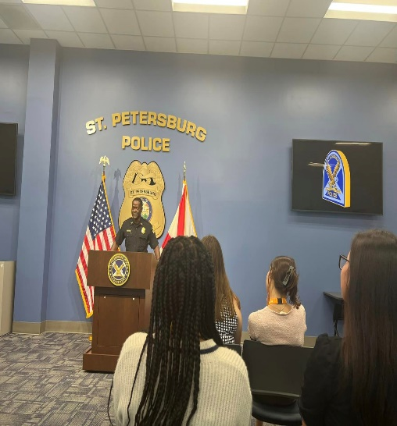
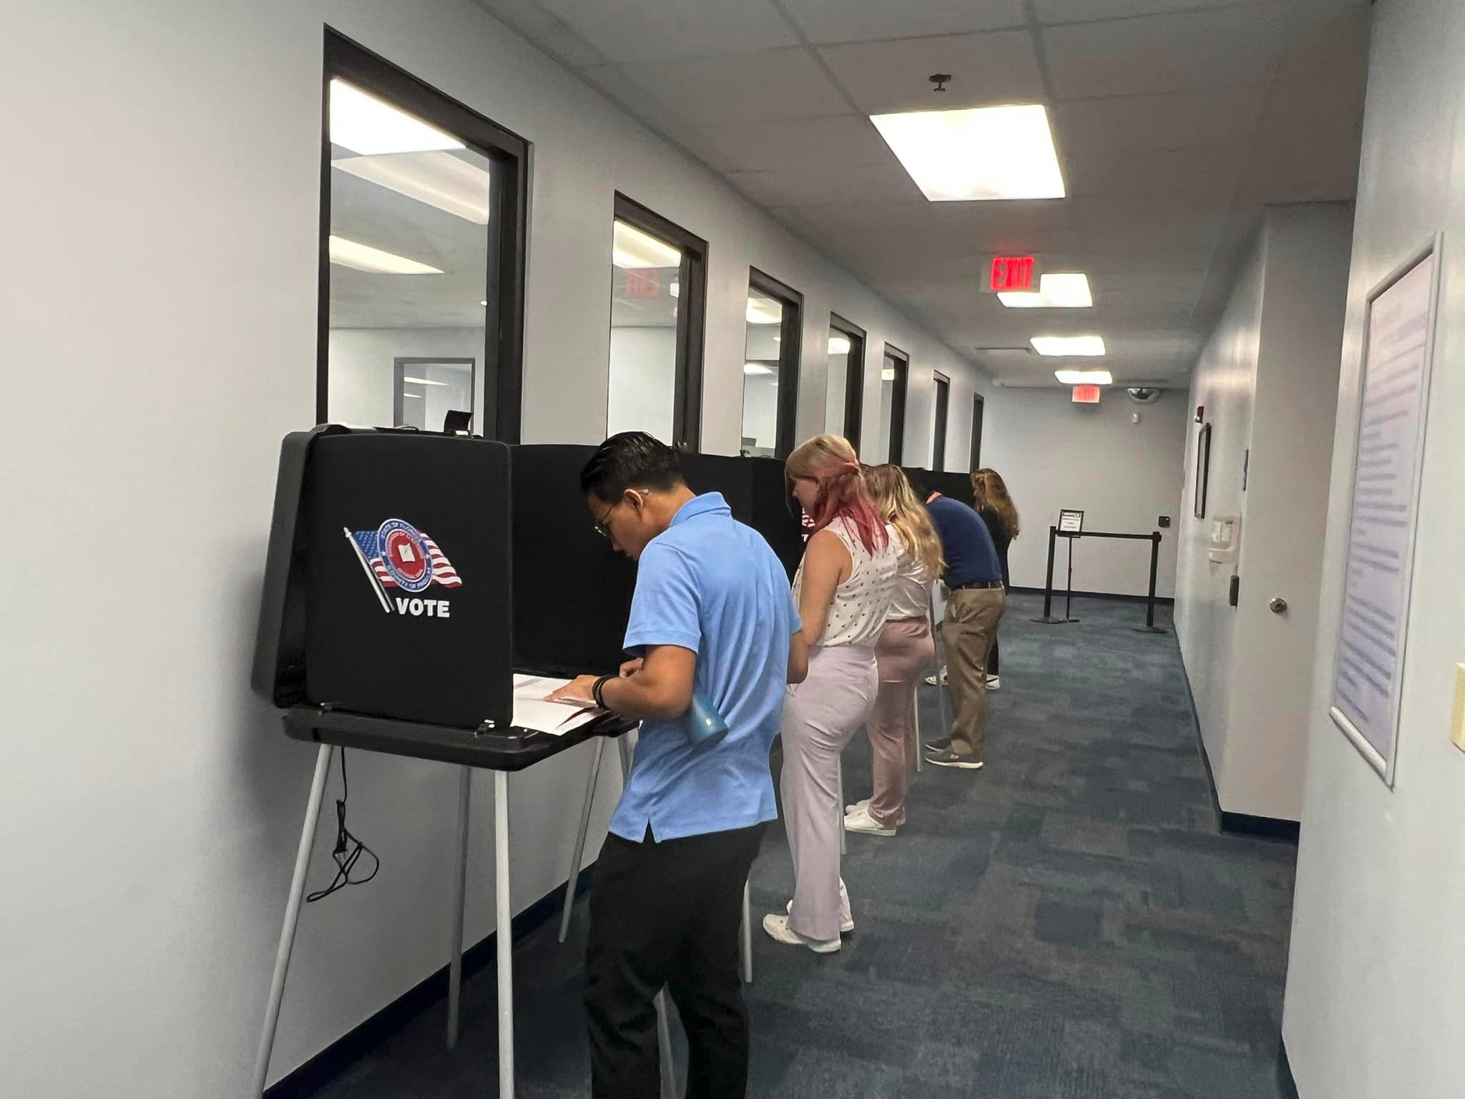

Slide 18
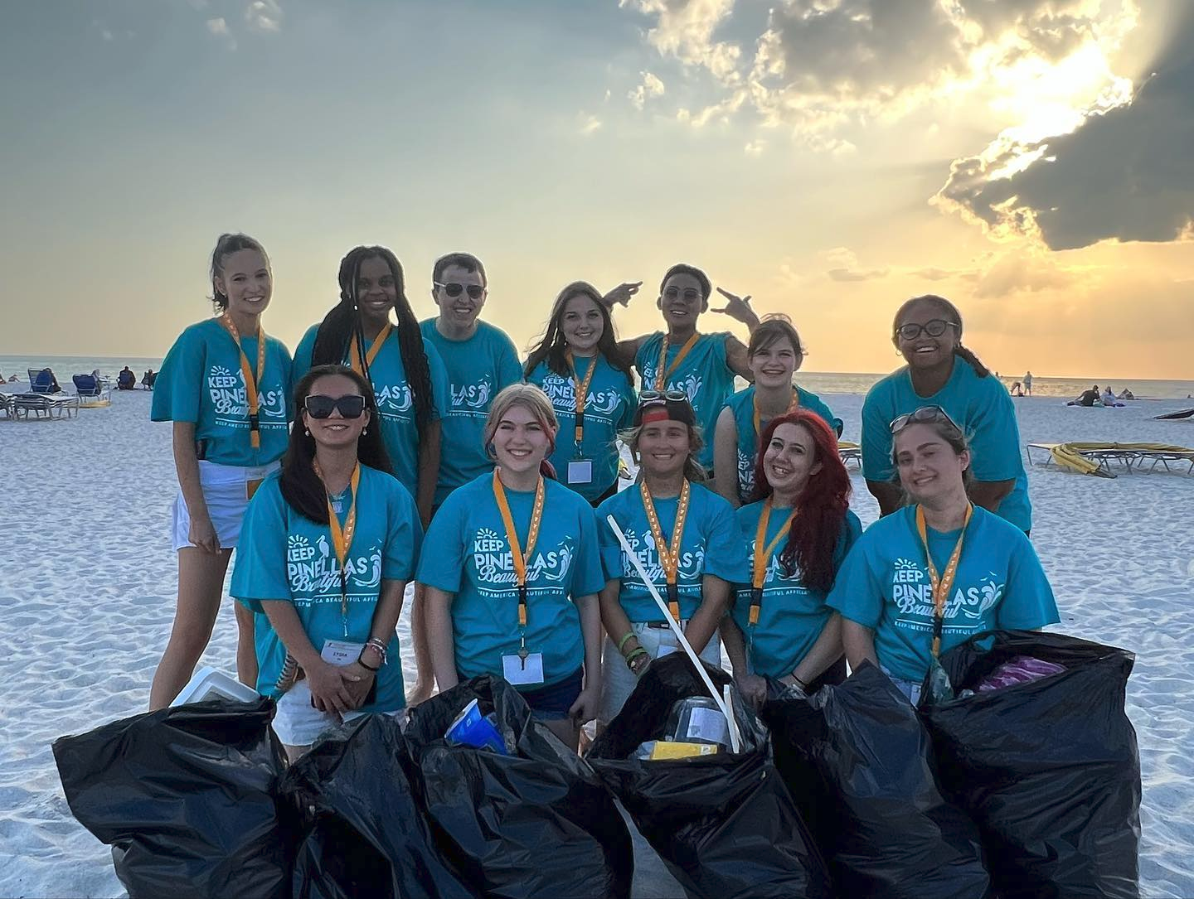
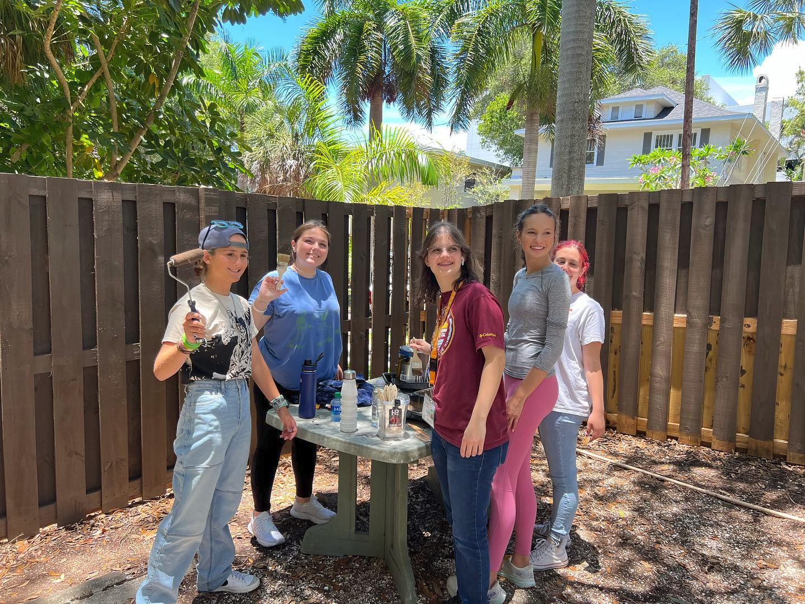
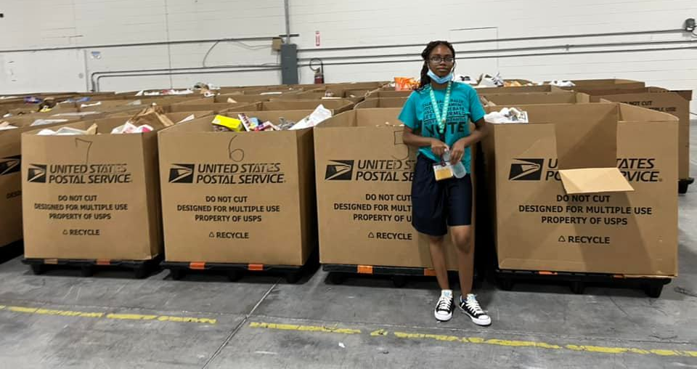

Slide 19
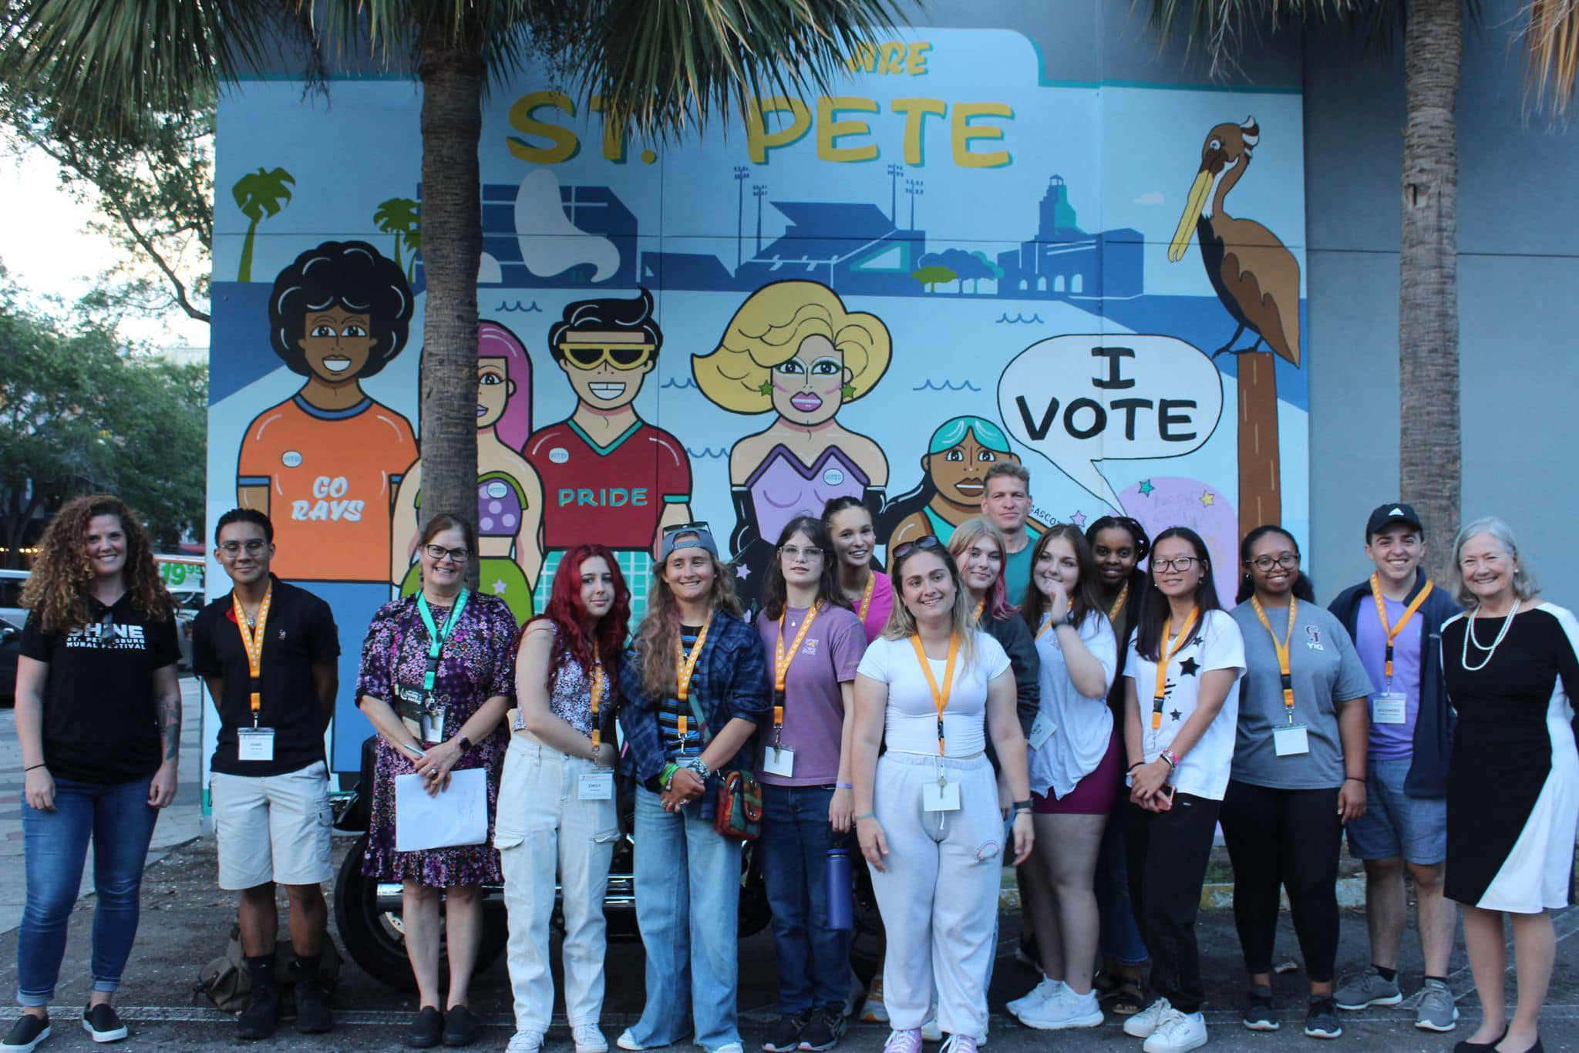
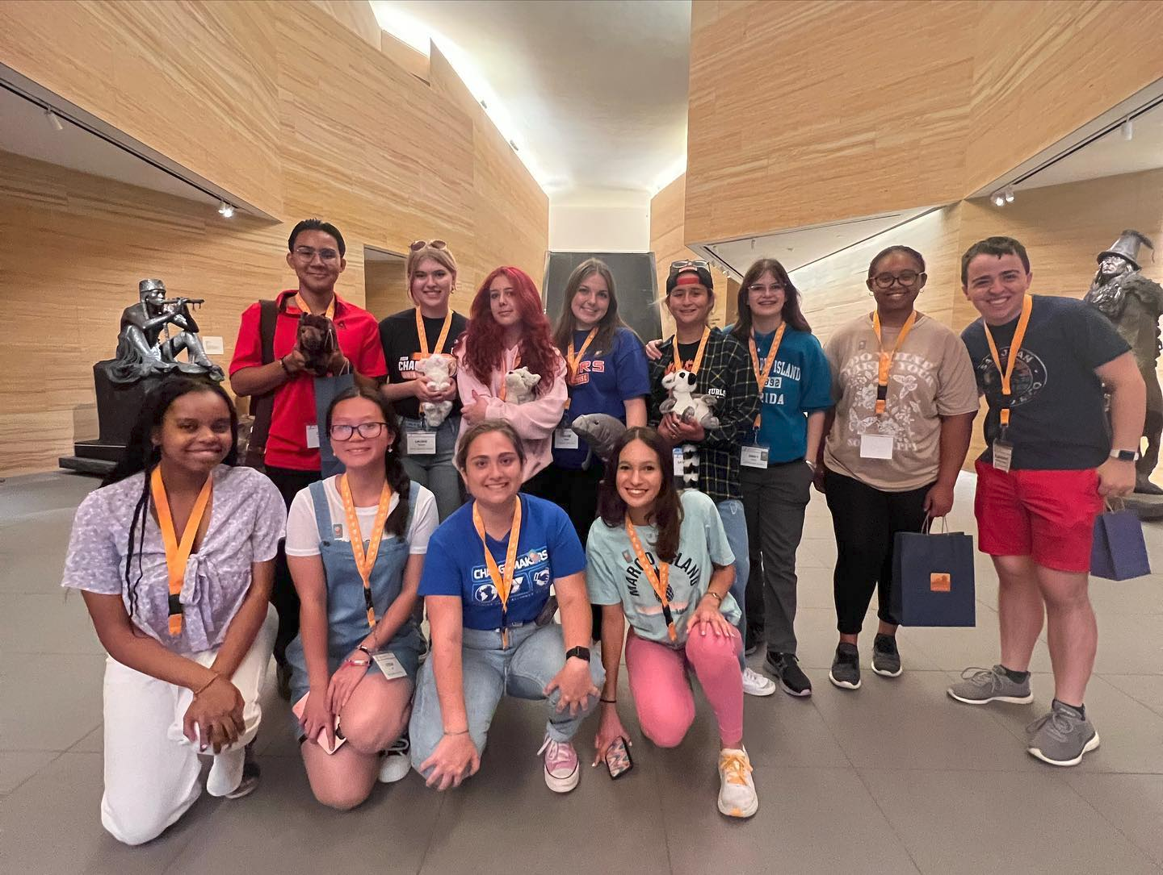
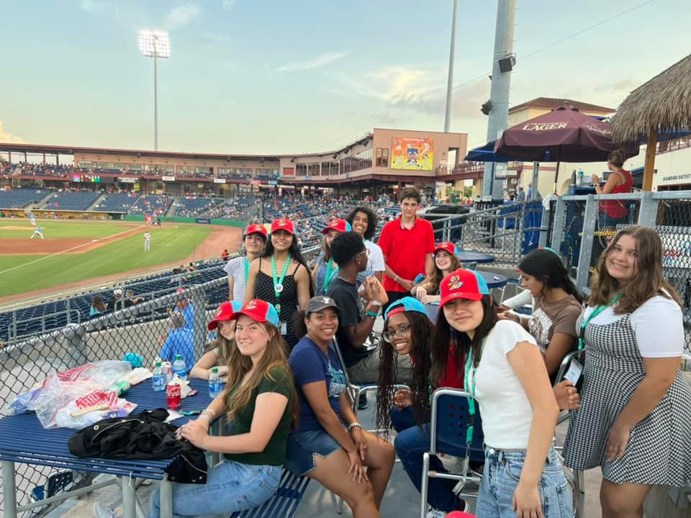
Cultural Activities in Pinellas County
Clearwater Marine Aquarium
Dali Museum
Holocaust Museum
Rays Game
Pinellas County Parks
James Museum of Western Art
Threshers Game

Slide 20
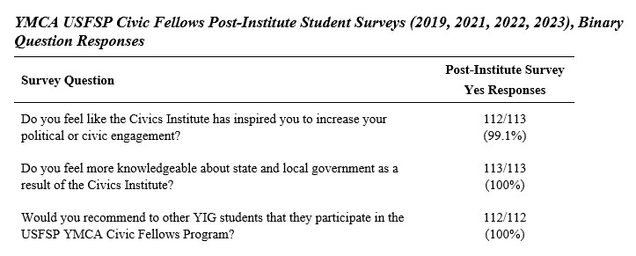
Program Assessment and Impact

Slide 23
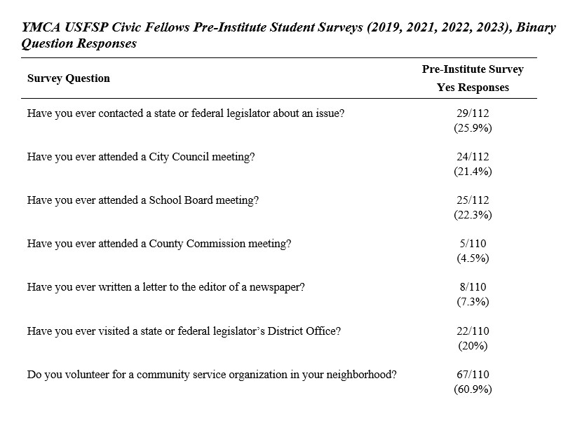

Slide 25
2022
“It truthfully is a once-in-a-lifetime experience and its an awesome way to expand your interests in politics by being aware of the different opportunities! ” – Delegate
“It’s a great program that furthers your education on civics and politics. You’re able to meet real like politicians that impact our life.” - Delegate
“I think this is a valuable experience that not many people get the opportunity for and it is definitely beneficial for teens who are interested the how your government works seamlessly.” - Delegate

Slide 26
Civic Fellows Portfolio
Victoria Lantzy: https://sites.google.com/view/victoriasyigcivicfellowsportf/home
Aanika Mehta: https://sites.google.com/view/aanika-mehta-yig-civic-fellows/home
Aditto Showkat: https://sites.google.com/view/adittos-yig-civic-fellows-prog/home
Destiny Spoor: https://sites.google.com/view/destinyspoor/home

Slide 27
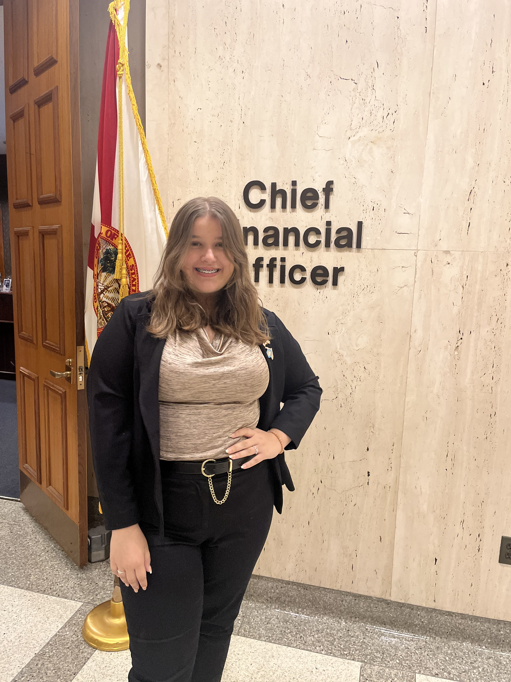
Civic Fellow Perspective: Emily Vigil

Slide 28
Reflections – Bringing College Civics Education to High School Students
In 2021, Florida’s Civic Standards were revised and put into effect for the 2023-24 school year, a portion of the revisions were removing the required service projects, trial simulations, and mock elections from schools' civic curricula that were once under SS.7.C.2.14, SS.7.C.2.6, and SS.7.C.2.7.
Experiential learning opportunities as provided by YIG and the USFSP YMCA Civic Fellows Program are needed even more

