Slide 1
Advancing Civic Health in Florida’s Communities
FCA Third Thursday 2023 Webinar Series
https://floridacivicadvance.com

Slide 2
Florida Civic Advance Advancing Civic Health in Florida’s Communities
FCA Third Thursdays Webinar
Thursday, July 20, 2023, 12-1:00 pm, EDT
Engaging Youth in Civic Health:
The USF St. Petersburg , Florida State Alliance of YMCAs’ Civic Fellows Program

Slide 3
Florida Civic Advance Advancing Civic Health in Florida’s Communities WHAT IS CIVIC HEALTH
Civic health relates to:
The overall wellbeing of residents, neighborhoods, and communities,
Using their voices to find solutions together
To improve the community

Slide 4
Florida Civic Advance Advancing Civic Health in Florida’s Communities WHAT IS CIVIC HEALTH
Communities with strong indicators of civic health have:
.
Higher employment rates | Accessible civic gathering places in libraries & parks
Stronger schools | More responsive local governments, and
Better individual physical health | Their residents live longer healthier lives

Slide 5
Florida Civic Advance Advancing Civic Health in Florida’s Communities THE CIVIC HEALTH CHALLENGE
Florida, the 3rd largest state, ranks among the lowest states in terms of civic health. We want to change that.
50th in nation in volunteering among 50 states (2015)
49th in belonging to a civic organization (2013)
50th in donating to charity (2015)
50th in helping neighbors fix a community problem (2015) and
50th attending public meetings (2015)

Slide 6
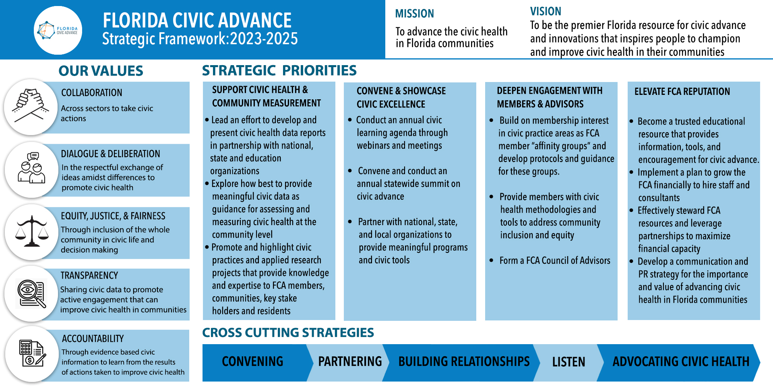
Advancing Civic Health in Florida’s Communities

Slide 7
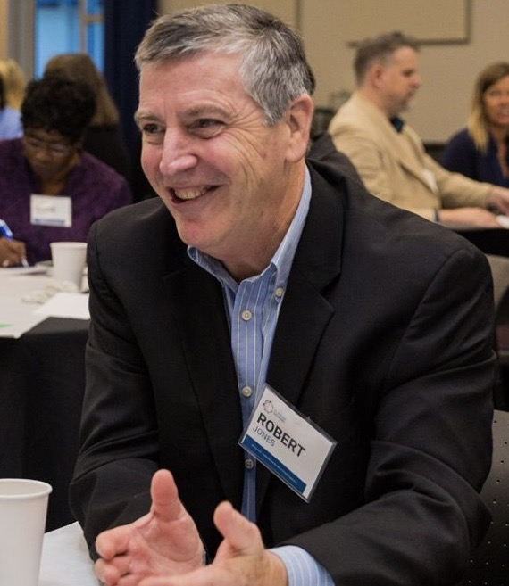
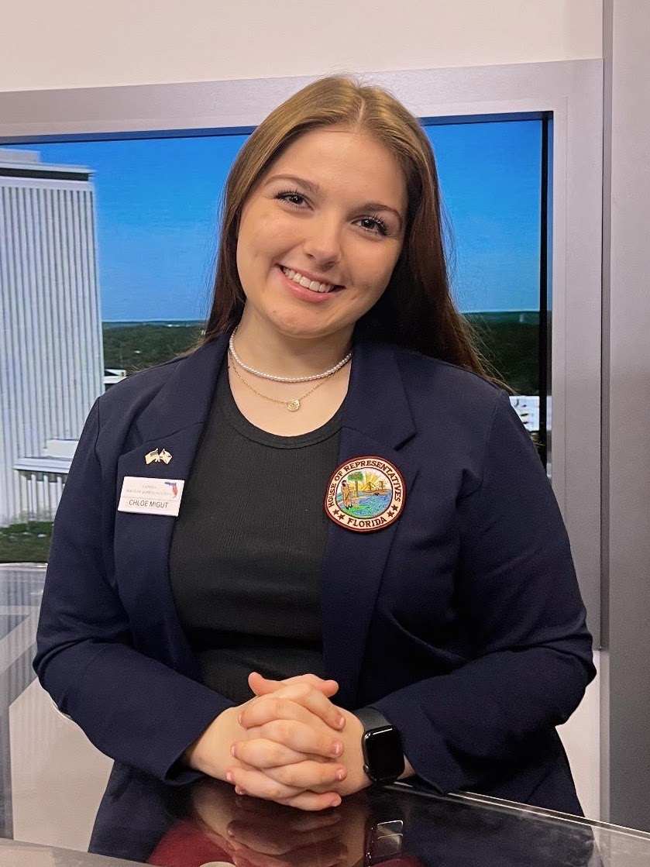
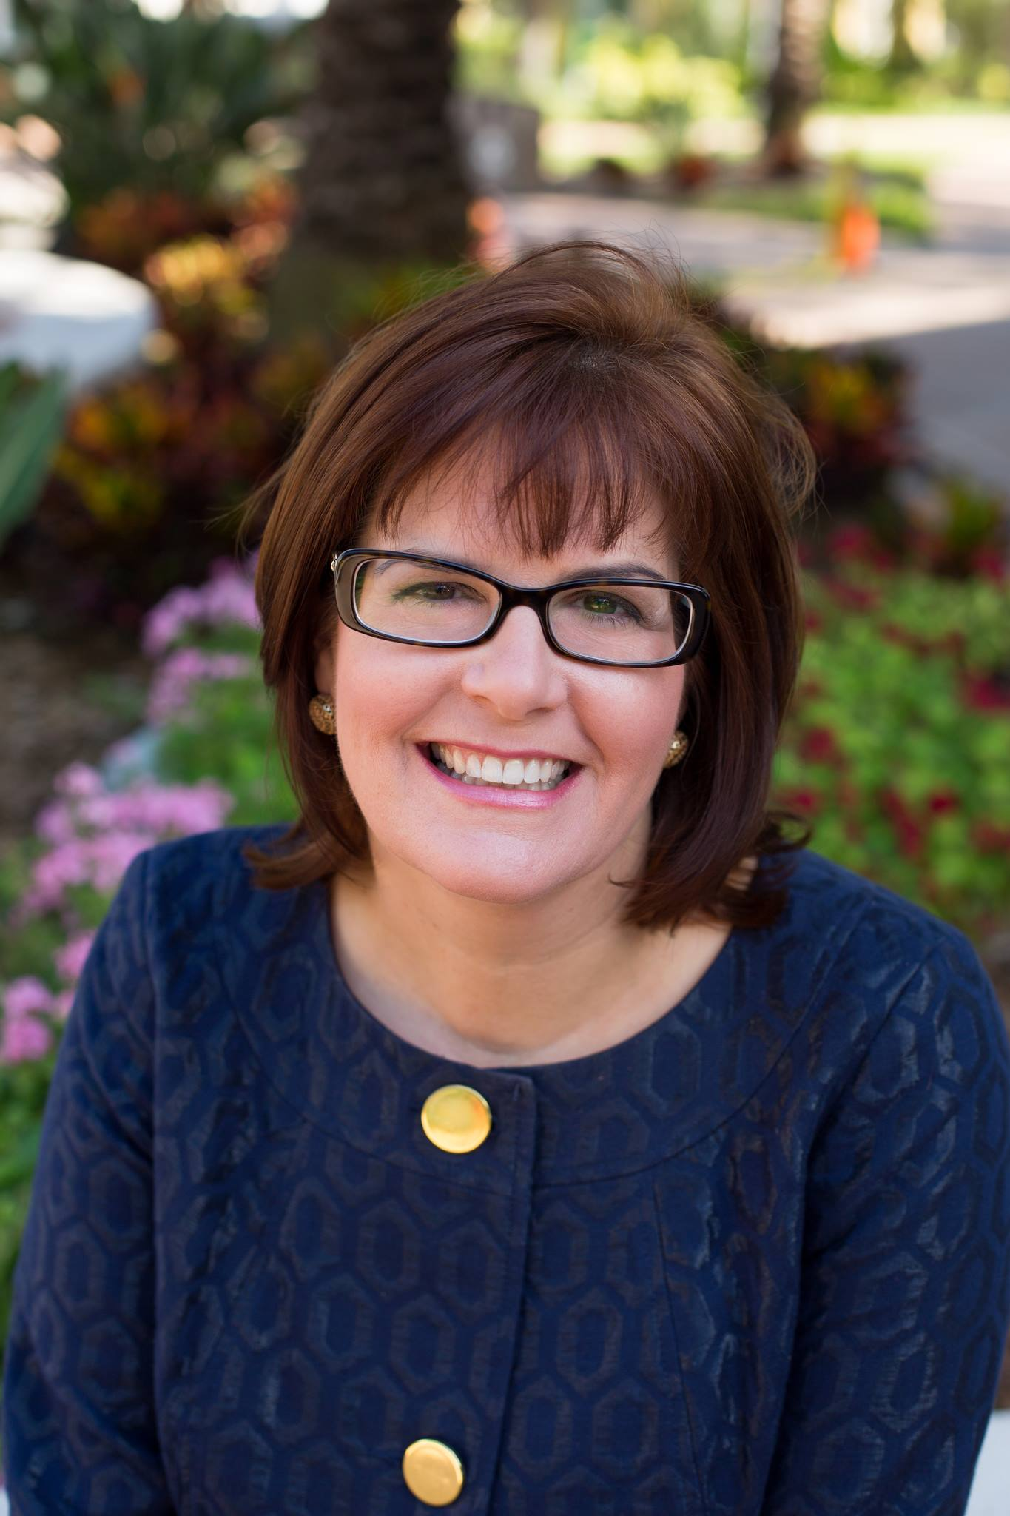
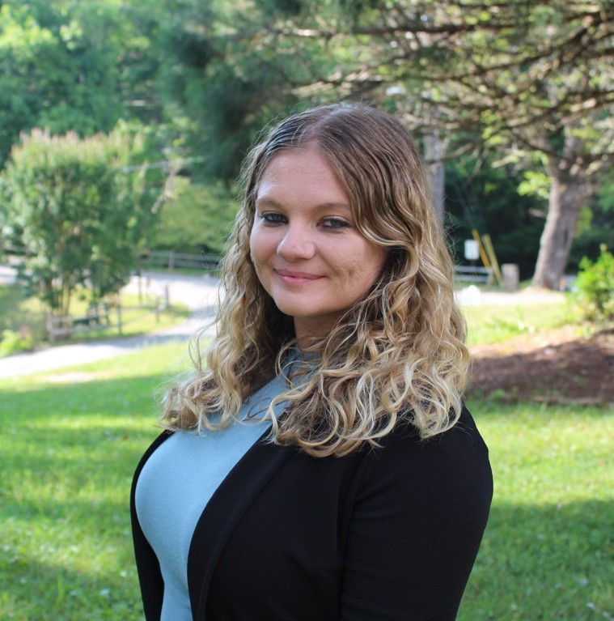
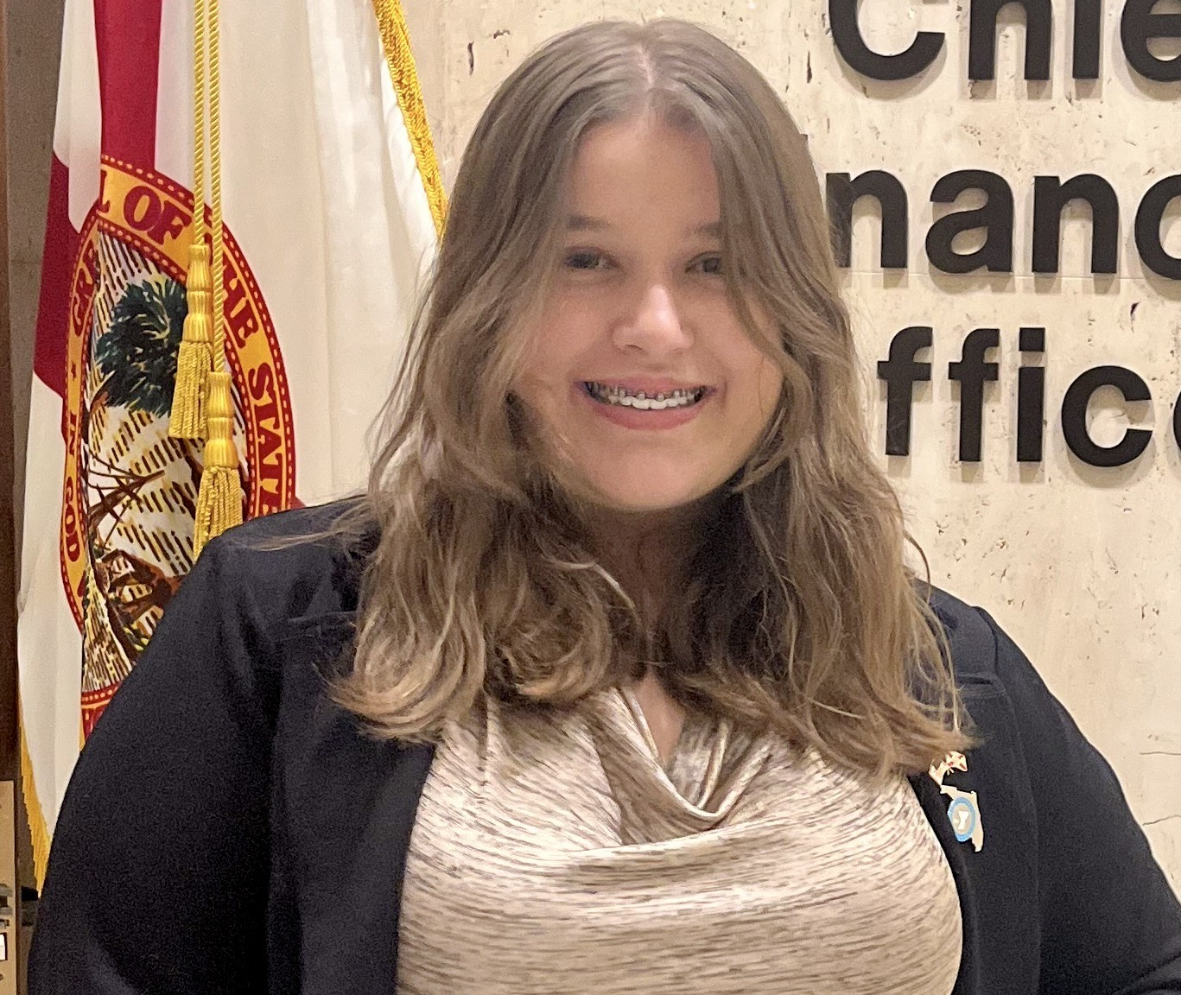
Florida Civic Advance Advancing Civic Health in Florida’s Communities Engaging Youth in Civic Health: The USF St. Petersburg , Florida State Alliance of YMCAs’ Civic Fellows Program Introducing the Presenters
Bob Jones
Moderator
FCA Board Member
Judithanne McLauchlan
Professor, Florida Studies, Lead Instructor for the USFSP YMCA Civic Fellows Program
Chelsea Coombes
State Director, Civic Engagement and Teen Initiatives, Florida State Alliance of YMCAs & Foundation
Emily Vigil,
High School Senior, 2021-2022 Civic Institute
Chole Migut
High School Junior, 2022-2023 Civic Institute
,

Slide 8
Florida Civic Advance Advancing Civic Health in Florida’s Communities “Engaging Youth in Civic Health””
What do you want to Learn From Today’s Webinar?
Who: Florida State YMCA Alliance, USF St Petersburg, The Florida Civic Advance
What: The Civic Institute model for youth engagement. More information on youth voice. What has been successful, best practices, lessons learned.
How: How to encourage intergenerational leadership. Youth engagement strategies. How do these efforts assure that there is a racial diversity of participants? What metrics are used and have there been longitudinal studies conducted? Opportunities for the business community to get involved with youth civic engagement

Slide 9
Engaging Youth in Civic Health The USF St. Petersburg YMCA Civic Fellows Program
Ms. Chelsea Coombes
Florida State Alliance of YMCAs
State Director, Civic Engagement and Teen Initiatives
Dr. Judithanne Scourfield McLauchlan
USF St. Petersburg, Duckwall Professor of Florida Studies; Director, Center for Civic Engagement; Lead Instructor, Civic Fellows Program
Ms. Emily Vigil & Ms. Chole Migut
USF St. Petersburg YMCA Civic Fellow
Florida Civic Advance Webinar Series
17 August 2023

Slide 10
Florida Civic Advance Advancing Civic Health in Florida’s Communities
FCA Third Thursdays Webinar
Thursday, September 21, 2023, 12-1:00 pm EDT
The Miami Underline Conservancy:
Reimagining the Civic Commons and Advancing Civic Health
Transforming public places into civic assets for the whole community the Underline this 120-acre, world-class linear park spanning 10-miles below Miami’s Metrorail that will transform regional mobility and celebrate diversity, equity, culture, and lifelong learning.
See FCA Website for registration:

Slide 11
Florida Civic Advance Advancing Civic Excellence in Florida’s Communities
SAVE THE DATE
Where: Center for Health Equity,
St Petersburg, Florida
Register Online Now

Slide 12
Florida Civic Advance Advancing Civic Excellence in Florida’s Communities
In Case You Missed Past FCA Civic Excellence Webinars
Visit our website: https://www.floridacivicadvance.net

Slide 13
Florida Civic Advance Advancing Civic Health in Florida’s Communities
Join us in advancing civic health in Florida’s communities!
Florida Civic Advance Membership
We welcome organizations and individuals to join as FCA members to build together a new nonprofit membership network dedicated to increasing civic practices and advancing civic health in Florida’s communities
https://floridacivicadvance.com/membership/

Slide 14
Florida Civic Advance Advancing Civic Excellence in Florida’s Communities
FCA Website
https://www.floridacivicadvance.com
Membership Benefits and Application
https://floridacivicadvance.com/membership/

Slide 15
Florida Civic Advance Advancing Civic Health in Florida’s Communities
https://www.floridacivicadvance.com

