Slide 1
Advancing Civic Health in Florida’s Communities
FCA Third Thursday 2023 Webinar Series
https://floridacivicadvance.com

Slide 2
Florida Civic Advance Advancing Civic Health in Florida’s Communities
FCA Third Thursdays Webinar
Thursday, December 14, 2023, 3-4 pm, EDT
“The Future of Civic Education:
A Consensus Roadmap for Excellence in Civic Learning?”

Slide 3
Florida Civic Advance Advancing Civic Health in Florida’s Communities Webinar Zoom Housekeeping
Place your device on Mute till the Q&A
The FCA conducts nonpartisan webinars
Show respect for the speakers and each other
Please use “Chat” to share questions, comments and links
to resources.
We will try to have the speakers answer your questions during the presentations
We will have an open Q & A after the presentations

Slide 4
Florida Civic Advance Advancing Civic Health in Florida’s Communities WHAT IS CIVIC HEALTH
“Civic health reflects the opportunities people have to participate in their communities.”

Slide 5
Florida Civic Advance Advancing Civic Health in Florida’s Communities WHAT IS CIVIC HEALTH
Civic health is connected to how long and how well we live, and relates to:
The overall wellbeing of residents, neighborhoods, and communities,
Using their voices to find solutions together
To improve and strengthen the community

Slide 6
Florida Civic Advance Advancing Civic Health in Florida’s Communities WHAT IS CIVIC HEALTH
Communities with strong indicators of civic health have:
.
Higher employment rates | Accessible civic gathering places in libraries & parks
Stronger schools | More responsive local governments, and
Better individual physical health | Their residents live longer healthier lives

Slide 7
Florida Civic Advance Advancing Civic Health in Florida’s Communities FLORIDA’S CIVIC HEALTH CHALLENGE
Florida, the 3rd largest state, ranks among the lowest states in terms of civic health. We want to change that.
50th in nation in volunteering among 50 states (2015)
49th in belonging to a civic organization (2013)
50th in donating to charity (2015)
50th in helping neighbors fix a community problem (2015) and
50th attending public meetings (2015)

Slide 8
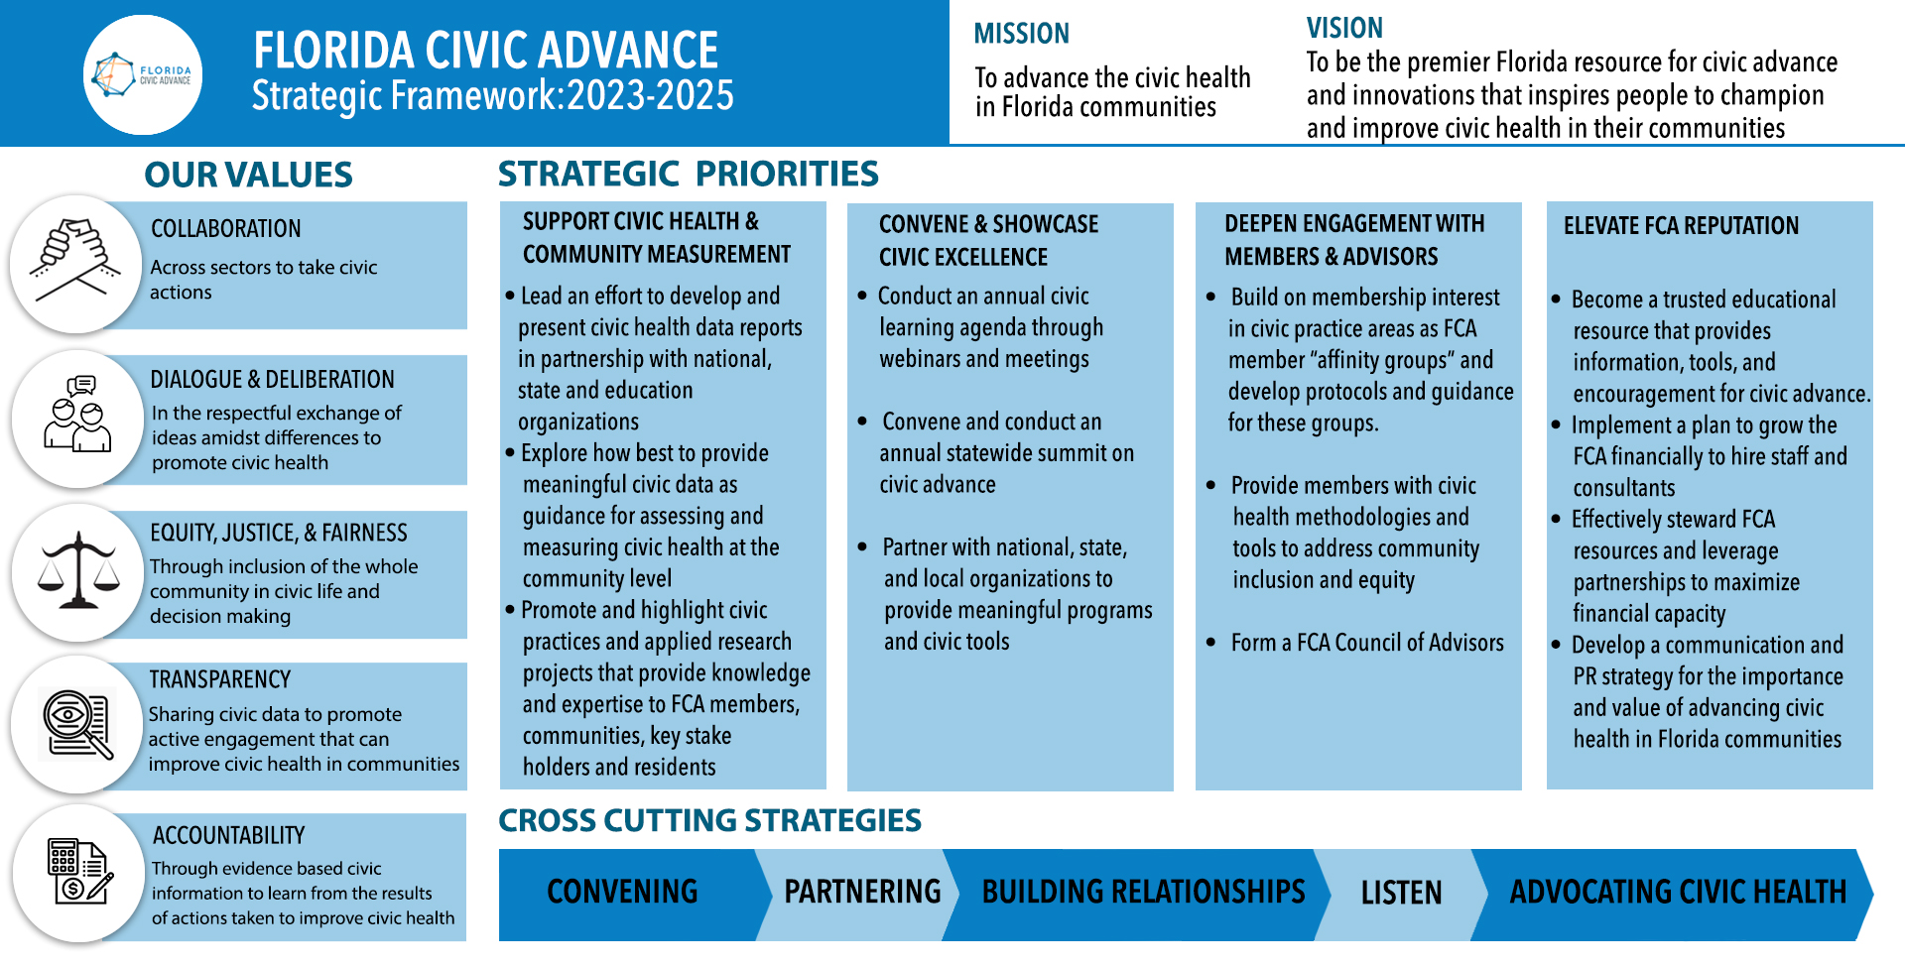
Advancing Civic Health in Florida’s Communities

Slide 9
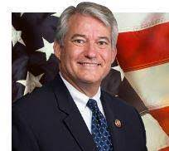
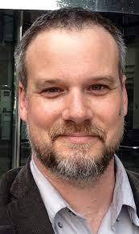
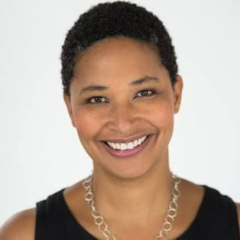
Introducing the Speakers
“The Future of Civic Education:
A Consensus Roadmap for Excellence in Civic Learning?”
Bob Jones
Introduction
FCA Board Member
Steve Masyada,
Director, Lou Frey Institute & Joint Center for Citizenship, University of Central Florida
Danielle Allen, Director, Allen Lab for Democracy Innovation, Harvard University
Hon. Dennis Ross,
Director, American Center for Political Leadership, Southeastern University
,

Slide 10
“The Future of Civic Education: A Consensus Roadmap for Excellence in Civic Learning?”
What do you want to Learn From Today’s Webinar?
Who? What? Why?
Who: Hearing from Danielle Allen and Dennis Ross, “great lineup” Steve Masyada and the UCF Frey Institute’s work, Florida Civic Advance
What: Current trends and info on the future of Civic Education. Data and research about the benefits of civic learning.” Ways to address the EAD design challenges for effective instruction. Ideas for advancing civics education in Florida and what other states are doing.

Slide 11
“The Future of Civic Education: A Consensus Roadmap for Excellence in Civic Learning?”
What do you want to Learn From Today’s Webinar?
Who? What? Why?
How: How EAD can help advance civic learning in the Sunshine State without fanning the flames of the culture wars How does civility figure in Civic Education. How can civic education be inclusive, culturally relevant/sensitive and help liftup the common values shared by most people regardless of income, race, politics, age, etc.. Methods I can use to get our students more civically engaged. How to shape discussions about civic education in ways that empower college students to become active and engaged in participatory politics.

Slide 12
We’ve Created a Roadmap for Excellence in History and Civics
https://www.educatingforamericandemocracy.org/

Slide 14
Led by a Diverse Network of 300+ Scholars, Educators, Students and Practitioners
FUNDED BY
LED BY

Slide 15
Guidance for Civic and History Education Excellence
Educating for American Democracy explores what and how to teach civics and history, building students’ knowledge and capacities to sustain America’s constitutional democracy

Slide 16
The Roadmap to Educating for American Democracy offers guidance for the content and instructional strategies of K–12 history and civic education across the United States
Inquiry framework and design principles that states and districts may use to develop and deliver excellent history and civic learning.
Not a series of facts but questions that promote depth over breadth
Not a national curriculum nor a mandate

Slide 17
The Roadmap
Can be used by teachers, schools, districts or states to design instructional standards
Encourages a telling of America’s plural, yet shared, story and a more complete and honest accounting of the past—both the good and the bad
Cultivates reflective patriotism
Is organized in 7 themes across 4 grade bands: K-2, 3-5, 6-8, 9-12 that integrate history and civics
Includes pedagogy strategies for excellence in teaching

Slide 18
The Seven
Themes
The
Five
Design
Challenges
Notes:
Being an EAD teacher starts with a dispositional shift to truly expect and support success in civic life from all students and a commitment to continuous improvement. It then moves to establishing a set of community norms that allow rigorous and challenging topics and questions to be explored deeply and courageously. Once these conditions are met, we describe how an inquiry-based instructional arc can be designed using a vast number of pedagogical techniques, supported by student engagement in practices of constitutional democracy within the classroom and then in the community. The cycle of development for an EAD teacher starts with a commitment to serve all students well and ends with affirmation of that commitment through use of formative assessments and information from assessments for self-reflection and refinement of instructional strategies.
Taken together, these six EAD core pedagogical principles describe what it means to be an EAD teacher and how teachers, students, and school and community leaders can support EAD-aligned civic education through their action.
The description of each principle explains “What” (what do we mean by this principle?), “Why” (what is the rationale and evidence supporting this principle?), and “How” (how can EAD supporters put this idea into action?).

Slide 19
The Seven
Themes
The
Seven
Themes

Slide 20
DESIGN CHALLENGE 1: Motivating Agency, Sustaining the Republic
DESIGN CHALLENGE 2: America’s Plural Yet Shared Story
DESIGN CHALLENGE 3: Simultaneously Celebrating and Critiquing Compromise
DESIGN CHALLENGE 4: Civic Honesty, Reflective Patriotism
DESIGN CHALLENGE 5: Balancing the Concrete and the Abstract
The Seven
Themes
The
Five
Design
Challenges
The Five Design Challenges

Slide 21
Florida Civic Advance Advancing Civic Excellence in Florida’s Communities
In Case You Missed Past FCA Civic Excellence Webinars
Visit our website: https://www.floridacivicadvance.net

Slide 22
Florida Civic Advance Advancing Civic Health in Florida’s Communities
Join us in advancing civic health in Florida’s communities!
Florida Civic Advance Membership
We welcome organizations and individuals to join as FCA members to build together a new nonprofit membership network dedicated to increasing civic practices and advancing civic health in Florida’s communities
https://floridacivicadvance.com/membership/

Slide 23
Florida Civic Advance Advancing Civic Excellence in Florida’s Communities
FCA Website
https://www.floridacivicadvance.com
Membership Benefits and Application
https://floridacivicadvance.com/membership/

Slide 24
Florida Civic Advance Advancing Civic Health in Florida’s Communities
https://www.floridacivicadvance.com

