Slide 1
Cities of Belonging
Civic Commons

Slide 2
About Me
Public Engagement Partners
Civic Commons (Seattle Foundation)
Quixada Moore-Vissing, PhD

Slide 3
Introduction: Americans feel like they don’t belong
The American Immigration Council released a special report where they found that only
36% of Americans feel they belong at work
32% feel they belong in the nation
26% feel they belong in their local community

Slide 4
Why Belonging Matters
Americans are increasingly isolated, particularly among youth
Loneliness is bad for physical health but has also spurned an epidemic of mental health issues
Americans are increasingly segregated where they live, go to school, work, and socialize
Divisiveness is at an all time high

Slide 5
Poll
How does a lack of belonging affect your local community?
What connections do you see between belonging and civic engagement?

Slide 6
Civic Engagement and belonging
If you build it….THEY STILL MAY NOT COME…
Belonging helps to address:
Systems and histories of discrimination
Barriers to feeling welcome

Slide 7
Civic health and belonging
Assessments are like a doctor’s check up, give us information
But then we need to take action. What can action look like?
Deeper community exploration
Policy change
Community initiatives
Civic education

Slide 9
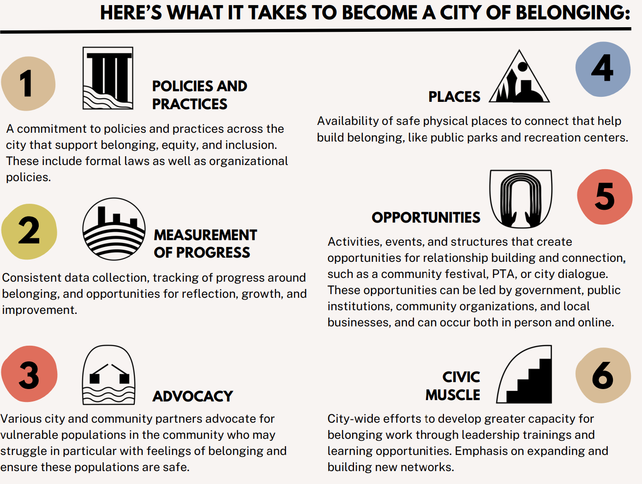

Slide 10
MOVING TOWARDS BELONGING
GET A BASELINE
BELA - Belonging and Engagement Landscape Analysis
Collect data around belonging and engagement in the local community through a survey that draws on national indicators like the Belonging Barometer
Deep-dive into the assets and challenges in the local community through interviews, focus groups, and document analysis
TOOLKITS & TRAININGS
CUSTOMIZED COACHING
Resources related to creating cultures of belonging, healing, and community engagement based on data from the baseline and civic engagement scan
Regular advising with a local steering committee on how to design and implement the belonging framework in the community

Slide 11
IMPACTS
POLICY
SOCIAL CONNECTIVITY
NARRATIVE SHIFT
Increased capacity of local staff working in and outside of government to create policy and institutional practices that support belonging
More organizational collaborations, formal and informal networks, and individual relationships
Mindset shifts where people begin thinking about the local community differently and in ways that foster increased equity, participation, and collaboration

Slide 12
closing
In this moment in history, it can sometimes feel like there are no paths forward in untangling our complex social challenges. There is hope. By fostering cultures of belonging at the local level, we can begin to heal our communities at both the individual and collective level.

Slide 13
THANK YOU
Quixada Moore-Vissing
Frank Nam
Michael Brown
quixada@publicengagementpartners.com

