Slide 1
Public Health, Civic Health, and Equity: What are the Connections?
2023 FCA Summit
Civic Health for the Whole Community: From Data to Community Action and Results
Dawn M. Hunter, JD, MPH, CPH
Presented October 27, 2023

Slide 2
About the Network for Public Health Law
Through our National Office and five Region Offices, the Network provides legal technical assistance, consulting, trainings and resources to local, state, and national health agencies and organizations across the United States.
What we do:
Strategic Consultation & Guidance
Knowledge Building & Training
Research & Analysis
Awareness Building & Connection
Notes:
We believe in the power of public health law and policy to improve lives and make our communities safer, healthier, stronger and more equitable. We know that understanding, navigating and using law and policy can transform our communities so we work to help public health leaders, policymakers, researchers, educators, advocates and health care providers do just that.

Slide 3
Top Areas for Legal Technical Assistance
COVID-19 Emergency Legal Response
Substance Use & Harm Reduction
Health Information Data Sharing
Statutes and Regulatory Information
Marijuana/Cannabis
Environmental Public Health
Tobacco Control
Injury Prevention and Safety
Adults at Risk

Slide 4
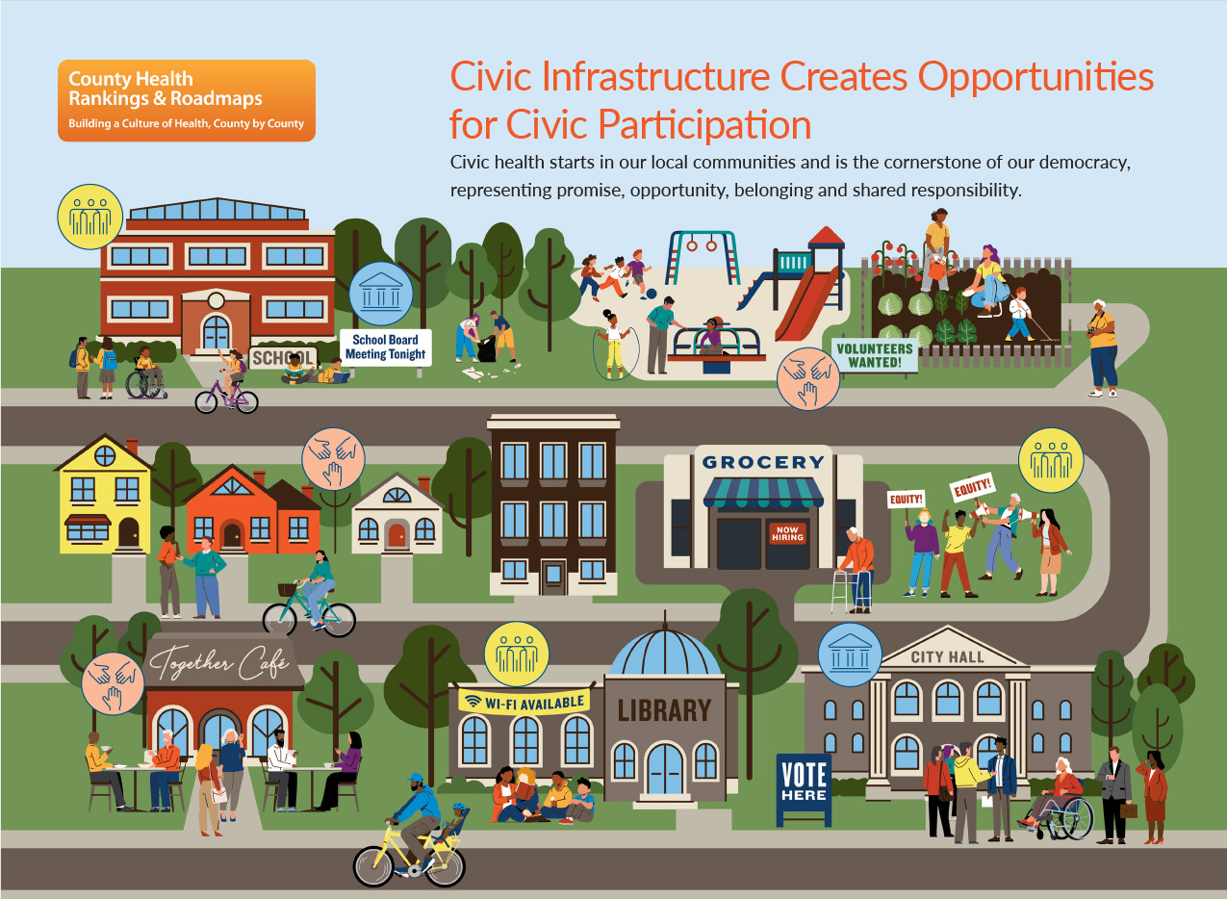
2023 Country Health Rankings National Findings Report: Cultivating Civic Infrastructure and Participation for Healthier Communities
Notes:
Civic Spaces to Connect, Learn, and Collectively Act
Governance and Resources
Social Networks and Shared Culture

Slide 5
Law creates the conditions for health

Slide 6
Top 10 Public Health Achievements of the 20th Century
Vaccinations
Motor vehicle safety
Safer workplaces
Control of infectious diseases
Decline in heart disease/stroke deaths
Safer and healthier foods
Healthier mothers and babies
Family planning
Fluoridation of drinking water
Recognition of tobacco as a health hazard
6
CDC, MMWR 1999: Vol. 48 / No. 12
Notes:
Behind every public health outcome (good or bad) is a law or polic
From the MMWR
In the twentieth century, public health interventions helped to increase life expectancy among U.S. residents by 62%, from 47.3 years in 1900 to 76.8 in 2000.1 In this timeframe, the most notable achievements in public health, assisted by the efforts of public health agencies across the country, include
Modern public health agencies use their authority for more than preventing epidemics and tracking, investigating and stopping the spread of disease and other health threats (e.g. foodborne illness, HIV/AIDS, measles). These agencies serve many other critical functions, such as preventing injuries; promoting and encouraging healthy behaviors such as diet and exercise; preventing chronic diseases, including cancer and diabetes; planning for and responding to disasters and assisting communities in recovery; protecting against environmental hazards; assuring the quality and accessibility of services, and advancing health equity.

Slide 7
Laws behind those achievements
School Vaccination Laws
Helmet and Seatbelt Laws
Speed Limits
OSHA
Biosafety Standards
Quarantine and Isolation
Drinking Water Standards
FDA, USDA and state food inspections
Food fortification (flour, salt)
School Lunch Programs
Women, Infants, and Children Program (WIC)
Newborn Screening
Master Settlement Agreement
Clean Indoor Air laws

Slide 8
Law as a Determinant of Health
The law operates as a determinant by establishing the framework that we operate in – where we live, work, play, pray, and learn.
As a set of commands, requirements, or prohibitions on action.
As processes and procedures for making decisions, creating new laws, and interpreting existing laws.
As a set of norms and expectations that can influence behavior, even in the absence of a command, prohibition, or requirement.
As individual rights and obligations.

Slide 9
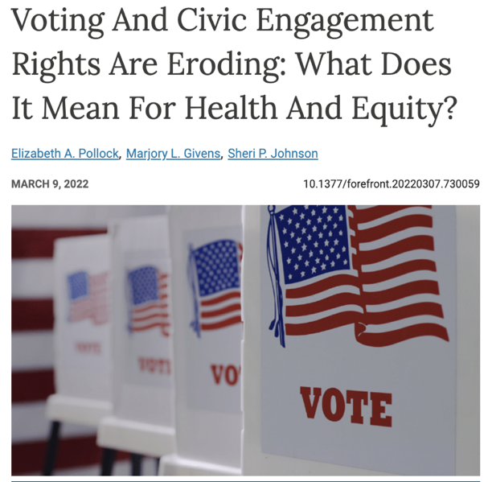
Why is a public health lawyer talking about voting?
“As many places in the US have declared racism a public health crisis, the erosion of voting rights must be understood as manifestations of structural and cultural racism and thus, prioritized for action. When democracy is weakened, social cohesion and public health suffer.”
Pollock, EA, Givens, ML, & Johnson, SP. (2022, March 9). Voting and civic engagement rights are eroding: What does it mean for Health and equity?, Health Affairs Forefront. Health Affairs.
9

Slide 10
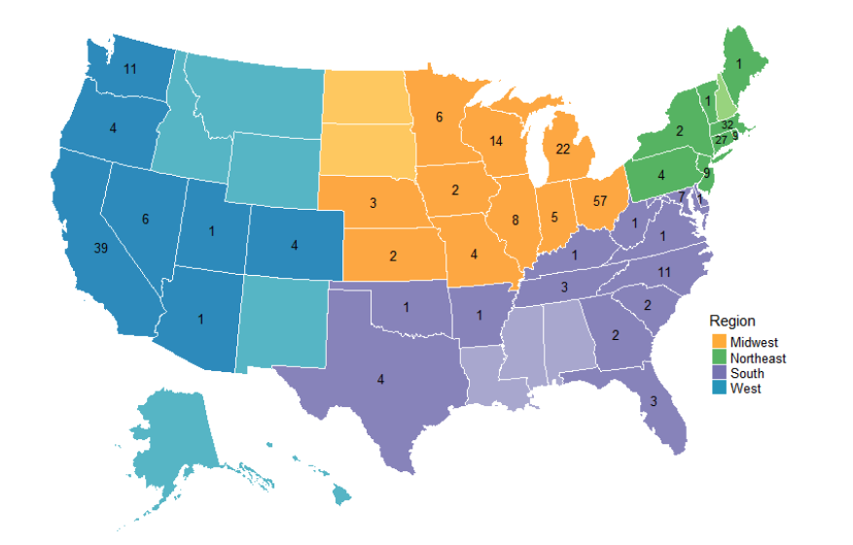
Racism as a Public Health Crisis
Map of localities responding to racism as a public health crisis, by state and region (Dec. 2021)
Taking a public health approach means recognizing that it affects large numbers of people over time, and requires policy and system change over individual interventions
Crystal N. Lewis, Ruqaiijah Yearby, Charysse Gibson, Abby R. Jaeger, and Maya T. Lawson. (August 2022). Racism is a Public Health Crisis: How Local Governments are Responding. Institute for Healing Justice and Equity.

Slide 11
Three common threads across declaration preamble statements
Racism affects lifelong health outcomes even before birth and across every stage of life.
Racism significantly reduces life expectancy and increases premature mortality.
Unequal access to opportunity affects economic stability, homeownership, and intergenerational wealth accumulation.
Hunter, D. and Lawton, B. (April 2022). Racism as a Public Health Crisis — Perspectives on Healthy Aging. The Network for Public Health Law.
Notes:
Racism significantly reduces life expectancy (a measure of how long a person can expect to live at birth that varies by age, gender, race and ethnicity, and geographic location), and increases premature mortality (commonly measured by years of potential life lost due to preventable death).
Unequal access to opportunity due to redlining and geographic segregation, discriminatory lending practices, and other discriminatory laws and policies negatively affects economic stability, homeownership, and intergenerational wealth accumulation.
Healthy aging

Slide 12
Law is a tool for equity

Slide 13
Using an Equity Lens
“Strategically, intentionally and holistically examining the impact of an issue, policy or proposed solution on underserved and historically marginalized communities and population subgroups.”
M.D. Douglas et al., (2019), Applying a Health Equity Lens to Evaluate and Inform Policy, Ethn. Dis. 29(Suppl 2): 329-342.
Considering process, outcomes, and values
Guided by a set of reflective questions that can lead to a different set of actions

Slide 14
Infant mortality rates, by race and Hispanic origin: United States, 2017–2018
Racism and Health Outcomes
Example: Infant Mortality
Ely DM, Driscoll AK. Infant mortality in the United States, 2018: Data from the period linked birth/infant death file. National Vital Statistics Reports, vol 69 no 7. Hyattsville, MD: National Center for Health Statistics. 2020.
14

Slide 15
Infant Mortality – How does law make a difference?
Civil rights laws
Minimum wage laws
Public health laws – (e.g. mortality review committees)
Medicaid expansion
Education and Training Requirements
Chay KY, Greenstone M. 2000. The Convergence in Black-White Infant Mortality Rates during the 1960's. American Economic Review, 2000; 90 (2): 326-332.
Rosenquist NA, Cook DM, Ehntholt A, Omaye A, Muennig P, Pabayo R. Differential relationship between state-level minimum wage and infant mortality risk among US infants born to white and black mothers. J Epidemiol Community Health. 2020 Jan; 74(1): 14-19.
Bhatt CB, Beck-Sagué CM. Medicaid Expansion and Infant Mortality in the United States. Am J Public Health. 2018 Apr; 108(4):565-567.
15
Notes:
Title VI of the Civil Rights Act of 1964
Title VI bars discrimination by government agencies receiving federal funding across a variety of services.
It had a significant impact on infant mortality in the years after it was enacted.
The Affordable Care Act further reduced infant mortality rates in Medicaid expansion states

Slide 16
Black and White Infant Mortality Rates in the South, 1955-1975
Excerpt from Chay and Greenstone, “The Convergence in Black-White Infant Mortality Rates During the 1960’s,” Accessed Oct. 28, 2020
Notes:
Also occurred within the context of other reforms, like the expansion in the 60s also of the maternal and infant care section of Title V of the 1935 Social Security Act, which resulted in increases in MCH funding.
Medicaid expansion states are required to cover the ten essential health benefits, including maternity and newborn care. Prior to the ACA, insurers did not have to cover these services as part of standard plans.
Nearly 60% of uninsured adults in non-expansion states are people of color.

Slide 17
Infant Mortality - How do policy decisions make a difference?
Flexner Report of 1910
Fewer Black Physicians
Worse experience and quality of care
Higher infant mortality
Campbell KM, Corral I, Infante Linares JL, Tumin D. Projected Estimates of African American Medical Graduates of Closed Historically Black Medical Schools. JAMA Netw Open. 2020; 3(8):e2015220.
Greenwood BN, Hardeman RR, Huang L, Sojourner A. Physician-patient racial concordance and disparities in birthing mortality for newborns. PNAS 2020; 117(35) 21194-21200
17

Slide 18
Voting Health
Law

Slide 19
What health outcomes are linked to voter turnout?

Slide 20
What is the relationship between voting and health?
Health indicators associated with civic engagement or voting
Self-rated health & mental health
Self-reported chronic health condition
Self-reported disability preventing work
Disability status
Use of healthcare services
Health risk behaviors like smoking
Life expectancy & mortality rates
Income level
Education level
Neighborhood safety
20

Slide 21
Health and Democracy are Interdependent
Increased Civic Engagement
More Inclusive Health Policy (power, access, social cohesion)
Better Health Outcomes
21
Notes:
There are significant disparities in health outcomes related to opportunities for health and healthy conditions---connected to power. Health is a complex system or set of systems that intersect and influence one another.
Public health - "what we do collectively to assure the conditions for everyone to thrive and be healthy."
To advance health equity we need to develop the power to influence the systems that create healthy communities, the social and political determinants of health.
To assure health we must build our collective capacity to act = power

Slide 22
Cost of Voting Index Scores by State (2020)
Cost of Voting in the American States: 2020
The cost of voting refers to the time and effort associated with casting a vote and is intended to characterize the overall electoral climate in each state.
States
Scot Schraufnagel, Michael J. Pomante II, and Quan Li. Election Law Journal: Rules, Politics, and Policy. Dec 2020. 503-509.
22
COVI Index Value
Notes:
or, in other words, the extent to which each state embraces inclusivity in the electoral process versus restriction or exclusion.

Slide 23
Components of the Cost of Voting Index: 2020
Registering to Vote
Registration deadlines
Voter registration restrictions
Registration drive restrictions
Pre-registration laws
Automatic voter registration
Casting a Ballot
Voting inconvenience
Voter ID laws
Poll hours
Early voting
23

Slide 24
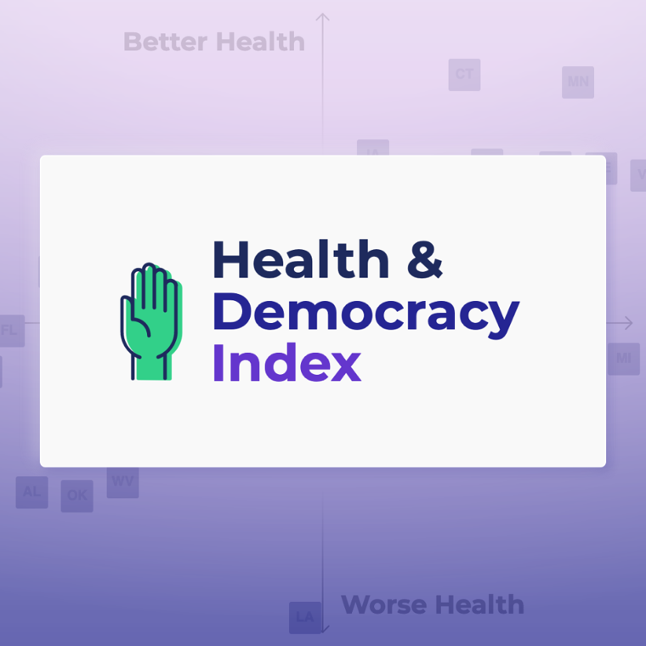
Making the connection to Health
The Health & Democracy Index is a way to visualize the relationship between the Cost of Voting and health outcomes.
States with more voting access and greater civic participation are healthier.
https://democracyindex.hdhp.us/
24

Slide 25
Default View: Overall Health
2021
2023

Slide 26
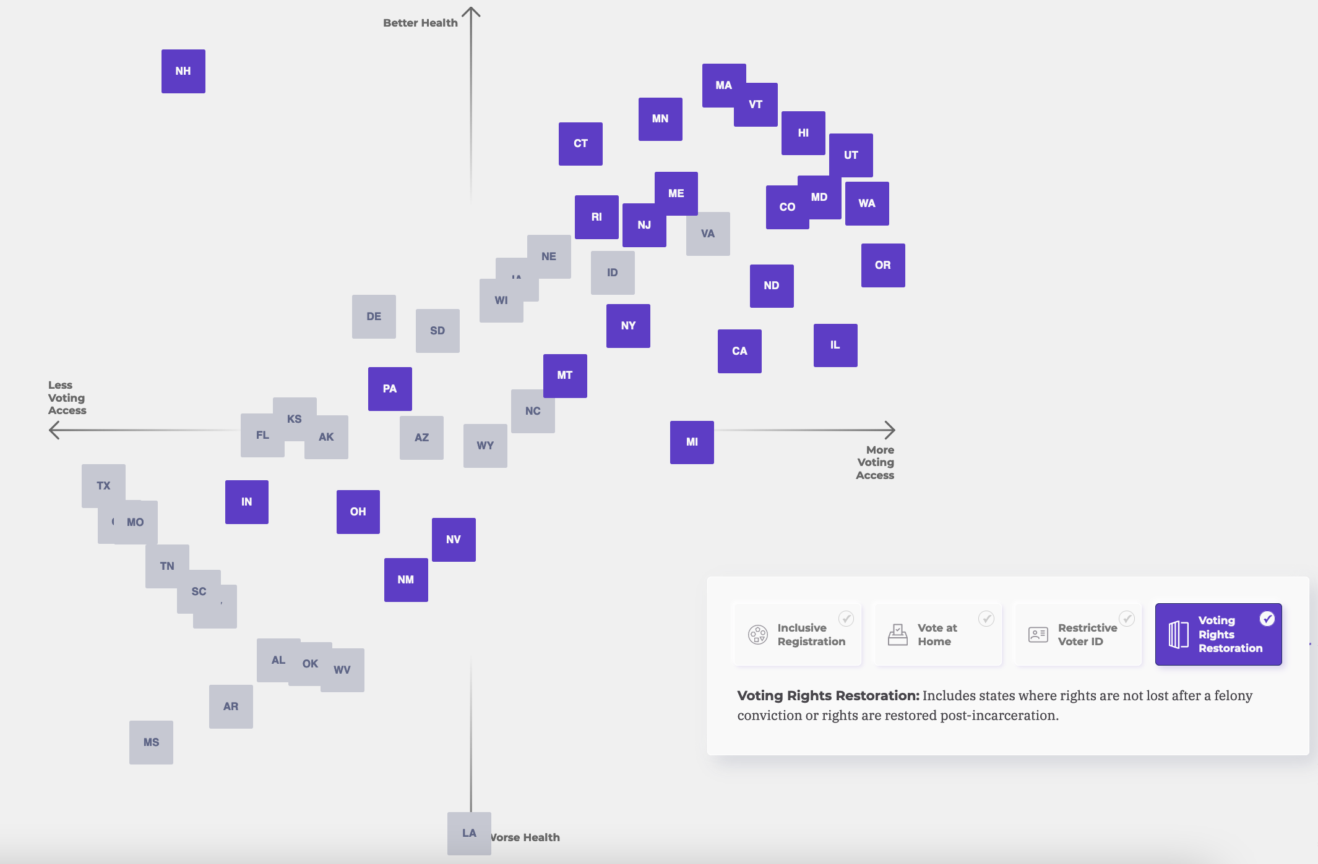
In states where rights are not lost or are restored post-incarceration, people have better overall health.
Interactive Voting Policy Picker
You can see the relationship between 4 categories of voting policies and overall health:
Inclusive Registration
Vote at Home
Restrictive Voter ID
Voting Rights Restoration (displayed).
26
Notes:
Explain where Florida stands

Slide 27
What is the impact?
27
@votingrightslab on Twitter, 8/9/2022

Slide 28
Status of Voting Rights Restoration
2023
New Mexico HB 4 (citizens on parole).
Minnesota HF 28 (citizens on parole).
Tennessee Supreme Court, Falls v. Goins, June 2023 (people with felony convictions must have their voting rights restored by a judge or provide evidence that they were pardoned).
2021
Connecticut SB 1202 (citizens on parole).
New York SB 830 (citizens on parole).
Washington HB 1078 (citizens on parole).
Virginia Executive Action (on release from incarceration).
2020
California Proposition 17 (citizens on parole).
Washington, D.C. B 825 (vote while incarcerated).
Iowa Executive Order 7, August 5, 2020 (completion of sentence).
New Jersey AB 5823 (citizens on parole and on release from incarceration).
According to The Sentencing Project, 4.6 million people were disenfranchised in 2022.

Slide 29
What affects both voter turnout and health outcomes?

Slide 30
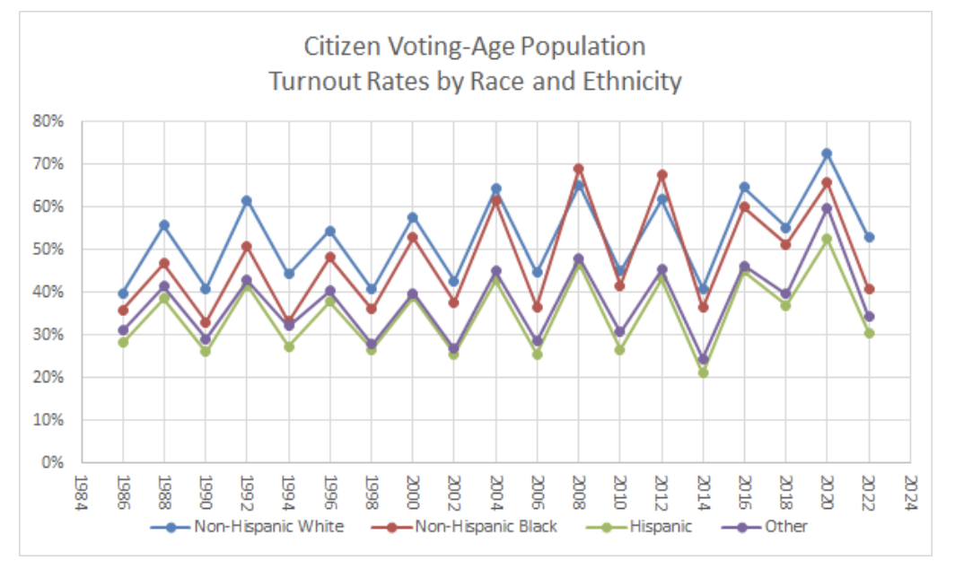
Disparities in civic participation and health equity
Source: US Elections Project / Current Population Survey

Slide 31
Research An Analysis of Inter-State Variation, 1996-2020 (publication pending)
The research question:
When the citizens of a state are more involved in their communities (through volunteering, voting, or joining groups) do these individuals, and the states they reside in, experience better health?
Conducted by Dr. Scot Schraufnagel
Chair, Department of Political Science, Northern Illinois University and supported by the Network for Public Health Law
31

Slide 32
Civic Engagement and Public Health - State-Level (Bivariate Relationship Strong and Statistically significant)
Year of Presidential Election
An increase in the cost of voting is associated with a decrease in overall public health.
Publication pending, S. Schraufnagel
32
The Bivariate Relationship between the Cost of Voting and Overall State Health

Slide 33
Civic Engagement and Public Health - Individual-Level (Bivariate Relationship strong and Statistically Significant)
An increase in the cost of voting associates with higher bad health and lower good individual health.
Using the Behavioral Risk Factor Surveillance System (2021) and the COVI (2020)
Publication pending, S. Schraufnagel
33

Slide 34
Conclusions
Strong bivariate relationships withstand great scrutiny
Higher cost of voting index (COVI) values indicate worse state health outcomes
Higher state COVI values indicate worse individual health outcomes
The effect of a restrictive state electoral climate on bad health is greater for residents without a college diploma, low-income residents, people over 65, Black Americans, and Hispanic Americans
34

Slide 35
Bivariate Relationships: Overall State Health the COVI and State Minority Populations *
Unpublished data, S. Schraufnagel 2022
* Presidential election years 1996-2020, inclusive. Sample size 350. The % Latinx population in each state is not statistically significant (p < .05).

Slide 36
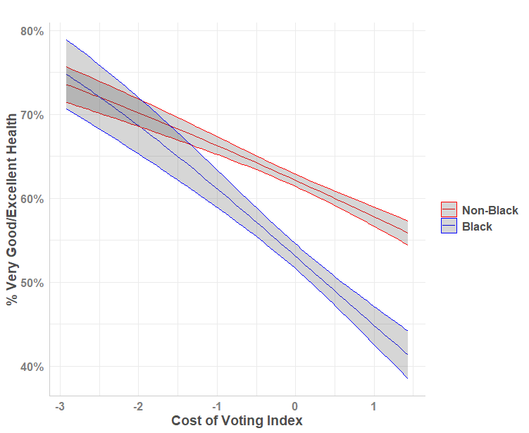
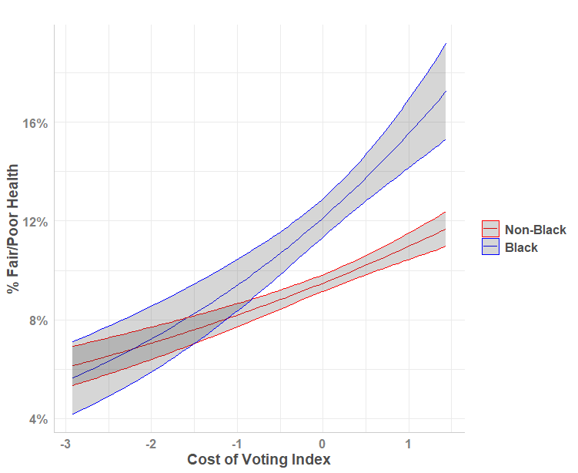
Preliminary Findings: Racial Health Equity and the Cost of Voting
Schraufnagel, Hunter, Durbin, and Mahs (publication pending 2023).

Slide 37
Voting, Political Power, and Black Health
We have done a deeper dive on this data (publication pending).
In 42 states, Black people are underrepresented in the the legislature, and this gets worse in states where the cost of voting is higher.
These states may have entrenched structural barriers (redlining, unequal wages, failure to expand Medicaid, voter suppression).
The cost of voting has a greater burden on Black people, but it affects everyone.
When we have more inclusive policies and processes, everyone gets healthier and we can close the disparity gap.

Slide 38
Example of Impact: State Infant Mortality Rates
A COVI ranking of 50 is associated with the most restrictive electoral environment, while a COVI ranking of 1 is associated with the least restrictive electoral environment. For comparison, the U.S. average infant mortality rate is 5.67.

Slide 39
Voting, Political Power, and Black Health

Slide 40
Tying it all together – Medicaid Expansion example
Research shows a negative correlation between Medicaid enrollment and voter registration
This affects more people of color, low-income people, persons with disabilities, new and young voters, and people who move often
Research also shows that Medicaid expansion can increase voter turnout
Medicaid expansion has reduced disparities in coverage and access to care and increased financial stability
CIVIC ENGAGMENT
Voting on ballot initiatives
Electing leaders who support health reform
Educating and mobilizing voters on the issue
Better Individual Health
Better Population Health
Notes:
Maine, Missouri, Oklahoma – ballot initiative

Slide 41
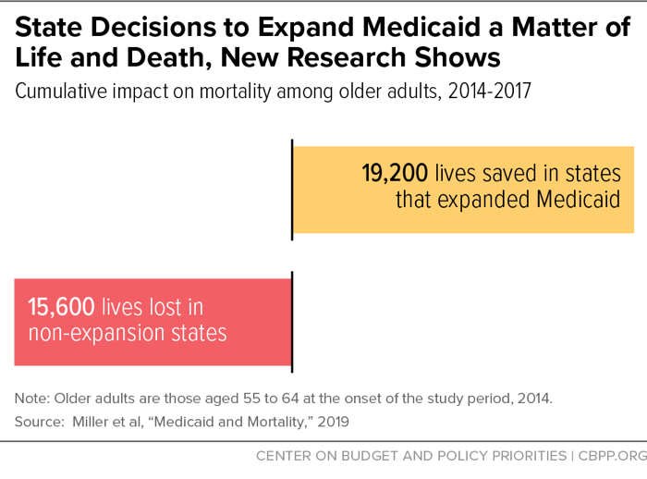

Slide 42
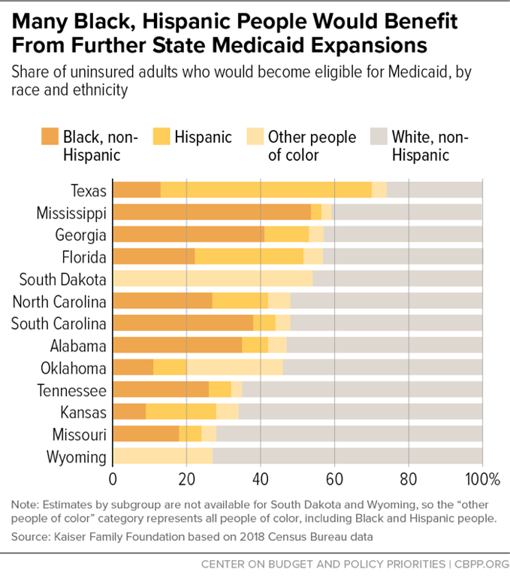
NOTE: Missouri, North Carolina, Oklahoma, and South Dakota have all since adopted Medicaid Expansion. North Carolina is not yet implemented.
Notes:
Nearly 60% of uninsured adults in non-expansion states are people of color.
The American Rescue Plan (ARP) is incentivizing states to expand Medicaid by providing money, flexibility, or both
An estimate by the Kaiser Family Foundation found that for North Carolina, that boost to the bottom line would be about $1.7 billion overall, while the cost to the state would be about a half-billion dollars a year, a net gain of as much as $1.2 billion for the state.
I know that Medicaid expansion can be a touchy subject but it’s important when having that discussion to have all the relevant data - health, economic, and otherwise.
Also – it benefits the uninsured

Slide 43
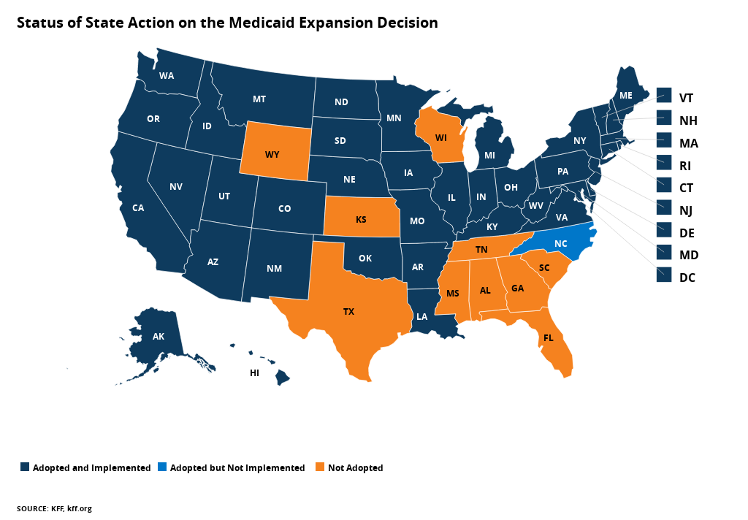
Current Status of Medicaid Expansion (last checked 9-3-2023)

Slide 44
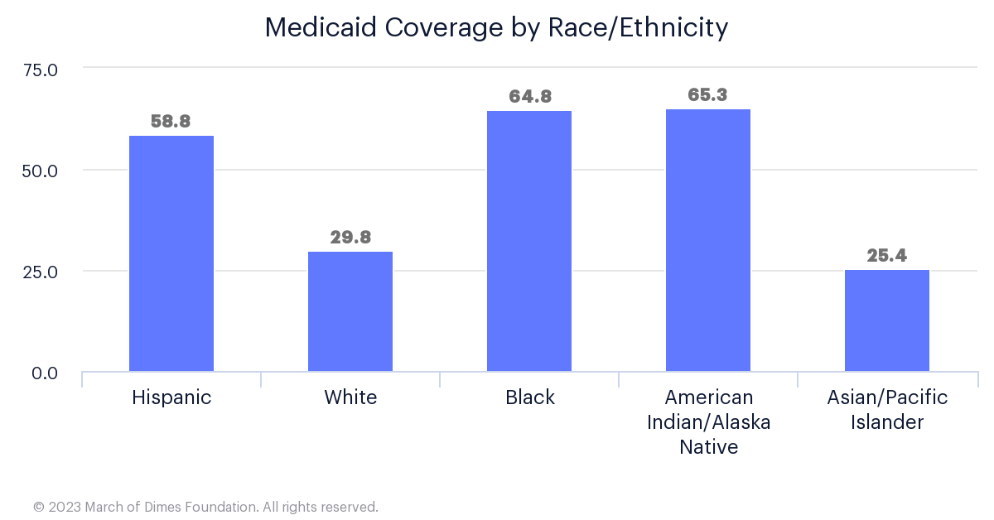
Postpartum Medicaid Coverage – a critical policy intervention for Black Maternal Mortality
*United States, 2018-2020 Average
All race categories exclude Hispanics. Medicaid percentages indicate a woman was insured with Medicaid at the time of her birth. National Center for Health Statistics, final natality data. Retrieved September 4, 2023, from www.marchofdimes.org/peristats.

Slide 45
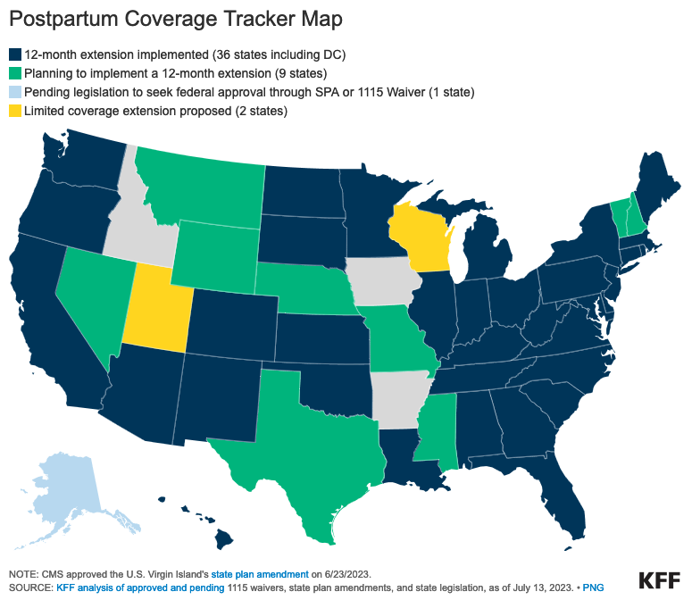
Postpartum Medicaid Coverage

Slide 46
Law as a tool for advocacy

Slide 47
At least 10 jurisdictions mention voting or civic participation in their declaration of racism as a public health crisis:
Eaton County, MI (June 2020)
Ingham County, MI (June 2020)
Kalamazoo County, MI (June 2020)
Jackson, MI (June 2020)
Chattanooga, TN (July 2020)
East Lansing, MI (November 2020)
San Diego County, CA (January 2021)
Multnomah County, OR (April 2021)
St. Petersburg, FL (July 2021)
New York City Board of Health (October 2021)
Hunter, D. (2021, December 15). Voting rights: Why they should be included in declarations of racism as a public health crisis. Network for Public Health Law.

Slide 48
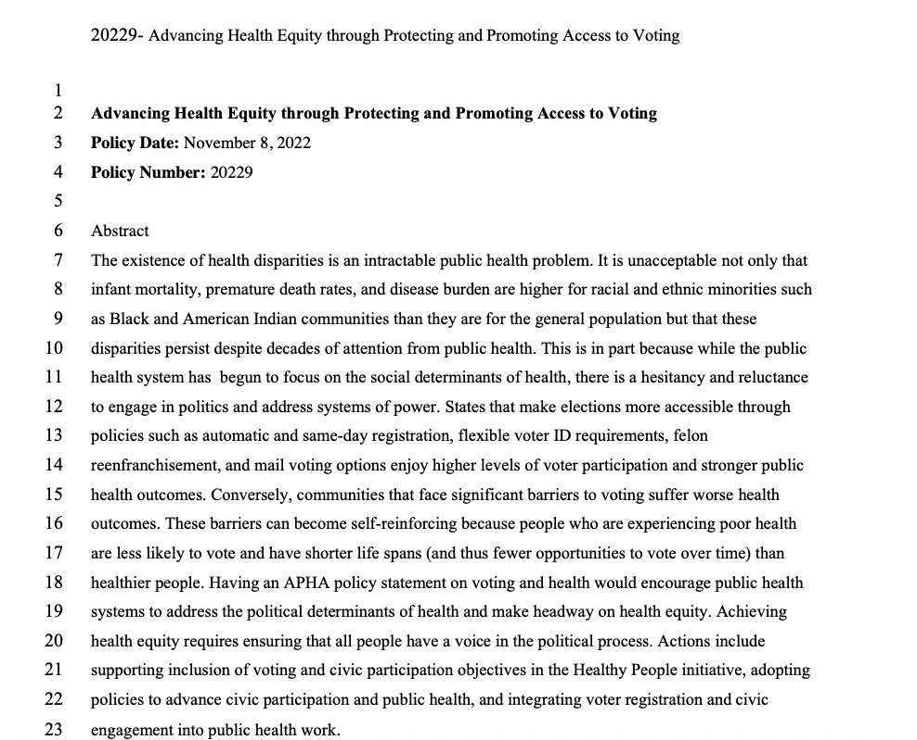
APHA Policy Statement 20229: Advancing Health Equity Through Protecting and Promoting Access to Voting
Approved on November 8, 2022!
https://www.apha.org/Policies-and-Advocacy/Public-Health-Policy-Statements/Policy-Database/2023/01/18/Access-to-Voting

Slide 49
The Power of Partnership
Influenced by:
A sign-on letter in April 2021 advocating for the inclusion of voting metrics in Healthy People 2030
The launch of the Health & Democracy Index in August 2021
Submission of public comments in response to a Request for Information in January 2022
A letter to the Biden Administration in September 2022

Slide 50
Take Action!
YOU
YOUR ORGANIZATION
Make sure you are registered to vote, know your election dates, and are familiar with the issues impacting your community.
Pay attention to and vote in local elections – these determine how people experience life day-to-day (home, work, school, recreation).
Get involved in your community! Volunteering is good for your health and the health of your community.
Ensure there are policies that support engagement (time off to vote, leave for serving as a poll worker).
Host town halls or other community sessions with local elected officials on public health issues.
Engage in non-partisan voter education and voter registration efforts. See Vote411.
If you can’t do any of these things directly – be a good partner!
Incorporate civic health strategies into existing community engagement processes.

Slide 51
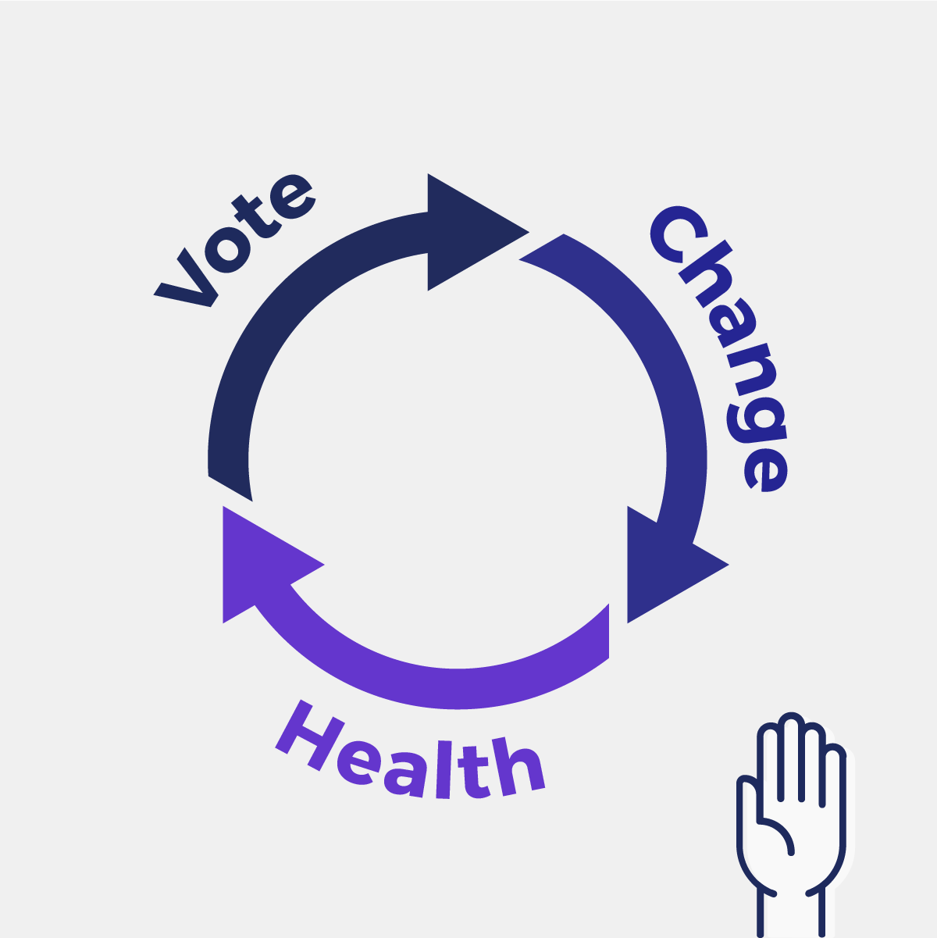
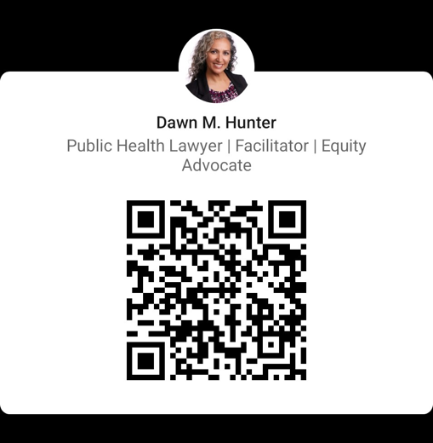
Thank you!
Dawn Hunter
dhunter@networkforphl.org
LinkedIn:

