Slide 1
“
FLORIDA CIVIC ADVANCE 2023 SUMMIT PROGRAM
Civic Health for the Whole Community:
From Data to Community Action and Results
October 26, 2023, 1:30 pm- 8:30 pm
October 27, 2023, 8:30 am-3:00 pm
Center for Health Equity St. Peterburg, Florida
Advancing Civic Health in Florida’s Communities

Slide 2
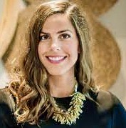
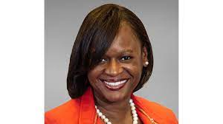
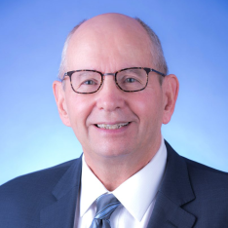
Welcome and Introductions
“
Ashley Dietz,
Co-host, CEO Florida Philanthropy Network
FCA Board Member
Dr. Kanika Tomalin, President and CEO, Foundation for a Healthy St. Petersburg
Jim Murley, Chief Resiliency Officer, Miami Dade County,
President, Florida Civic Advance Board

Slide 3
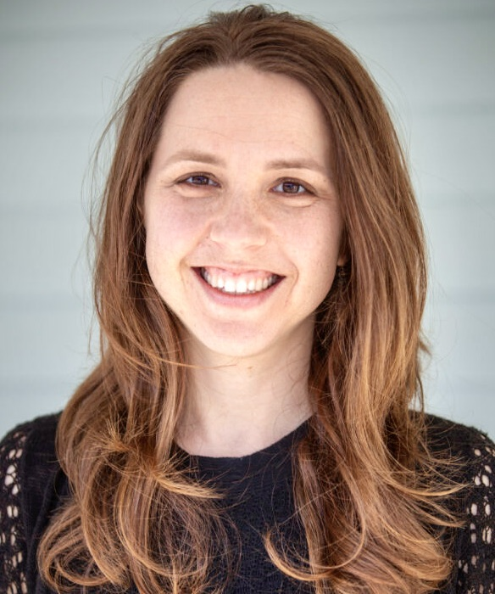
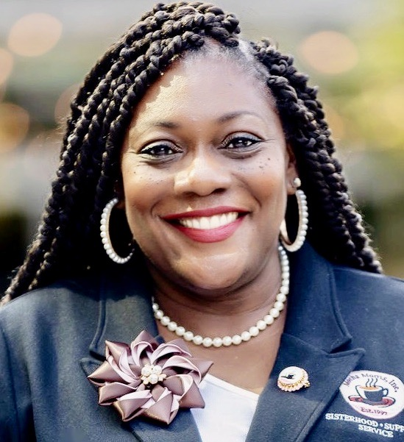
Welcome and Introductions World Café Hosts
“
Ashley Cooper, World Café Co-host, Ashville, North Carolina
Danae Aicher, World Café Co-host,
Oviedo, Florida

Slide 4
Welcome and Introductions Welcome on behalf of Florida Civic Advance The Florida Civic Advance’s mission is to advance the civic health in Florida communities We are a nonpartisan Florida nonprofit membership organization We are having this important conversation about civic health in Florida’s communities the midst of crisis and polarization Together we will explore and identify civic strategies and tools you can take home to advance the civic health of your community .

Slide 5
Welcome and Introductions Thanks to the FCA Summit Planning Team Kyandra Darling, Center for Health Equity Bola Adeshina, The Peace Workout Ingrid Bredenburg, M.A Ashley Cooper, World Café Host Danae Aicher, World Café Host Jeff Johnson, AARP, FCA Board Member Emery Ivery, FCA Board Member Ashley Dietz, Florida Philanthropic Network, FCA Board Member Jim Murley, FCA Board President, Chief Resiliency Officer, Miami Dade County

Slide 6
Florida Civic Advance Advancing Civic Health in Florida’s Communities
FLORIDA CIVIC ADVANCE 2023 SUMMIT PROGRAM AT A GLANCE
Civic Health for the Whole Community: From Data to Community Action and Results
October 26, 2023, 1:30 pm- 8:30 pm, October 27, 2023, 8:30 am-3:00 pm
Day One, Thursday, October 26, 2023
12:30 pm- Registration, sign in, snack and afternoon refreshments
1:00 pm Opening, Welcome Remarks and Overview of Summit Objectives and Introduction of Summit Sponsors,
Introduction of World Café Host Team
1:15 Understanding Civic Health - How to Measure It, Why It Matters, and How It Can Transform Democracy –
Quixada Moore-Vissing, PhD
2:15 Equity in Measurements of Civic Health and Infrastructure, Joseph K. Hoereth, PhD,
3:00 Coffee Break- Sponsored by the Allegany Franciscan Ministries
3:15 Case Study- Miami Dade County Thrive 305 Initiative and Civic Health, Patrick Morris, Senior & Jim Murley
3:45 Introduction to World Café- Host Team: Ashley Cooper & Danae Aicher
5:20 Stretch Break
5:30 Keynote- The Working Cities Challenge and Civic Health, Richard C. Walker III
6:15 Reception- Sponsored by The Central Florida Foundation
7:00 Dinner at the Center- Sponsored by Local Voices United
7:30 Dinner Keynote: Public Engagement on Race and Equity, Matt Leighninger
8:45 pm Recess

Slide 7
Florida Civic Advance Advancing Civic Health in Florida’s Communities
FLORIDA CIVIC ADVANCE 2023 SUMMIT PROGRAM AT A GLANCE
Civic Health for the Whole Community: From Data to Community Action and Results
October 26, 2023, 1:30 pm- 8:30 pm, October 27, 2023, 8:30 am-3:00 pm
Day Two, Friday, October 27, 2023
8:00 am Registration, sign in, and continental breakfast.
8:30 Welcome, Overview of Day Two Agenda
8:35 Public Health, Civic Health, and Equity: What are the Connections? Dawn Hunter,
9:15 Case Study- 2019 St. Petersburg Civic Health Study- Tim Dutton, Linsey Grove, & Veatrice Farrell,
10:05 Case Study- Gulfport on the Edge: Community Conversations bring Neighbors Together, Ingrid Bredenberg,
Bredenberg Associates
10:45 Coffee Break- Sponsored by the Allegany Franciscan Ministries
11:00 World Café- Round Table Conversations- Civic Health and My Home Community - Possibilities for Action
12:15 Lunch
12:30 Lunch Keynote: Expanding Civic Health in Florida- Thoughts on the Media, Communication and Community- Cameron Hickey, CEO National Conference on Citizenship, Introduction Hon. Dennis Ross
1:45 Town Hall- Civic Health and the Whole Community- Civic Health and My Home Community- What We’re Learning -World Café Hosts.
2:30 Next Steps, Closing Thoughts, Thanks, and Summit Evaluations.
3:00 pm Adjourn and Safe Travels

Slide 8
Florida Civic Advance Advancing Civic Health in Florida’s Communities
Summit Sponsors
Stuart Langton Associates

Slide 9
“
FLORIDA CIVIC ADVANCE 2023 SUMMIT PROGRAM
Civic Health for the Whole Community:
From Data to Community Action and Results
DAY ONE
Advancing Civic Health in Florida’s Communities

Slide 10
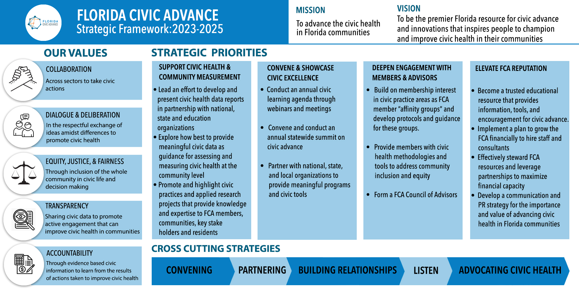
Advancing Civic Health in Florida’s Communities

Slide 11
Florida Civic Advance Advancing Civic Health in Florida’s Communities WHAT IS CIVIC HEALTH
“Civic health reflects the opportunities people have to participate in their communities.”

Slide 12
Florida Civic Advance Advancing Civic Health in Florida’s Communities WHAT IS CIVIC HEALTH
Civic health is connected to how long and how well we live, and relates to:
The overall wellbeing of residents, neighborhoods, and communities,
Using their voices to find solutions together
To improve and strengthen the community

Slide 13
Florida Civic Advance Advancing Civic Health in Florida’s Communities WHAT IS CIVIC HEALTH
Communities with strong indicators of civic health have:
.
Higher employment rates | Accessible civic gathering places in libraries & parks
Stronger schools | More responsive local governments, and
Better individual physical health | Their residents live longer healthier lives

Slide 14
Florida Civic Advance Advancing Civic Health in Florida’s Communities FLORIDA’S CIVIC HEALTH CHALLENGE
Florida, the 3rd largest state, ranks among the lowest states in terms of civic health. We want to change that.
50th in nation in volunteering among 50 states (2015)
49th in belonging to a civic organization (2013)
50th in donating to charity (2015)
50th in helping neighbors fix a community problem (2015) and
50th attending public meetings (2015)

Slide 15
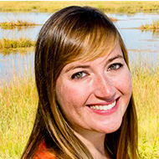
Florida Civic Advance Advancing Civic Health in Florida’s Communities
Understanding Civic Health - How to Measure It, Why It Matters, and How It Can Transform Democracy
Quixada Moore-Vissing, PhD - President of Public Engagement Partners, Faculty Fellow, Carsey School of Public Policy at the University of New Hampshire
Introduction: Ashley Dietz, FCA Board Membe

Slide 16
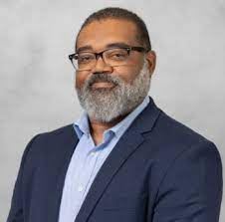
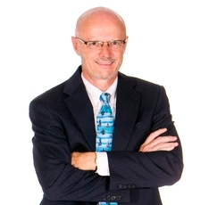
Florida Civic Advance Advancing Civic Health in Florida’s Communities
Equity in Measurements of Civic Health and Infrastructure
Joseph K. Hoereth, PhD, has served as Director, Institute for Policy and Civic Engagement (IPCE), University of Illinois, Chicago,
Introduction: Tim Dutton, FCA Board Member

Slide 17
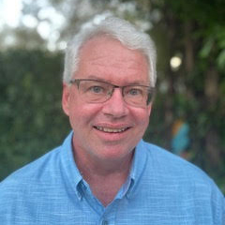
Florida Civic Advance Advancing Civic Health in Florida’s Communities
Case Study- Miami Dade County Thrive 305 Initiative and Civic Health
Patrick Morris, Senior Manager Civic & Philanthropic Partnerships, Miami Dade County
Jim Murley, Chief Resiliency Officer, Miami Dade County

Slide 18
Coffee Break Sponsor

Slide 19
Introduction to World Café
Ashley Cooper, World Café Co-host, Ashville, North Carolina
Danae Aicher, World Café Co-host,
Oviedo, Florida

Slide 20
Introduction to World Café

Slide 21
Introduction to World Café
Conversations that Matter- Initial Round
Civic Health and My Home Community - Opportunities and Challenges

Slide 22
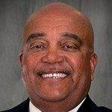
Florida Civic Advance Advancing Civic Health in Florida’s Communities
The Working Cities Challenge and Civic Health
Richard C. Walker III, Former Senior VP Federal Reserve Bank, Boston, Harvard Advance Leadership Institute Fellow. Introduced by Emery Ivery, FCA Board Member
Introduction: Emery Ivery, FCA Board Member

Slide 23
Florida Civic Advance Advancing Civic Health in Florida’s Communities
Sponsor, FCA Summit Reception

Slide 24
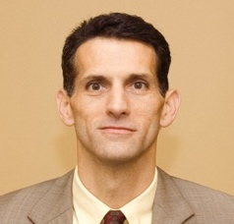
Florida Civic Advance Advancing Civic Health in Florida’s Communities
Sponsor, Dinner Keynote
Scott Dudley, Director, Legislative Affairs at Florida League of Cities

Slide 25
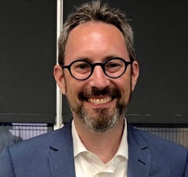
Florida Civic Advance Advancing Civic Health in Florida’s Communities
What Have We Learned from Public Engagement on Race and Equity
Matt Leighninger, Director, Center for Democracy Innovation, National Civic League,
Introduction: Tim Dutton, FCA Board Member

Slide 26
“
FLORIDA CIVIC ADVANCE 2023 SUMMIT PROGRAM
Civic Health for the Whole Community:
From Data to Community Action and Results
Recess
Advancing Civic Health in Florida’s Communities

Slide 27
“
FLORIDA CIVIC ADVANCE 2023 SUMMIT PROGRAM
Civic Health for the Whole Community:
From Data to Community Action and Results
DAY TWO
Advancing Civic Health in Florida’s Communities

Slide 28
Florida Civic Advance Advancing Civic Health in Florida’s Communities
FLORIDA CIVIC ADVANCE 2023 SUMMIT PROGRAM AT A GLANCE
Civic Health for the Whole Community: From Data to Community Action and Results
October 26, 2023, 1:30 pm- 8:30 pm, October 27, 2023, 8:30 am-3:00 pm
Day Two, Friday, October 27, 2023
8:00 am Registration, sign in, and continental breakfast.
8:30 Welcome, Overview of Day Two Agenda
8:35 Public Health, Civic Health, and Equity: What are the Connections? Dawn Hunter,
9:15 Case Study- 2019 St. Petersburg Civic Health Study- Tim Dutton, Linsey Grove, & Veatrice Farrell,
10:05 Case Study- Gulfport on the Edge: Community Conversations bring Neighbors Together, Ingrid Bredenberg,
Bredenberg Associates
10:45 Coffee Break- Sponsored by the Allegany Franciscan Ministries
11:00 World Café- Round Table Conversations- Civic Health and My Home Community - Possibilities for Action
12:15 Lunch
12:30 Lunch Keynote: Expanding Civic Health in Florida- Thoughts on the Media, Communication and Community- Cameron Hickey, CEO National Conference on Citizenship, Introduction Hon. Dennis Ross
1:45 Town Hall- Civic Health and the Whole Community- Civic Health and My Home Community- What We’re Learning -World Café Hosts.
2:30 Next Steps, Closing Thoughts, Thanks, and Summit Evaluations.
3:00 pm Adjourn and Safe Travels

Slide 29
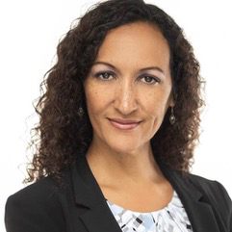
Florida Civic Advance Advancing Civic Health in Florida’s Communities
Public Health, Civic Health, and Equity: What are the Connections?
Dawn Hunter, Network for Public Health Law, Director of the Southeastern Region Office.
Introduction: Tim Dutton, FCA Board Member

Slide 30
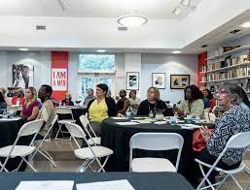
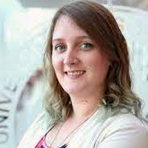
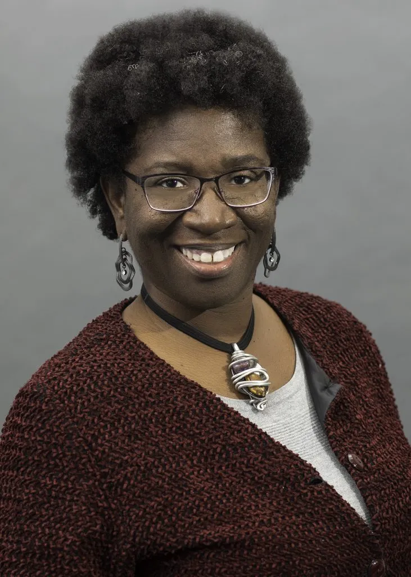
Case Study 2019 St Petersburg Civic Health Study Advancing Civic Health in Florida’s Communities
Interviewer: Tim Dutton,
FCA Board Member
Linsey Grove, , DrPH, MPH, CPH, St Petersburg Area League of Women Voters,
Veatrice Ferrell, Community Foundation of Tampa Bay, Director, Digital Inclusion Program. I

Slide 31
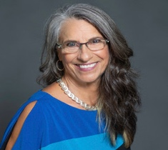
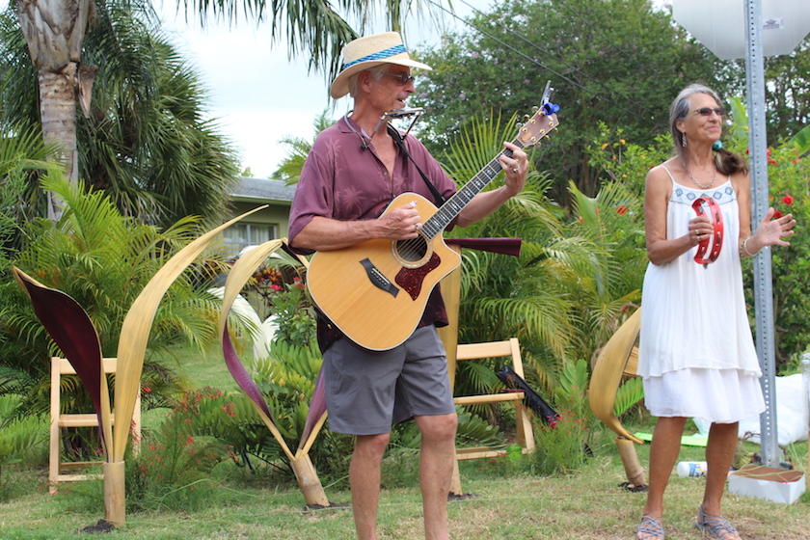
Case Study Advancing Civic Health in Florida’s Communities
Gulfport on the Edge: Community Conversations Bring Neighbors Together
Ingrid Bretenberg, Bretenberg Associates, Gulfport
Berkeley Grimball, Artist, Musician

Slide 32
Coffee Break Sponsor

Slide 33
Civic Health and My Home Community - Possibilities for Action
Ashley Cooper, World Café Co-host, Ashville, North Carolina
Danae Aicher, World Café Co-host,
Oviedo, Florida

Slide 34
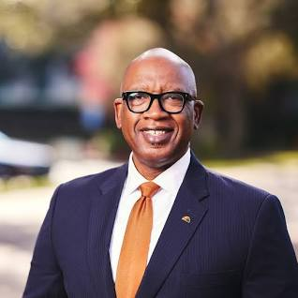
Florida Civic Advance Advancing Civic Health in Florida’s Communities
Lunch Welcome
Mayor Ken Welch, St. Petersburg, Florida

Slide 35
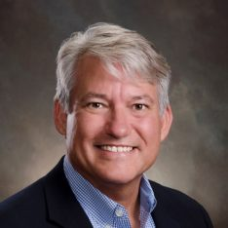
Florida Civic Advance Advancing Civic Health in Florida’s Communities
Lunch Keynote
Expanding Civic Health in Florida- Thoughts on the Media, Communication and Community
Cameron Hickey, CEO National Conference on Citizenship,
Introduced by Dennis Ross, FCA Board Member

Slide 36
Florida Civic Advance Advancing Civic Health in Florida’s Communities
Mayor Ken Welch, St. Petersburg, Florida

Slide 37
Florida Civic Advance Advancing Civic Health in Florida’s Communities
Next Steps, Closing Thoughts, Thanks, and Summit Evaluations
FCA Civic Health Index Initiative 2024 Launch Announcement
& Florida Local Health Guide

Slide 38
Town Hall- Civic Health and the Whole Community Civic Health and My Home Community What We’re Learning & Next Steps- World Café Hosts.
Ashley Cooper, World Café Co-host, Ashville, North Carolina
Danae Aicher, World Café Co-host,
Oviedo, Florida

Slide 39
Florida Civic Advance Advancing Civic Health in Florida’s Communities
Join us in advancing civic health in Florida’s communities!
Florida Civic Advance Membership
We welcome organizations and individuals to join as FCA members to build together a new nonprofit membership network dedicated to increasing civic practices and advancing civic health in Florida’s communities
https://floridacivicadvance.com/membership/

Slide 40
Florida Civic Advance Advancing Civic Health in Florida’s Communities
Summit Sponsors
Stuart Langton Associates

Slide 41
Florida Civic Advance Advancing Civic Health in Florida’s Communities
Join us in advancing civic health in Florida’s communities!
Florida Civic Advance Membership
We welcome organizations and individuals to join as FCA members to build together a new nonprofit membership network dedicated to increasing civic practices and advancing civic health in Florida’s communities
https://floridacivicadvance.com/membership/

Slide 42
Florida Civic Advance Advancing Civic Excellence in Florida’s Communities
FCA Website
https://www.floridacivicadvance.com
Membership Benefits and Application
https://floridacivicadvance.com/membership/

Slide 43
Florida Civic Advance Advancing Civic Health in Florida’s Communities
https://www.floridacivicadvance.com

