Slide 1
Advancing Civic Health in Florida’s Communities
FCA Third Thursday 2024 Webinar Series
https://floridacivicadvance.com

Slide 2
Florida Civic Advance Advancing Civic Health in Florida’s Communities
FCA Third Thursdays Webinar
Thursday, January 18, 2024, 12-1 pm, ET
“Is Belonging at the Heart of Civic Health?
The Greater Seattle Compact for Belonging”

Slide 3
Florida Civic Advance Advancing Civic Health in Florida’s Communities Webinar Zoom Housekeeping
Place your device on Mute till the Q&A
The FCA conducts nonpartisan webinars
Show respect for the speakers and each other
Please use “Chat” to share questions, comments and/or links
to resources.
We will try to have the speakers answer your questions during the presentations
We will have an open Q & A after the presentations

Slide 4
Florida Civic Advance Advancing Civic Health in Florida’s Communities WHAT IS CIVIC HEALTH
“Civic health reflects the opportunities for people to have a voice and to participate in their communities to find solutions together.”

Slide 5
Florida Civic Advance Advancing Civic Health in Florida’s Communities WHAT IS CIVIC HEALTH
Communities with strong indicators of civic health have:
.
Higher employment rates | Accessible civic gathering places in libraries & parks
Stronger schools | More responsive local governments, and
Better individual physical health | Their residents live longer healthier lives

Slide 6
Florida Civic Advance Advancing Civic Health in Florida’s Communities FLORIDA’S CIVIC HEALTH CHALLENGE
Florida, the 3rd largest state, ranks among the lowest states in terms of civic health. We want to change that.
50th in nation in volunteering among 50 states (2015)
49th in belonging to a civic organization (2013)
50th in donating to charity (2015)
50th in helping neighbors fix a community problem (2015) and
50th attending public meetings (2015)

Slide 7
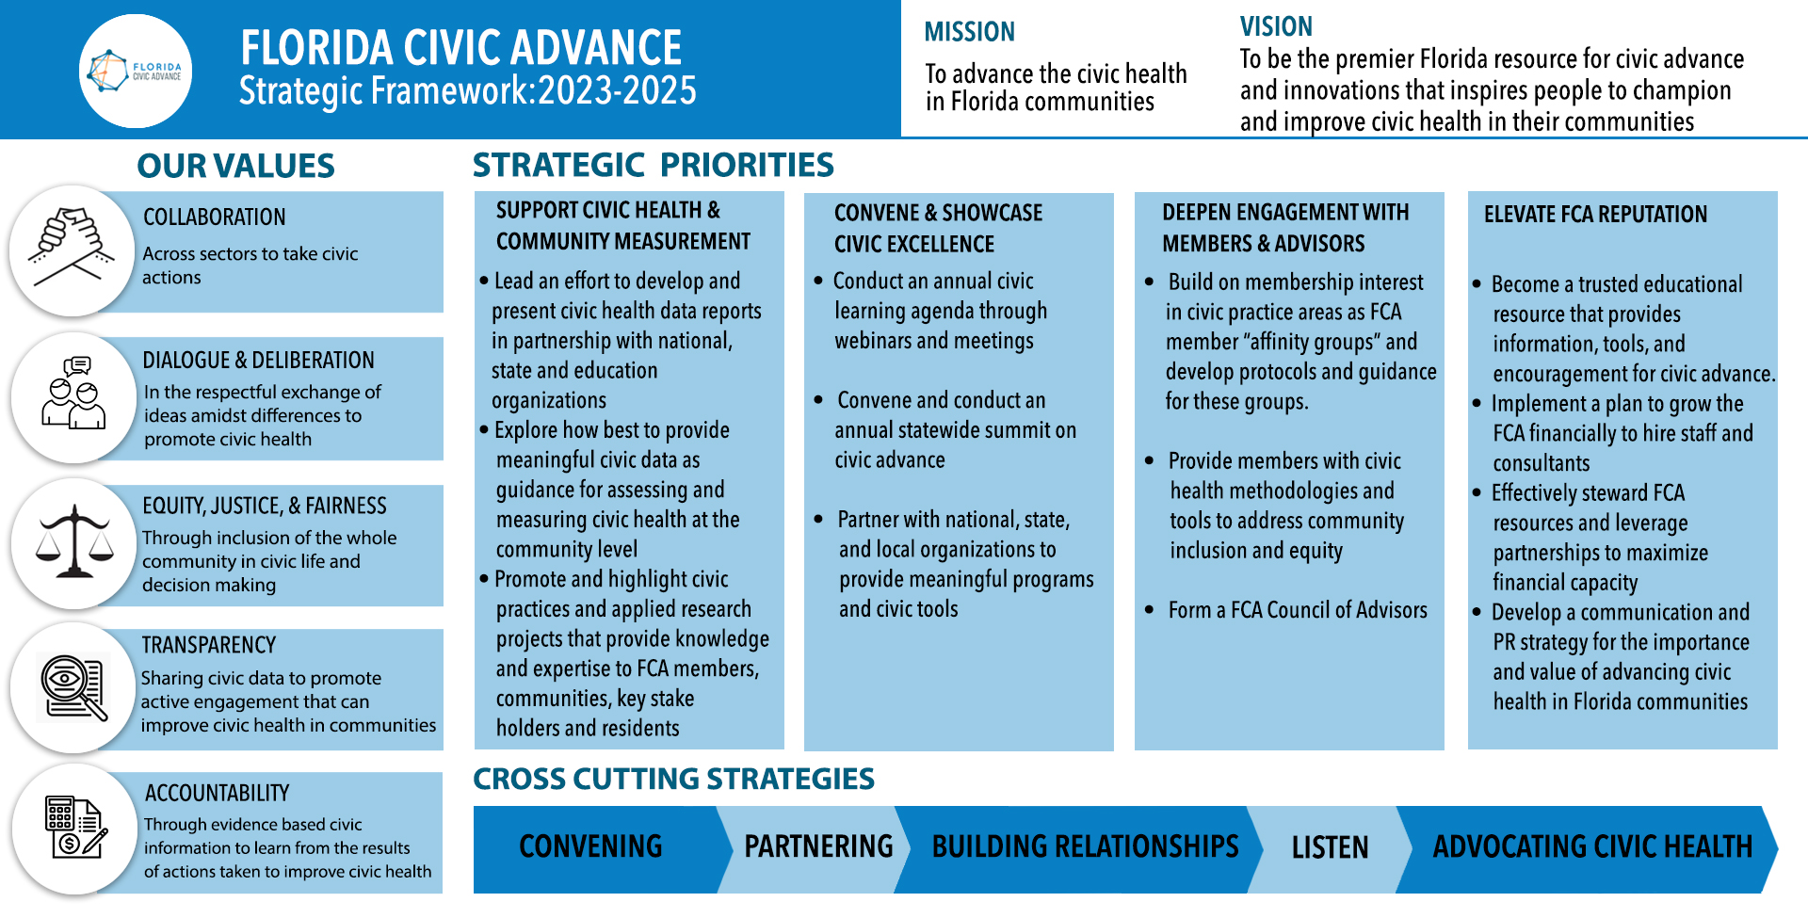
Advancing Civic Health in Florida’s Communities

Slide 8
Introducing the Presenters
Is Belonging the Heart of Civic Health?
Tim Dutton, FCA Board Member, Sarasota
Quixada Moore-Vissing, Public Engagement Partners, Maine

Slide 9
Is Belonging the Heart of Civic Health?
What do you want to Learn From Today’s Webinar?
Who? What? How?
Who: Hearing from Quixada Moore-Vissing
What: How does belonging apply to underserved communities? What is a belonging strategy?
How: Funding the work. How does this connect with civic engagement and civic health? How to produce a belonging movement? How does belonging connect with deliberative democracy?

Slide 10
Florida Civic Advance Advancing Civic Health in Florida’s Communities
FCA Third Thursdays Webinar
Thursday, February 15 , 2024, 12-1:00 pm EDT
Civic Health and Youth:
Stetson University Law Youth Civic Engagement Program
The Youth Civic Engagement program is a free weeklong hybrid program that teaches students how to empower themselves and others to become catalysts for positive social change through civic education and advocacy.
See FCA Website for registration:

Slide 11
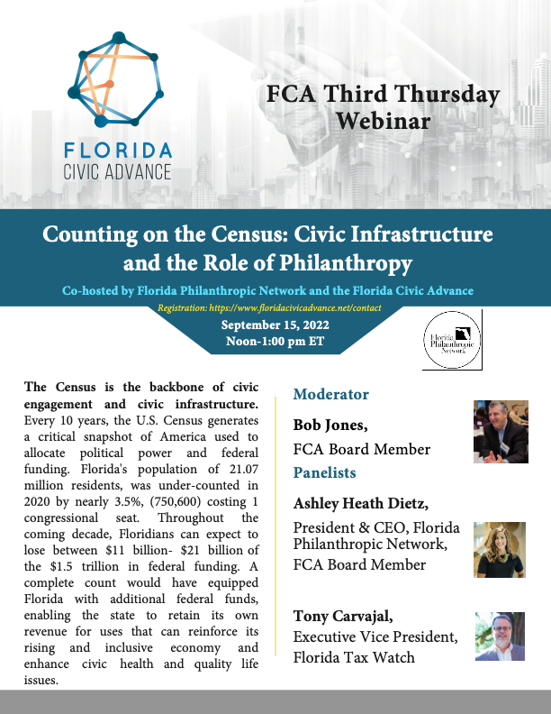
Florida Civic Advance Advancing Civic Excellence in Florida’s Communities
In Case You Missed Past FCA Civic Excellence Webinars
Visit our website: https://www.floridacivicadvance.net

Slide 12
Florida Civic Advance Advancing Civic Health in Florida’s Communities
Join us in advancing civic health in Florida’s communities!
Florida Civic Advance Membership
We welcome organizations and individuals to join as FCA members to build together a new nonprofit membership network dedicated to increasing civic practices and advancing civic health in Florida’s communities
https://floridacivicadvance.com/membership/

Slide 13
Florida Civic Advance Advancing Civic Excellence in Florida’s Communities
FCA Website
https://www.floridacivicadvance.com
Membership Benefits and Application
https://floridacivicadvance.com/membership/

Slide 14
Florida Civic Advance Advancing Civic Health in Florida’s Communities
https://www.floridacivicadvance.com

