Slide 1
Engage St. Pete:
A community-based approach to understanding civic health and health equity
Presented by: Dr. Linsey Grove, DrPH, MPH, CPH
Co-Authors: Amy Keith, MPA, Susie Patterson, PhD, Julie Kessell, MD

Slide 2
Acknowledgement
This project was funded by the Foundation for a Healthy St. Petersburg.

Slide 3
St. Petersburg Profile
Fifth most populous city in Florida
Second largest city in the Tampa Bay Area
Geographically segregated

Slide 4
Civic health and public health
Civic health is “the way that communities are organized to define and address public problems.”
Civically engaged communities tend to enjoy higher levels of self-reported health, income, employment and education.
Communities with poor health outcomes are less likely to engage in policy making and political participation.
Marginalized communities often face greater barriers to both health and wellness and to democratic participation.
Notes:
Slide purpose: Speaking to the broad definition we used of civic health that looked at a broad range of engagement. And intersection of civic health and community/public health.
“The project adopted a broad definition, encompassing formal and informal political, community, and neighborhood engagement, as well as perceptions of trust and cohesion.“...”There are many ways for people to be civically engaged: voting, volunteering, attending public meetings, contacting elected representatives, organizing neighbors for a common activity, joining a local organization, donating to causes impacting the community, and many more.”

Slide 5
Civic health information gap
St. Petersburg’s lowest score on the 2016 STAR Community Rating System™ assessment was in the Equity and Empowerment category, which includes measures of civic engagement and other social determinants of health.
The City lacked data on resident empowerment, volunteerism, and perceptions of community cohesion.
Overall lack of information on differences and similarities across demographics, place, and economic status, with respect to civic health and engagement.

Slide 6
Research goal:
Fill the civic engagement information gap to provide an evidence base for moving towards greater and more equitable citizen voice in decision-making and policy outcomes.

Slide 7
St. Pete Civic Health Survey
Survey based on measures from
National Conference on Citizenship “Civic Health Index;”
National Civic League “Civic Index;”
The STAR Community Rating System.
Convenience sampling with a broad range of promotion/recruitment pathways.
First round of data collection exceeded the target sample, but was highly skewed. Men, young people and people of color were under-sampled.
Comparative analysis found that other local community surveys, including surveys with far more promotion resources, faced similar demographic challenges.
Notes:
Survey available online and in paper copy at selected public locations and events (e.g. recreation centers during after-school program pick up).
Promoted via social media (Twitter, Nextdoor, Facebook), e-mail outreach by community and City partners, paid advertisements in local print and online media, posters at public libraries, tabling at public locations/events, and canvassing with doorhangers by youth volunteers. In order to encourage responses from individuals who do not usually participate in community surveys, and thus may be less or differently civically engaged, an incentive was offered in the form of a random drawing for one of forty $25 Visa gift cards.

Slide 8
Whose voices are being heard in community surveys meant to inform policy decisions?

Slide 9
An adaptive, multi-modal approach
Shifted approach following initial skewed survey results
Community feedback had guided initial questionnaire design and survey dissemination, but this feedback was limited and proved insufficient
Survey results showed limits of LWV network and social capital as a majority-white community organization
Community outreach and qualitative data collection:
Focus groups and mini-interviews with civically disenfranchised individuals
Community review and feedback process with community groups and key informants
Survey re-opened for second round of targeted data collection (via text message) from under-sampled groups, based on learning from qualitative process
Notes:
Team determined that leaving the survey open for longer would likely continue producing similarly skewed data
Over twenty community review meetings and key informant interviews were conducted with local and community-based groups.
In total, the survey had 1,590 respondents, and 505 individual comments were collected through the survey and mini-interviews.
Community review process was important to increase authentic community-based participation as well as create a space for feedback that didn’t feel so “research-y”

Slide 10
Areas of Focus
Civic Satisfaction
Attitudes
Neighborhood Cohesion
Community Participation
Political Participation

Slide 11
Finding Highlights: Civic Satisfaction
Top 3 issues were the SAME among both satisfied and dissatisfied residents:
Concern about the pace and scale of development and new construction (notably high-rises)
Concern about availability of affordable housing
Concern about inequality, gentrification, and the city becoming too focused on the wealthy

Slide 12
Finding Highlights: Attitudes
84% of survey respondents believe they can have a positive impact on their community
Respondents who identified as Black were significantly less likely than respondents who identified as white to report that people like them have a say in local government decisions
During community review, organization leaders and members of the Black community described a history of distrust and broken promises from the local government
During focus group discussions, participants indicated that they believed they had the ability to voice concerns to local government, but they did not necessarily believe anyone would listen

Slide 13
Finding Highlights: Neighborhood Cohesion
A majority of respondents reported that people in their neighborhoods are willing to help their neighbors and that they generally get along with each other.
Analysis using a five-factor measure of neighborhood cohesion found no significant differences in terms of race, gender, or educational levels.
A significant difference was found between income levels: people who reported over 6 figure incomes reported higher levels of neighborhood cohesion than people who make less than $50,000 (the median income).
Notes:
In community review meetings there was a distinct theme with respect to the perceived impact that transience has on neighborhood cohesion. Homeownership, length of time someone had lived in their home, and family ties were perceived as increasing trust and participation in the neighborhood.
Some community review discussions highlighted the importance of having an organizer within the neighborhood who puts efforts into promoting social interaction.
In one community review meeting, the long hours and evening hours that many people work were highlighted as having a negative impact on cohesion.
Focus group participants spoke to this disinvestment by pointing out the lack of resources that exist in South St. Petersburg neighborhoods. One participant pointed out that these neighborhoods are “dealing with lack of funds. It’s hard to [get together as a community] with a lack of funds...When you start in a struggle, it’s hard to reach back and say ‘brother, I got you.’” Other participants pointed out specific differences between resources on the north side of the city versus the south side.
Many of the focus group participants discussed the importance of focusing on youth, specifically how important mentoring and modeling behavior is for their communities. There was an overall shared sense that one of the best ways to make a positive impact is through being
an example for youth.

Slide 14
Three major themes on neighborhood cohesion can be drawn from the focus groups with civically disenfranchised people:
self-preservation
lack of public investment
importance of intergenerational modeling

Slide 15
Finding Highlights: Community Participation
Respondents from the baby boomer generation volunteer the most, and millennial respondents volunteer the least.
Religious institutions represent hubs of engagement for the community in some parts of the city, for volunteering, donating, and helping each other out.
Over 87% of respondents reported donating at least twenty-five dollars or more in the past year.
The survey did not distinguish between donations to local, state, national, or international organizations. Thus, the high rate of donating may not benefit the St. Petersburg community directly.
Notes:
Respondents from one particular zip code, which encompasesses a large portion of St Petersburg’s historically black community, were significantly more likely to give to religious organizations compared to any other zip code. Community review meetings with leaders and members of the Black community also indicated the importance of churches as an avenue for participation.

Slide 16
Finding Highlights: Political Participation
86% of the voting age population of St. Petersburg was estimated to have been registered to vote and 66% of registered voters cast a ballot in the November 2018 General Election.
19.7% voted in the November 2019 municipal general elections.
Clusters of high and low voter turnout reflect long-standing issues of public investment, wealth, and race that impact voter access, confidence and disenfranchisement.
Community review participants highlighted the opportunity cost of engaging in public meetings and other city consultation processes: it takes considerable time and effort, and their participation appears to have little impact on decision-making.
Notes:
Survey respondents from 33704, which encompasses the high voter turnout cluster of Snell Isle, Crescent Heights and the Old Northeast, and is the most affluent zip code in the city, reported the highest percentages of contacting public and elected officials, signing petitions, and participating in public actions.
Even amongst very politically engaged citizens, there is dissatisfaction with “post election” engagement with government and elected officials.
Community review meetings highlighted dissatisfaction with the scheduling of public meetings during regular business hours, which is challenging for working people to attend. COVID-19 may actually produce improvements here. With public meetings - and participation in them by citizens - moving online, more citizens have the opportunity to engage. In the future, a hybrid model of online and in-person engagement may provide for maximum engagement by citizens amidst widely varying work schedules, obligations, access and abilities.
There was a palpable sense of frustration with community engagement processes that one participant summed up as “disempowerment through engagement.”

Slide 17
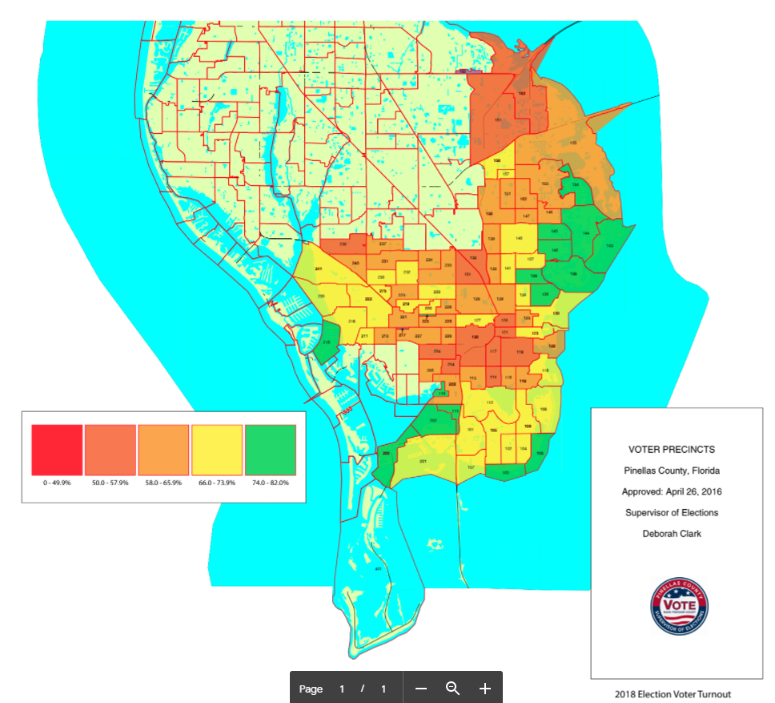
There is a cluster of high voter turnout in the neighborhoods just north of downtown and a cluster of low voter turnout in the neighborhoods just south of downtown.

Slide 18
Links to physical and mental health
The challenges faced in obtaining responses from men may be reflective of lower levels of community engagement by men more broadly, which may be a health concern especially as men age.
People who reported good to excellent health were significantly more likely to report believing they can have a positive impact on their community than people who reported fair or poor health.
People with self-reported good to excellent health were significantly more likely than people with fair health status to indicate that people like them have a say in local government.
However, there was no significant difference between people with self-reported good to excellent health status and people with poor health status.
Notes:
Some participants in community review discussions theorized that that older people may have poor health status and be less community engaged, but may feel empowered to have a say through voting and contacting officials.
During one community review meeting in South St. Petersburg, participants highlighted that men have more trouble than women finding work, staying civically engaged, volunteering, and getting training; in addition, many men are disenfranchised as a result of prior felony convictions.

Slide 19
Opportunities
Overall, St. Petersburg is an engaged city, with relatively high proportions of residents across city zip codes voting, volunteering, donating to charity, participating in the community, and seeking to engage in government decision-making processes.
If public decision-making processes are designed to facilitate participation and seek out learning from under-heard communities, the findings of this study lead us to believe that residents of St. Petersburg are ready for that engagement.
Results from elderly survey respondents suggest that while health is strongly tied to engagement, it need not be a barrier to engagement if people with poor health status have avenues and perceptions of access to decision-makers.

Slide 20
A lot of very different people across St. Petersburg have similar concerns about development and cost of living, as well as frustrations with public consultation processes. This can help galvanize discussion and action to ensure that growth is sustainable, equitable and inclusive.

Slide 21
Challenges
Overall concern, regardless of neighborhood or demographics, with respect to the responsiveness of city government to residents and about what interests are influencing city decision-making.
Sense that public consultation and engagement processes are not effectively being used to enable minority and marginalized groups to meaningfully influence city decision-making.
Notes:
This issue of equitable resident influence in decision-making is a particular challenge when combined with the number of concerns respondents raised that are linked to local policy decisions;

Slide 22
Historical and ongoing issues of racial injustice need to be proactively and equitably addressed.

Slide 23
Linked to concerns about equitable citizen influence on decision-making are concerns about the city’s direction on policies that impact social determinants of health:
Pace, scale and sustainability of development
Affordable housing
Inequality and gentrification

