Slide 1
What have we learned from public engagement on race and equity?
…and from the waves of civic innovation inspired (in part) by that work?
…and where do we go from here?
(a recent history, looking to the future)
Matt Leighninger, Center for Democracy Innovation at the National Civic League
Florida Civic Advance Summit
October 26th, 2023
Notes:
Dealing with pandemic, polarization, technology; Val Ramos victory lap

Slide 2
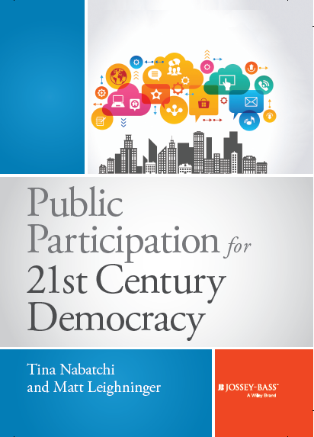
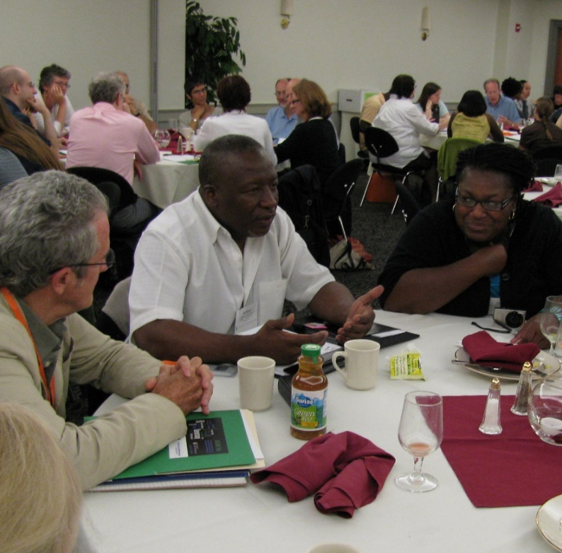
Matt Leighninger
• Grew up in Kalamazoo, Michigan
• Everyday Democracy, DDC, Public Agenda, NCoC
• Center for Democracy Innovation at NCL
• Writing, practice, convening
Interests:
• Creating better systems for democracy
• Weaving digital, face-to-face together
• Democracy innovation in Global South

Slide 3
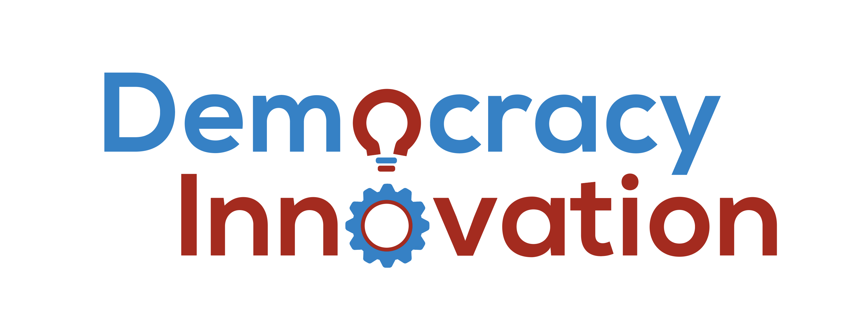
The Center for Democracy Innovation works to:
Sustain democracy by helping people redesign the “civic infrastructure” of their communities
Scale democracy through inclusive engagement to improve equity and governance
Measure the quality of democracy and engagement
Notes:
Incubated at NCoC, now based at NCL – how to save democracy is the wrong question – work of local civic leaders (work you are doing) leads us to the right question

Slide 4
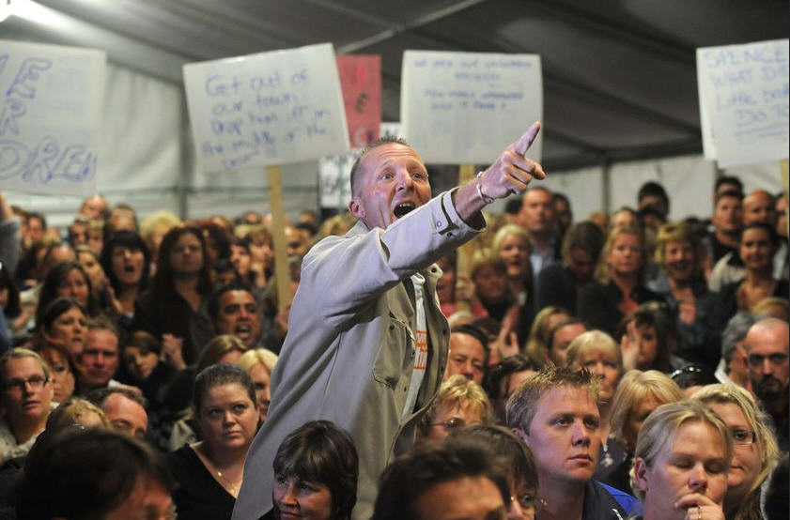
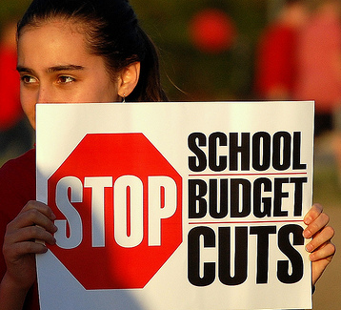
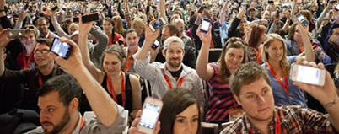
The big backdrop to this recent history – citizens have:
Higher levels of education (100-year trend)
Different attitudes toward authority (50-year trend)
Better able to find resources, allies, information (the Internet – 25-year trend)
* citizens = residents, people
Notes:
Why is civic innovation happening? Primary reason: changes in what “citizens” want and can contribute

Slide 5
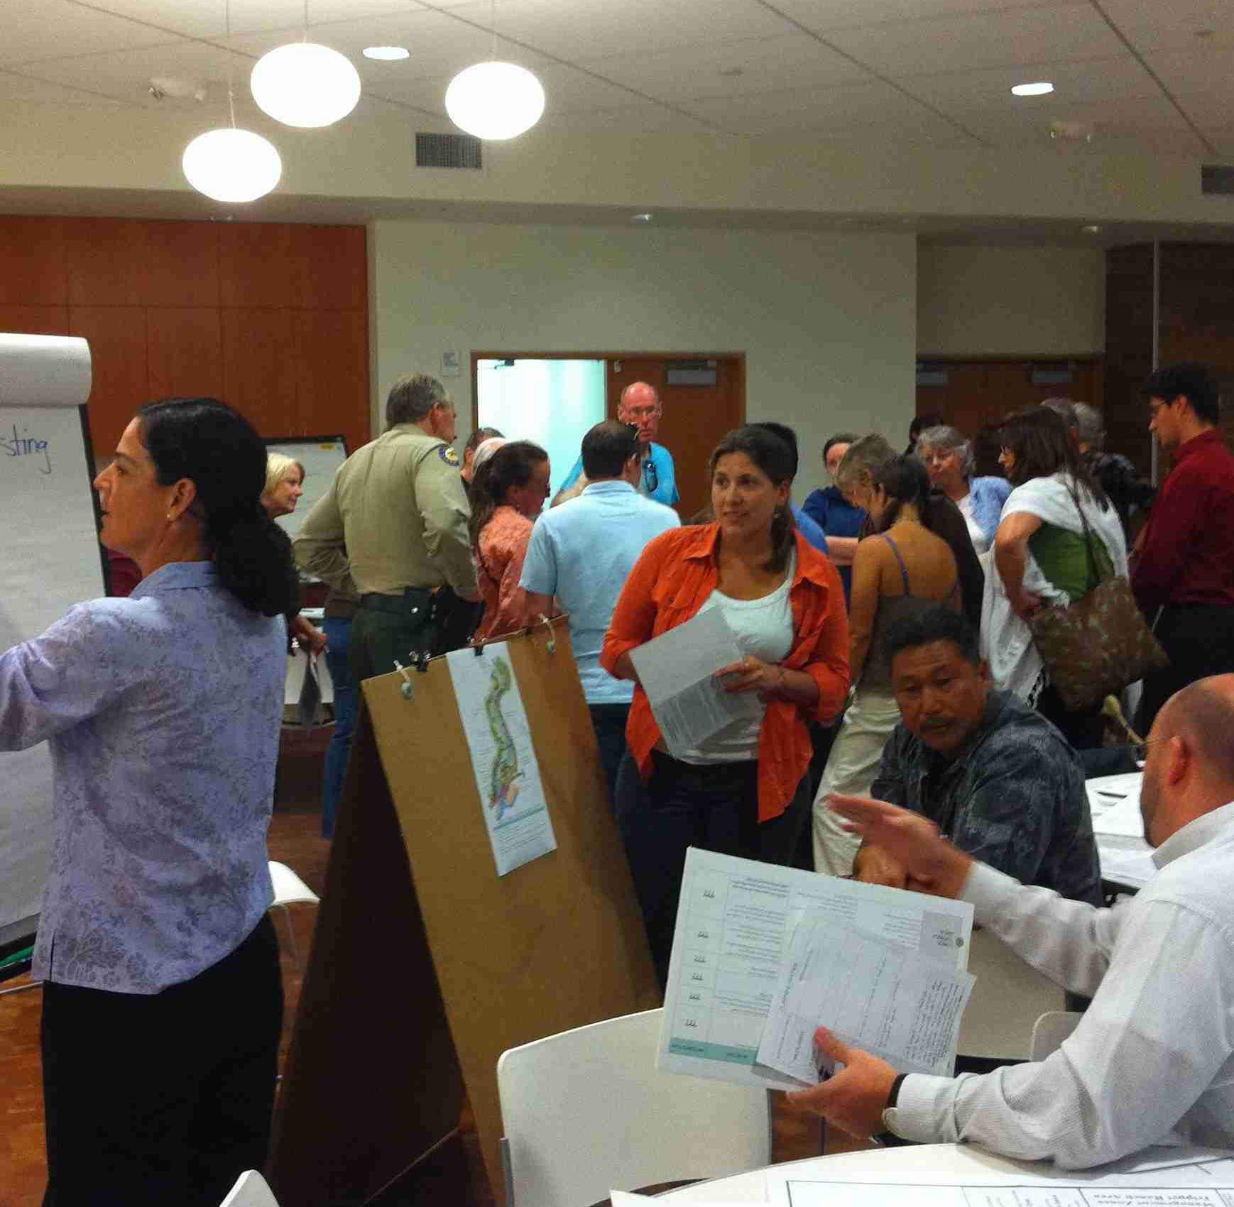
3 recent waves of civic innovation
First wave: Small-group deliberation, in the 1990s-2000s
Second wave: Digital platforms and tools, in the 2000s-2010s
Third wave: ?

Slide 6
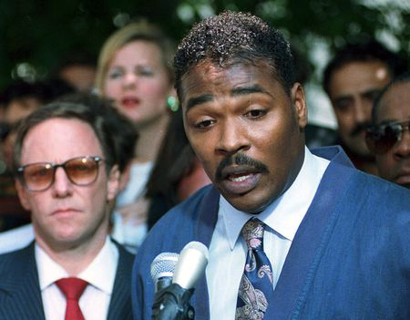
In the 1990s, a (seemingly) simple idea:
“Can’t we all just get along?”
Notes:
First wave

Slide 7
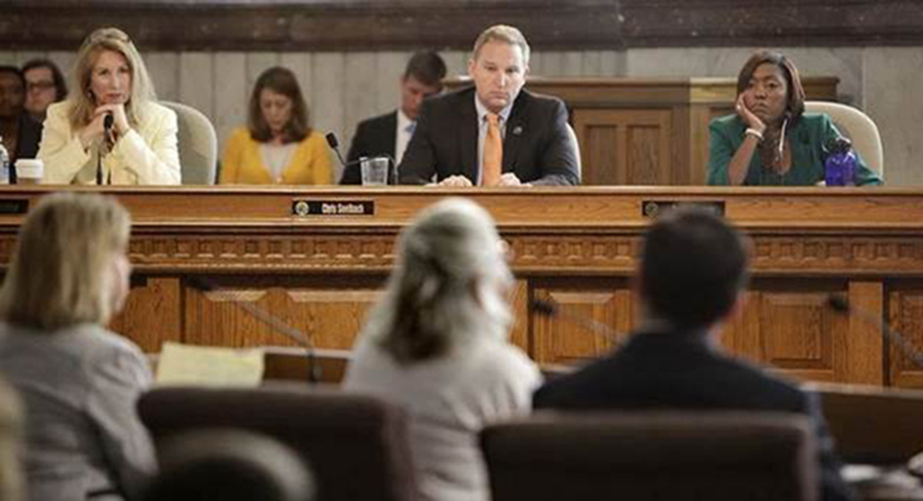
Race: Hard to address through conventional engagement

Slide 8
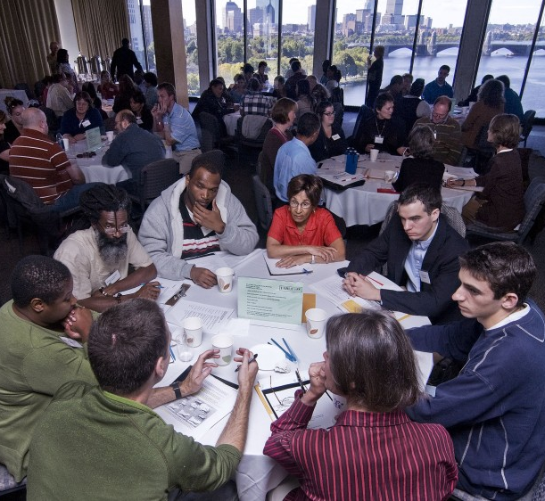
First wave of civic innovation: Small-group deliberation
• No more than 12 people per group
• Facilitator who is impartial (doesn’t give opinions)
• Start with people describing their experiences
• Lay out options
• Help people plan for action

Slide 9
“Thick” engagement:
Small groups, but big (diverse) numbers
A Dialogue-to-Change Engagement Framework
Organize
Dialogue
Action
Collective Action
Plan for Action
Facilitator Training
Kick Off
Action
Forum
Institutional and Policy Impact
Community Change
Set Goals
Recruit Participants & Facilitators
Individual Change

Slide 10
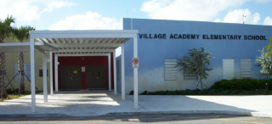
Typical local policy impacts of “thick” engagement in the 1990s
• Changed hiring practices (example: Springfield, IL)
• New facilities: schools, shopping centers, libraries (Delray Beach, Fort Myers)
• New policing strategies (Buffalo)
• Cultural festivals, fairs, parades (many places)
Notes:
But they didn’t change the institutions

Slide 11
“Thick” Engagement:
Encouraging citizen action
Capitalizing on the input and energy generated through the process

Slide 12
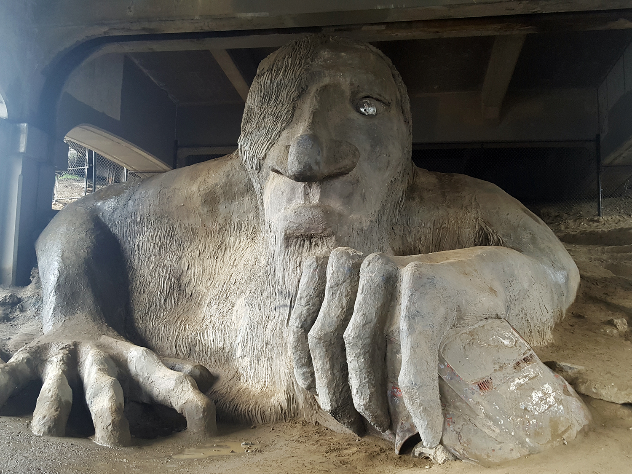
Notes:
concrete

Slide 13
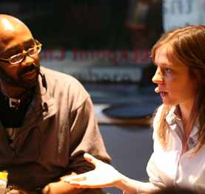
How engagement on race ‘set the template’
Emphasized importance of:
• Giving people chance to tell their stories
• Facilitation and ground rules set by the group
• Change at different levels – personal, volunteerism, policy
Notes:
Not just about information – about experience; not just about talk – about action

Slide 14
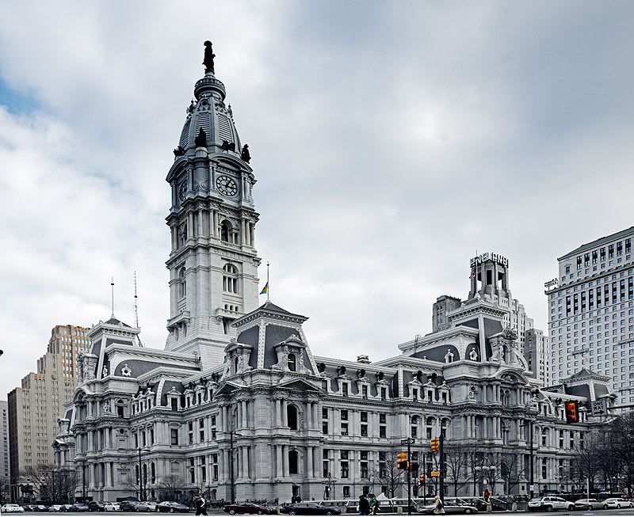
But this work did not change the institutions
• Lots of work for temporary gain
• Conventional engagement continues
• Inefficient – every organization on its own
• Community moves back to ‘politics as usual’
Notes:
Change slide

Slide 15
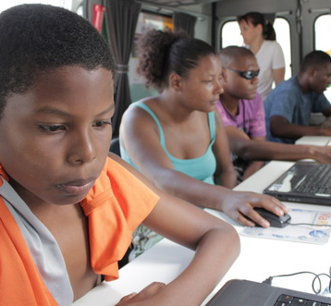
Second wave: Digital platforms and tools
• Empower the individual
• Chances to show a preference, contribute an idea, give a rating, donate money
• Digital divides: access, equipment, skill
• Fast, easy, convenient
• Closer to where people “are”
• Easier to scale, aggregate

Slide 16
“Thin” online engagement: A sampler
General Purpose | Examples
Crowdsourcing and Ideation | MindMixer; IdeaScale; OpenTownHall; SpigitEngage, Peak Democracy; Granicus; Codigital; Crowdbrite
Data Gathering and Feedback on Public Problems and Services | SeeClickFix; FixMyStreet; PublicStuff; Waze; NoiseTube
Crowdfunding | Citizinvestor; Neighbor.ly; Kickstarter; ioby
Petitions | Change.org
Games | Community PlanIt; City Creator; Super City
Mapping and Wikis | LocalWiki; Wikiplanning; MapIt; Mapumental; OpenStreetMap
Online deliberation | Common Ground for Action; Connecting with Congress

Slide 17
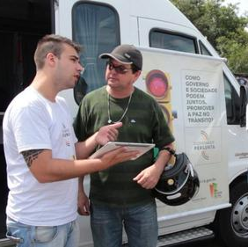
“The Government Asks”
Rio Grande do Sul, Brazil
• Crowdsourcing and voting on policy proposals
• Multichannel approach
• 360,000 votes cast for 3,600 proposals
• Impact on health, other policies
Notes:
Rio Grande do Sol - http://blogs.worldbank.org/publicsphere/node/5998

Slide 18
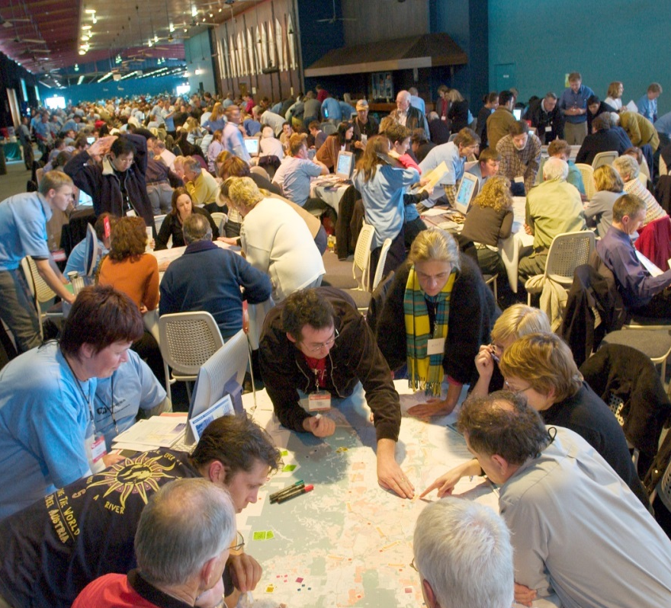
Proactive, network-based recruitment
Needed for thick and thin
Map community networks
Involve leaders of those networks
‘Who is least likely to participate?’
Use online as well as f2f connections
Follow up!
Notes:
Talk about flowers here

Slide 19
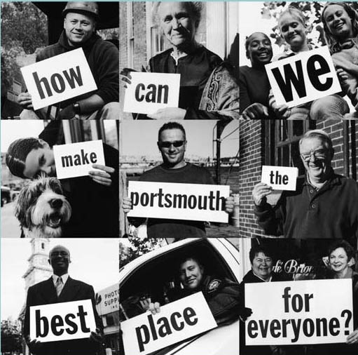
What does successful democracy look like?
Engagement opportunities that are regular (weekly or monthly) and highly social
Goals, data, discussions about addressing inequities
Opportunities that help emerging leaders step forward, get support
Give people a meaningful say on issues they care about, at polls and through engagement
Notes:
Or, to use the p. 7 definitions: democracy is civic engagement supported by civic infrastructure to improve civic health

Slide 20
What can we do? Change the civic infrastructure
Notes:
Conventional infrastructure for engagement is no longer equitable; this infrastructure was designed a century ago

Slide 22
What can we do?
Make sure our infrastructure fits our needs
Enabling
Small-Scale Decision Making
(individuals, families, groups, neighborhoods)
Enabling
Large-Scale Decision Making
(communities, cities, regions)
Encouraging Public Work
Thin
Participation
Conventional
Participation
Gathering Input and Data
Discussing and Connecting
Disseminating Information
Notes:
Don’t take the existing infrastructure as a given – decide what your community needs/wants and adapt the infrastructure to fit that

Slide 23
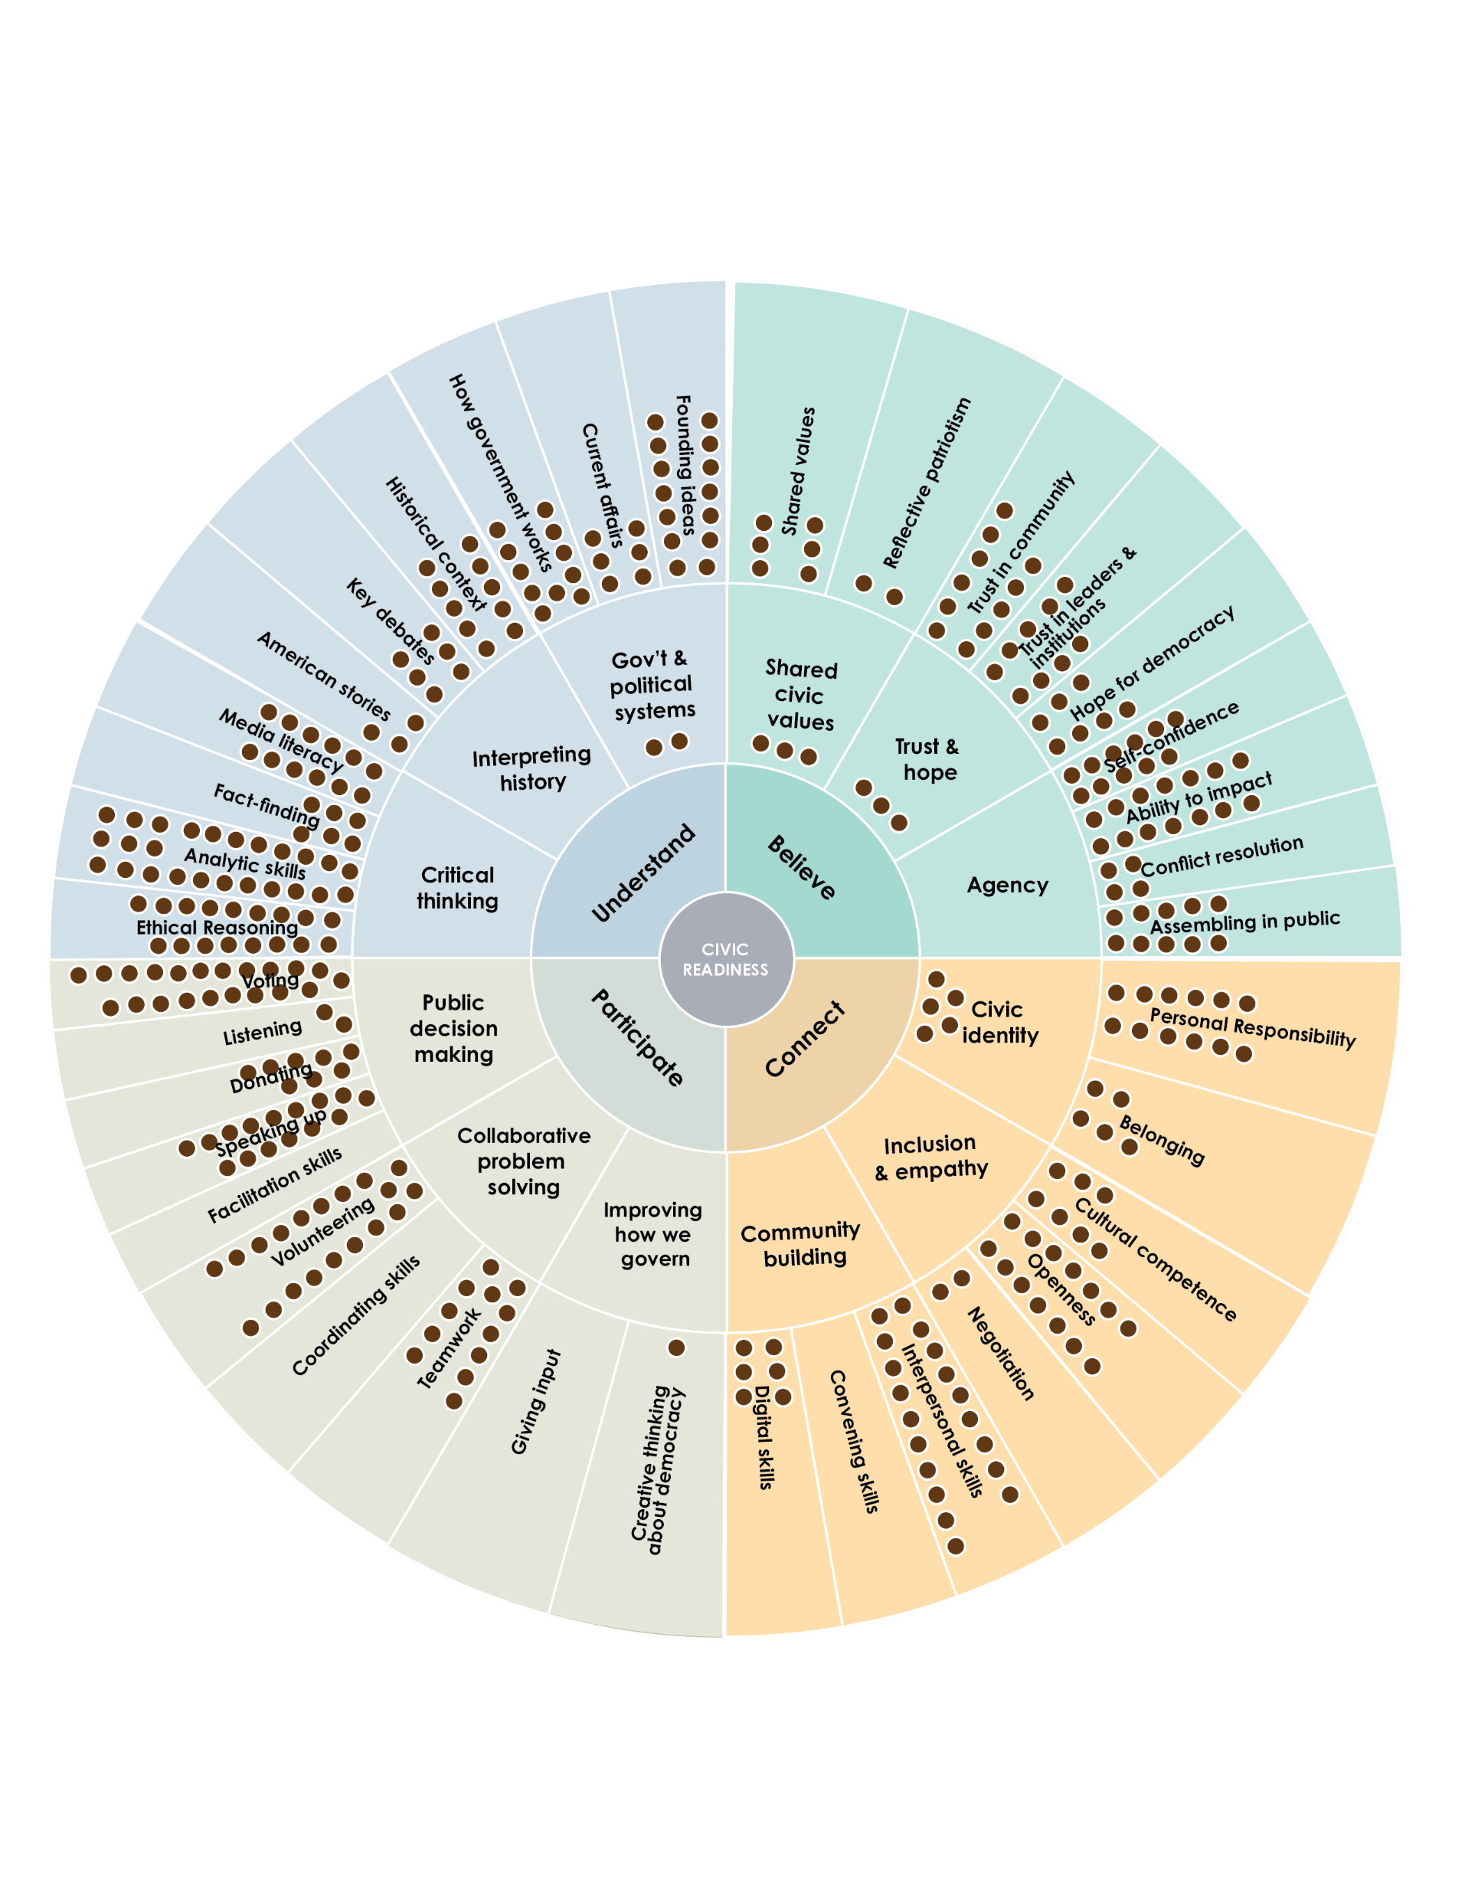
What can we do? Measure democracy
Measure both civic readiness (individuals) and civic opportunities (community)
To measure, have to define what’s important
A productive, bridging conversation in each community
(wheel is from Mapping Civic Measurement report, Inst. for Citizens and Scholars 2023)
Notes:
Refer to measurement sessions earlier today – mention Joe

Slide 24
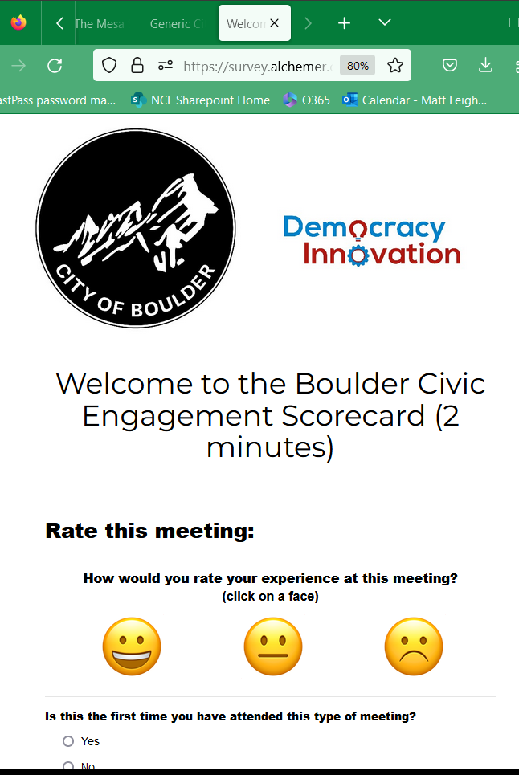
What can we do? Rate democracy
A Yelp for civic engagement, now in use in Boulder (CO), Mesa (AZ), and Fayetteville (NC)
Notes:
Most important measure: what are people thinking about their local democracy (mention Quixada)

Slide 25
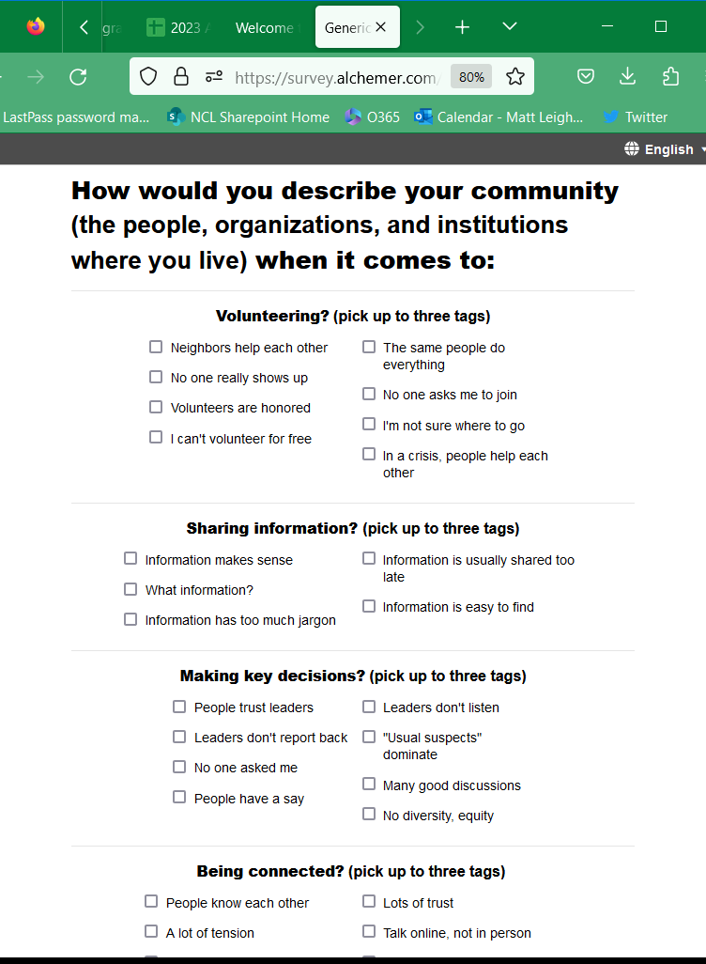
What can we do? Rate democracy
A Yelp for civic engagement, now in use in Boulder (CO), Mesa (AZ), and Fayetteville (NC)
Notes:
Not just government services – how is the whole community functioning?

Slide 26
Why rate meetings and local democracy?
Get data to help improve
Communicate that improvement is possible
Show how meetings rely on/connect with other aspects of community
Communicate that engagement is a shared community priority
Try the scorecard now by going to:
Bit.ly/NCLScorecard
(case sensitive)

Slide 27
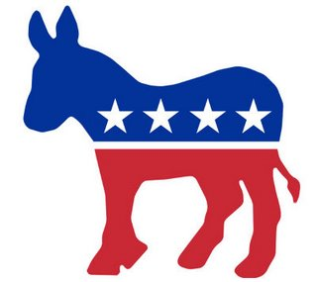
What can we do? Clarify the politics
Civic work challenges the thinking of Progressives and Conservatives
Experts don’t make all the decisions
Forces gov’t to be more accountable
Gov’t not enough to solve problems
Electeds don’t make all the decisions
Raises trust in gov’t, other institutions
Free market not enough
Notes:
But first: channeling the waves not a left-right thing. Neither progressive nor conservative national elites really get democracy – neither talk enough about citizens making decisions, one side demonizes government the other defends it, one side things gov’t is the problem-solver the other thinks problems solve themselves

Slide 28
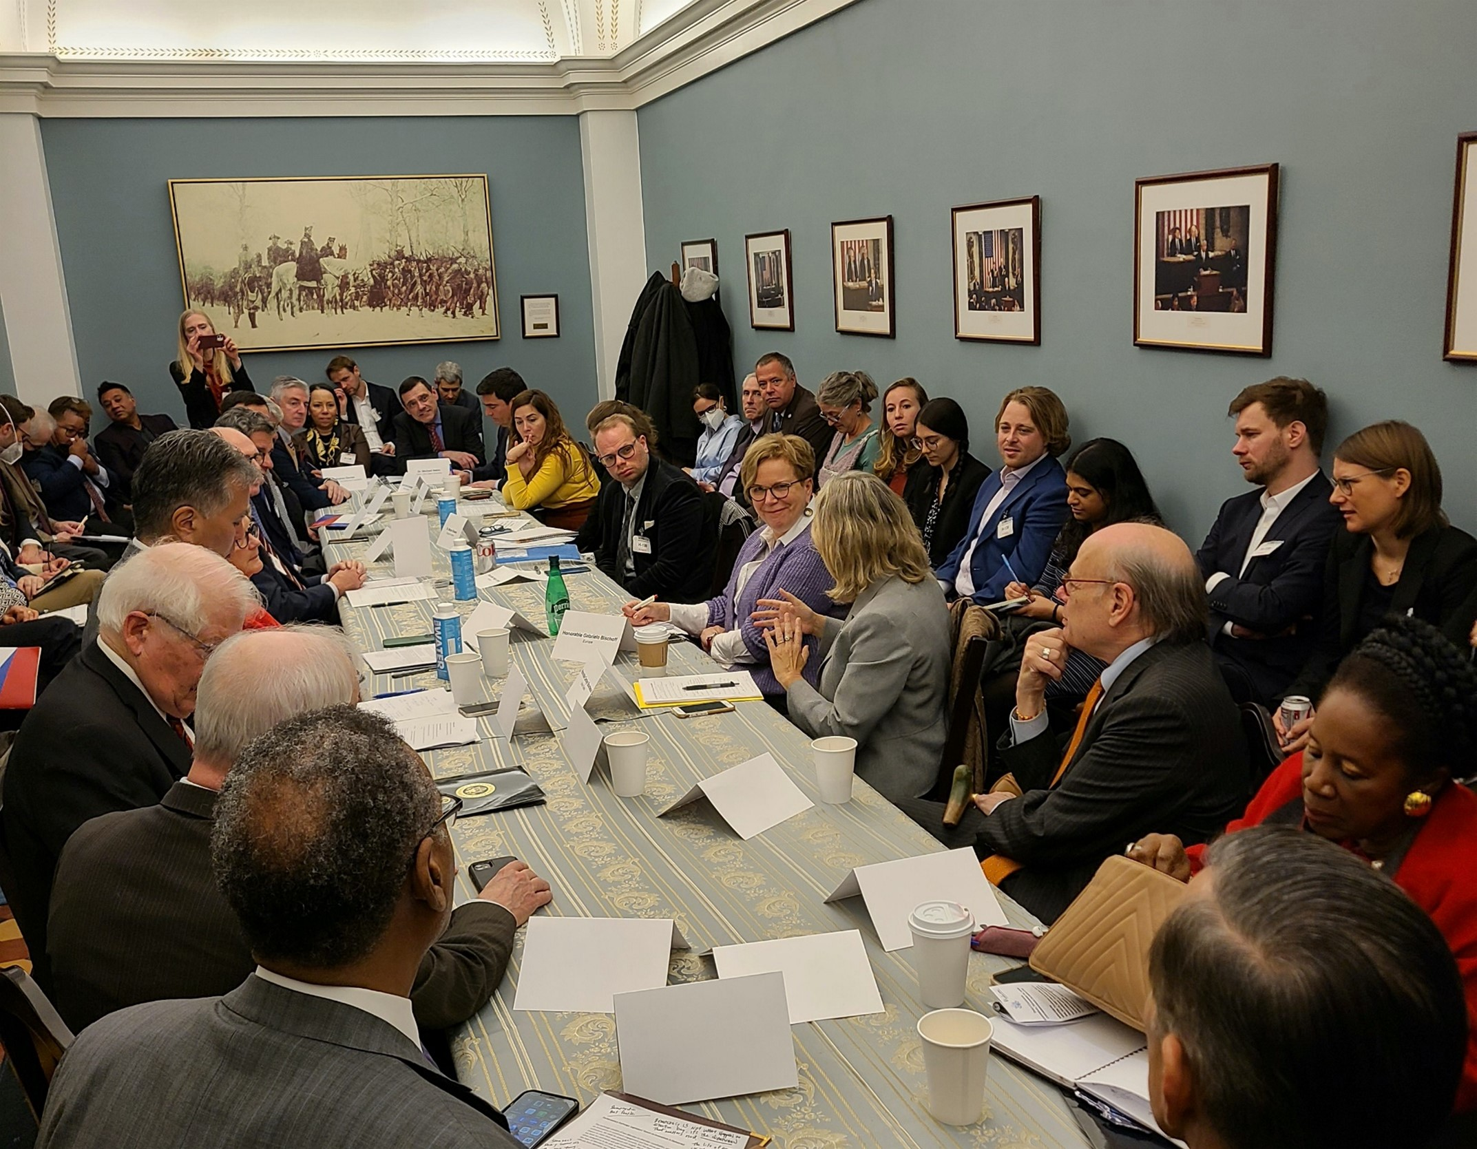
What can we do? More learning across borders

Slide 29
What can we do? Explore the benefits and dangers of AI
Notes:
Refer to essays

Slide 30
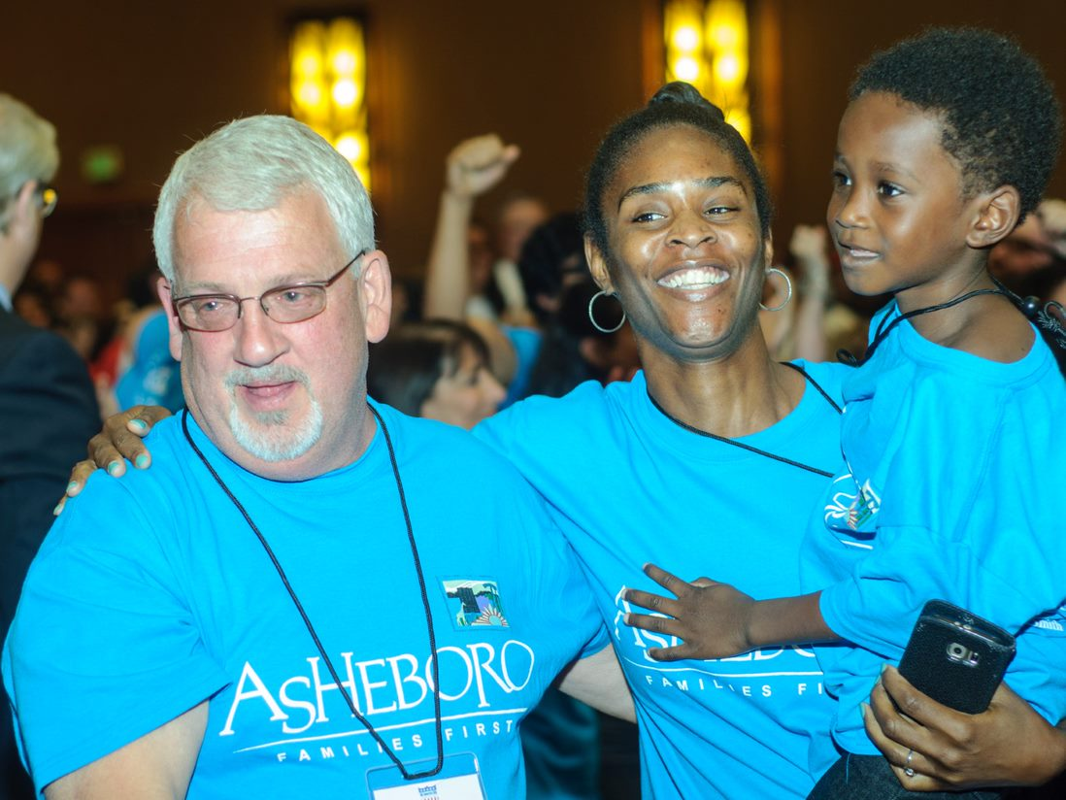
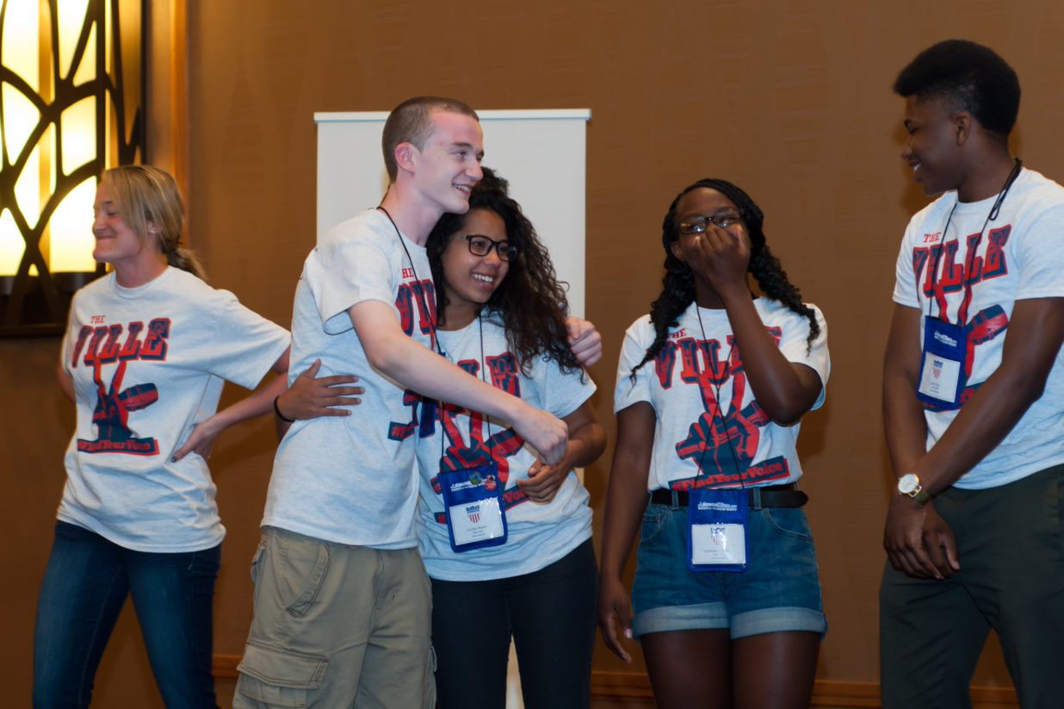
What can we do? Celebrate successes
(photos from the All-America Cities Awards)
Notes:
Civic life as it really is

Slide 31
What can we do? Celebrate successes

Slide 32
What kind of democracy do we want?
Notes:
Our enemy? Yes, Bolsonaro and Duterte and would-be American dictators. But really, it is resignation and lack of imagination. To save democracy, we need to change it

