Slide 1
Engaging Youth in Civic Health: The Stetson University Law Youth Civic Engagement Program

Slide 2
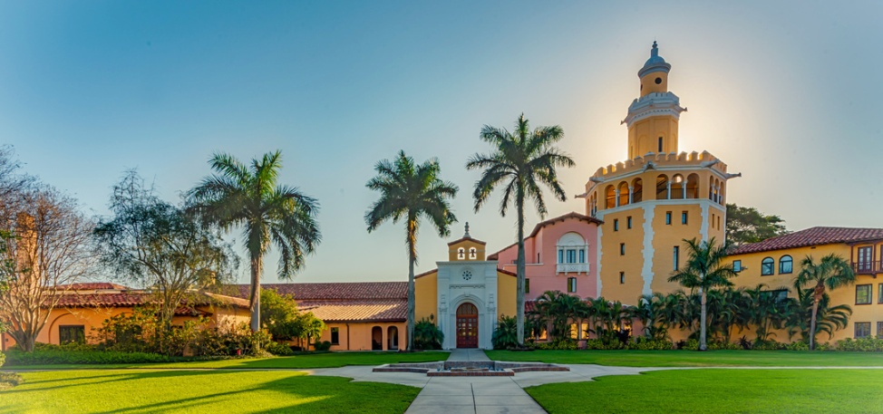
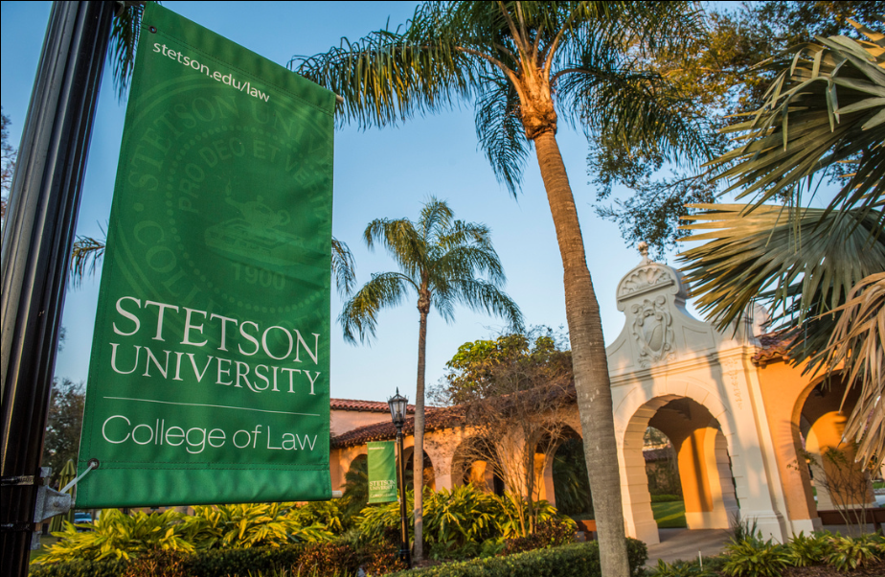
about Stetson
Located in Gulfport, Florida and another campus in downtown Tampa.
Florida's First Law school
#1 in Trial Advocacy
#3 in Legal Research in Writing
Social Justice Advocacy
Notes:
Student demographics:
Local v. out of state
Age
Why they choose Stetson
Employment after.

Slide 3
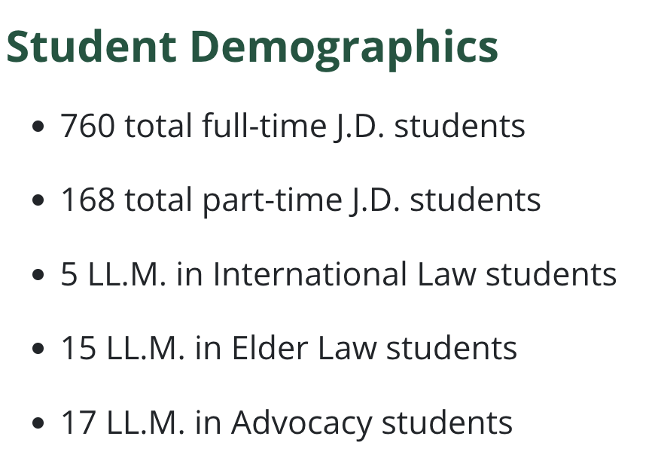
Stetson Demographics
Notes:
23%
25 states 1 foreign country
87 colleges /universities
Age: 20-59
Total new entrants: 305
Full time 249
Part time: 56

Slide 4
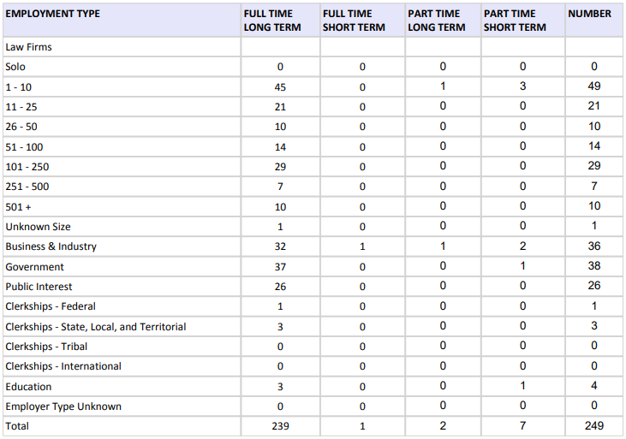
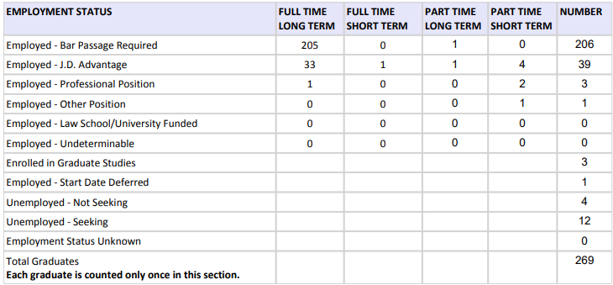
Employment statistics

Slide 5
The summer youth civic program
Notes:
Background on YCEP. How did it get started?
Whi is it important for students to learn about Civic Engagement?
ARe there similar programs offered at other schools?

Slide 6
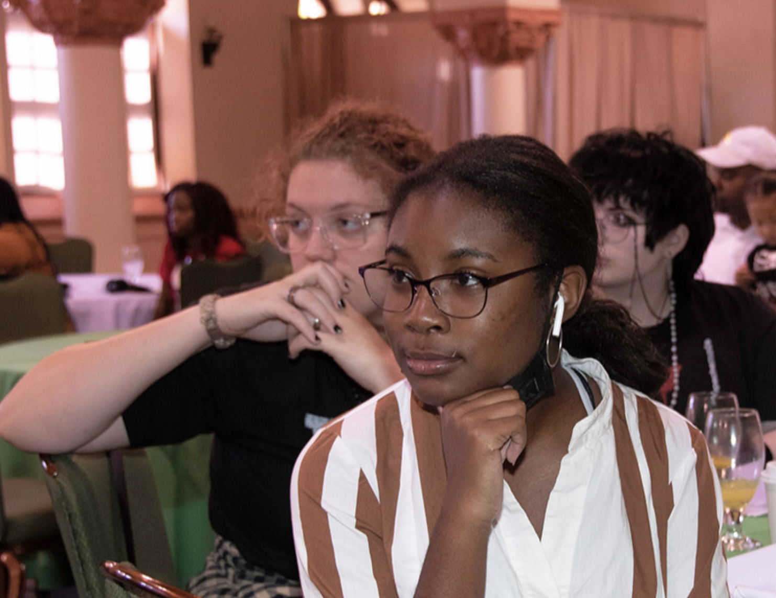
Goals and mission
Notes:
Describe the curriculum? How it was designed?
Information on the students, i.e. the recruitment process, costs, demographics.
What do you hope that students will do after participating in this program?

Slide 7
The curriculum
Notes:
If there is one important lesson that you want students to take away from this program what would that be?

Slide 8
Day 1
Opening and Welcome Remarks
Opening Engagement Activity: Participant Introductions and Goal Setting for the Program
Intro to Course Expectations
Module I: Mindfulness, Listening, and Civil Dialogue
Module II: Self and Society
Closing Reflections

Slide 9
Day 2
Opening Engagement Activity & Survey/Reflections on previous day
Module III: Human Rights and Global Citizenship
Community Engagement Activity:
College Readiness Workshop
Community Engagement Activity:
Navigating Being a Diverse Student Leader and Advocate
Closing & Reminders for Tomorrow

Slide 10
Day 3
Opening Engagement Activity & Mid-Survey/Reflections on previous day
Module IV: Advocacy, Activism and Social Change, Part 1
Community Engagement Activity: Understanding Local Government and City Council
Module V: Legal Case Review
Closing & Reminders for Tomorrow

Slide 11
Day 4
Opening Engagement Activity & Reflections - Prep for Afternoon -- Write down questions you would have for an attorney and a judge - if you could ask them anything, what would you ask?
Module VI: Advocacy, Activism and Social Change, Part 2
Advocate’s Self Care Toolkit
Closing & Reminders for Tomorrow

Slide 12
Day 5: Fieldtrip
Fieldtrip to the Courthouse
Mock Trial
Understanding the Court's responsibilities, process and procedures

Slide 13
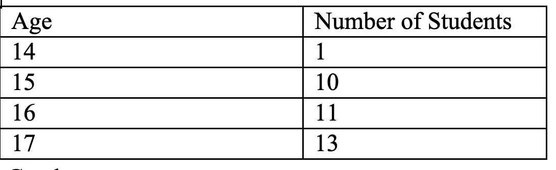
Age and School
24 high schools represented
Type of School | Percentage of applicants
Title 1 Public schools | 52%
Other Public Schools | 31%
Private or Homeschooled | 17%
2023

Slide 14
Gender

Slide 15
race

Slide 16
Experiences
PERSPECTIVES FROM PROFESSORS AND STUDENTS
Notes:
What feedback have you received from students? Any stories of how students have put their learning in practice? Any feedback from the parents?
What have been some of the challenges, if any? What has gone better than expected? Any surprises?
What is your vision or goals for the future of this program? What type of community support is needed?

Slide 17
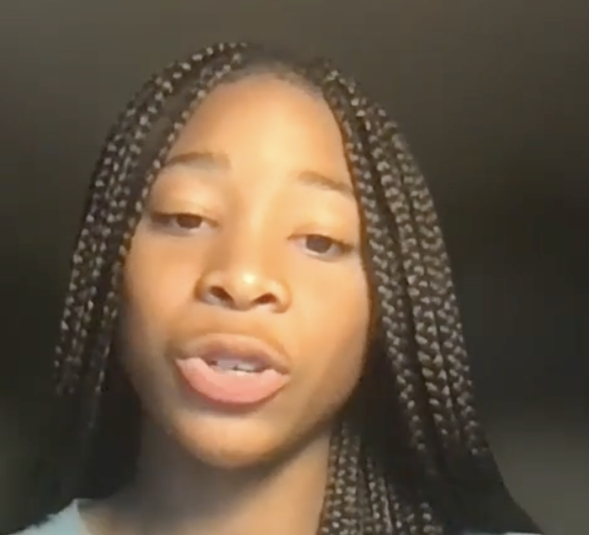
A word from a former student

Slide 18
Why students want to participate?
"I want to obtain leadership skills and become more active in my community. I also want to learn about civil rights and equal justice."
"I am interested in the program because as a young African American teenager,I think it is important for me to understand the laws of our system and how they apply to the community around me.I believe everyone should be there own advocate and it starts with learning as much as you can. Law and civics is apart of that. This can lead to actively participating in society"
"I am interested in this program because little things can make a big difference. Me contributing to the community would help out the people in need."

Slide 19
The impact

Slide 20
Impact of the program

Slide 21
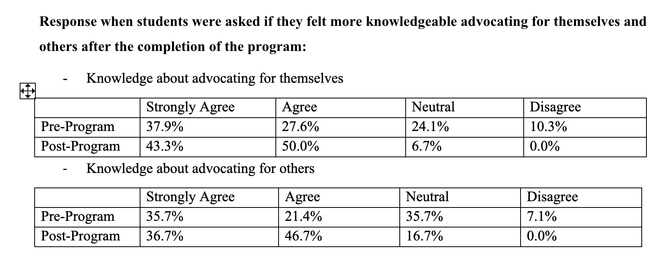
Impact of the program
How do we measure success?

Slide 22
ANTICIPATION AS WE MOVE AND GROW FORWARD
HOW OTHERS CAN SUPPORT US AND HOW CAN WE SUPPORT YOU.

Slide 23
QUESTIONS AND ANSWERS

