Slide 1
Advancing Civic Health in Florida’s Communities
FCA Third Thursday 2024 Webinar Series
https://floridacivicadvance.com

Slide 2
Florida Civic Advance Advancing Civic Health in Florida’s Communities
FCA Third Thursdays Webinar
Thursday, February 15, 2024, 12-1 pm, ET
“Engaging Youth in Civic Health:
Stetson Law Youth Civic Engagement Program”

Slide 3
Florida Civic Advance Advancing Civic Health in Florida’s Communities Webinar Zoom Housekeeping
Place your device on Mute till the Q&A
The FCA conducts nonpartisan webinars
Show respect for the speakers and each other
Please use “Chat” to share questions, comments and links
to resources.
We will try to have the speakers answer your questions during the presentations
We will have an open Q & A after the presentations

Slide 4
Florida Civic Advance Advancing Civic Health in Florida’s Communities WHAT IS CIVIC HEALTH
“Civic health reflects the opportunities people have to participate in their communities.”
National Conference on Citizenship

Slide 5
Florida Civic Advance Advancing Civic Health in Florida’s Communities WHAT IS CIVIC HEALTH
Communities with strong indicators of civic health have:
.
Higher employment rates | Accessible civic gathering places in libraries & parks
Stronger schools | More responsive local governments, and
Better individual physical health | Their residents live longer healthier lives

Slide 6
Florida Civic Advance Advancing Civic Health in Florida’s Communities FLORIDA’S CIVIC HEALTH CHALLENGE
Florida, the 3rd largest state, ranks among the lowest states in terms of civic health. We want to change that.
50th in nation in volunteering among 50 states (2015)
49th in belonging to a civic organization (2013)
50th in donating to charity (2015)
50th in helping neighbors fix a community problem (2015) and
50th attending public meetings (2015)

Slide 7
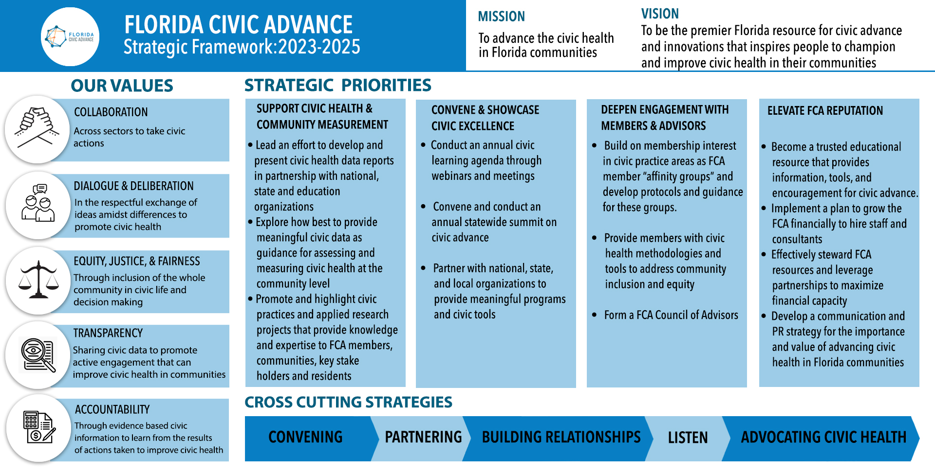
Advancing Civic Health in Florida’s Communities

Slide 8
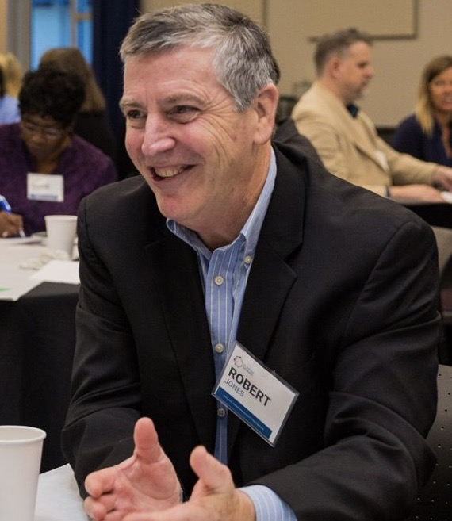
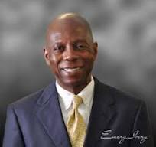
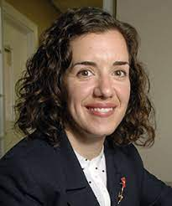
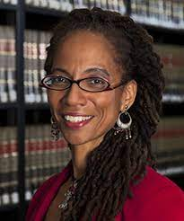
Introducing the Moderator & Presenters
“Engaging Youth in Civic Health: Stetson Law Youth Civic Engagement Program
Bob Jones
Introduction
FCA Board Member
Emery Ivery,
Moderator,
Board Member, Florida Civic Advance
Christine Cerniglia, Professor,
Director of Clinical Education, Stetson University College of Law
Judith Scully, Professor, Stetson University College of Law, founder, Social Justice Advocacy Concentration

Slide 9
“Engaging Youth in Civic Health: Stetson Law Youth Civic Engagement Program
What do you want to Learn From Today’s Webinar?
Who: Stetson Law, Youth Civic Engagement Program
What: Hear about other communities and efforts to engage youth. What data has been collected from participants following the program? More about youth and civic health. Civic programs in schools. Level of civic understanding of the students. Challenges of engaging youth in civic life. Best practices in undergraduate education.
How: Connecting the program to civic engagement activities in Gulfport and St Pete. How do you engage young people with voting? Teaching youth to engage in community. Partnership opportunities. How to provide equitable education for students.

Slide 10
Florida Civic Advance Advancing Civic Excellence in Florida’s Communities
In Case You Missed Past FCA Civic Excellence Webinars
Visit our website: https://www.floridacivicadvance.net

Slide 11
Florida Civic Advance Advancing Civic Health in Florida’s Communities
Join us in advancing civic health in Florida’s communities!
Florida Civic Advance Membership
We welcome organizations and individuals to join as FCA members to build together a new nonprofit membership network dedicated to increasing civic practices and advancing civic health in Florida’s communities
https://floridacivicadvance.com/membership/

Slide 12
Florida Civic Advance Advancing Civic Excellence in Florida’s Communities
FCA Website
https://www.floridacivicadvance.com
Membership Benefits and Application
https://floridacivicadvance.com/membership/

Slide 13
Florida Civic Advance Advancing Civic Health in Florida’s Communities
https://www.floridacivicadvance.com

