Slide 1
Advancing Civic Health in Florida’s Communities
FCA Third Thursday 2024 Webinar Series
https://floridacivicadvance.com

Slide 2
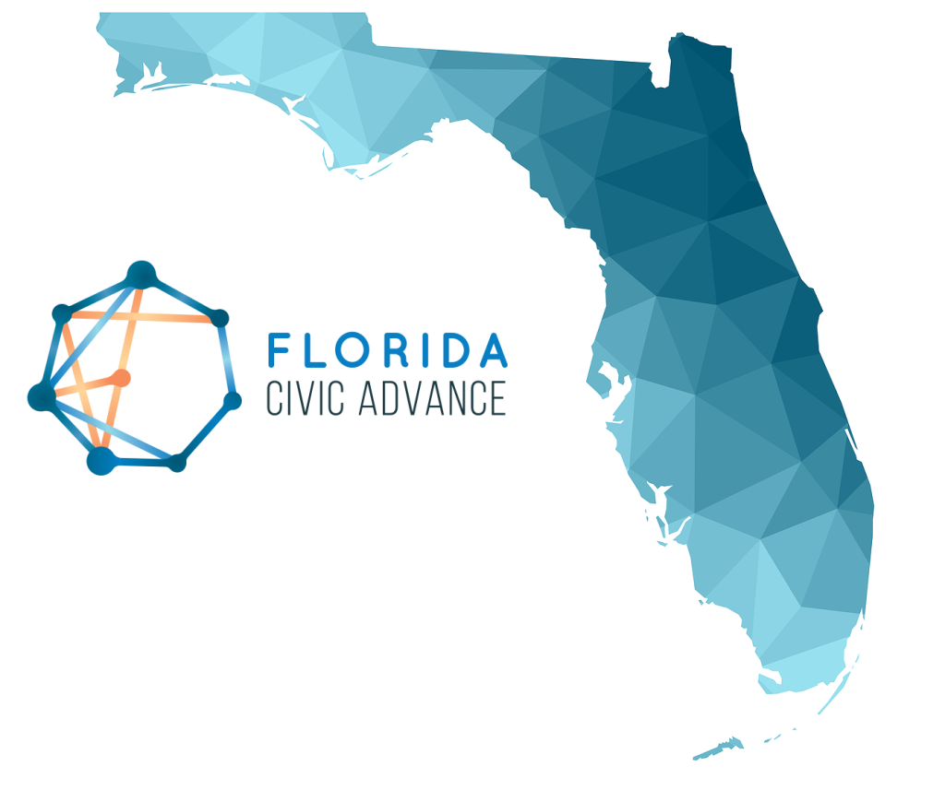
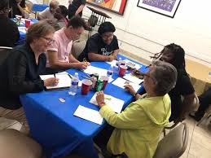
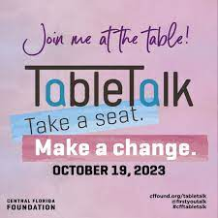
Florida Civic Advance Advancing Civic Health in Florida’s Communities
FCA Third Thursdays Webinar
Thursday, March 14, 2024, 12-1 pm, ET
“TableTalk:
Central Florida Foundation's Civic Conversations and Action Strategy”

Slide 3
Florida Civic Advance Advancing Civic Health in Florida’s Communities Webinar Zoom Housekeeping
Place your device on Mute till the Q&A
The FCA conducts nonpartisan webinars
Show respect for the speakers and each other
Please use “Chat” to share questions, comments and links
to resources.
We will try to have the speakers answer your questions during the presentations
We will have an open Q & A after the presentations

Slide 4
Florida Civic Advance Advancing Civic Health in Florida’s Communities WHAT IS CIVIC HEALTH
“Civic health reflects the opportunities people have to participate in improving their communities.”
National Conference on Citizenship

Slide 5
Florida Civic Advance Advancing Civic Health in Florida’s Communities WHAT IS CIVIC HEALTH
Communities with strong indicators of civic health have:
.
Higher employment rates | Accessible civic gathering places in libraries & parks
Stronger schools | More responsive local governments, and
Better individual physical health | Their residents live longer healthier lives

Slide 6
Florida Civic Advance Advancing Civic Health in Florida’s Communities FLORIDA’S CIVIC HEALTH CHALLENGE
Florida, the 3rd largest state, ranks among the lowest states in terms of civic health. We want to change that by bringing back the Civic Health Index as a guide for actions to improve Florida communities.
50th in nation in volunteering among 50 states (2015)
49th in belonging to a civic organization (2013)
50th in donating to charity (2015)
50th in helping neighbors fix a community problem (2015) and
50th attending public meetings (2015)

Slide 7
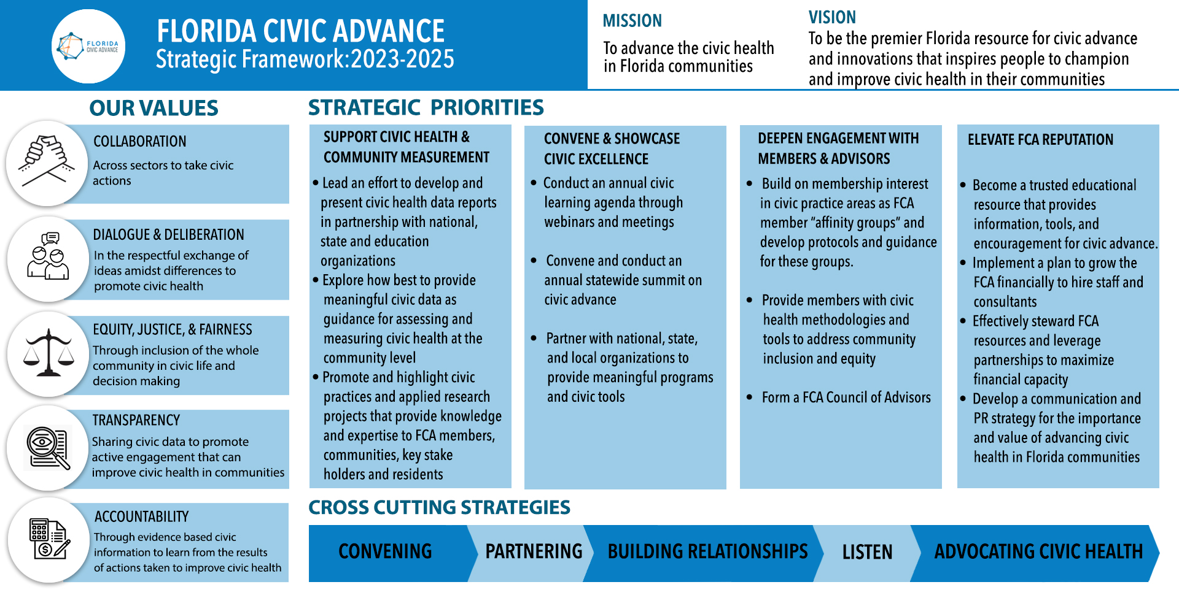
Advancing Civic Health in Florida’s Communities

Slide 8
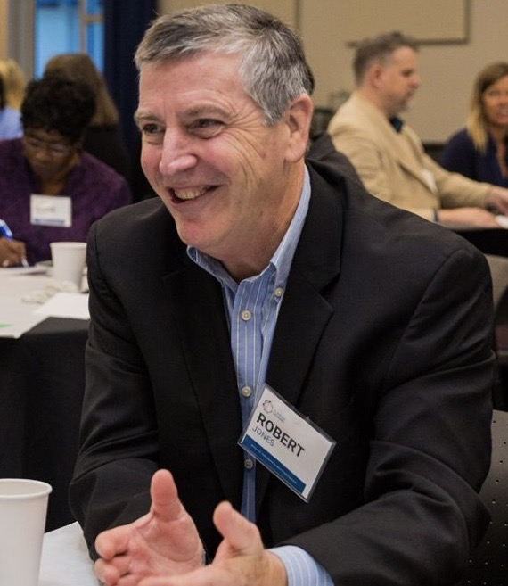
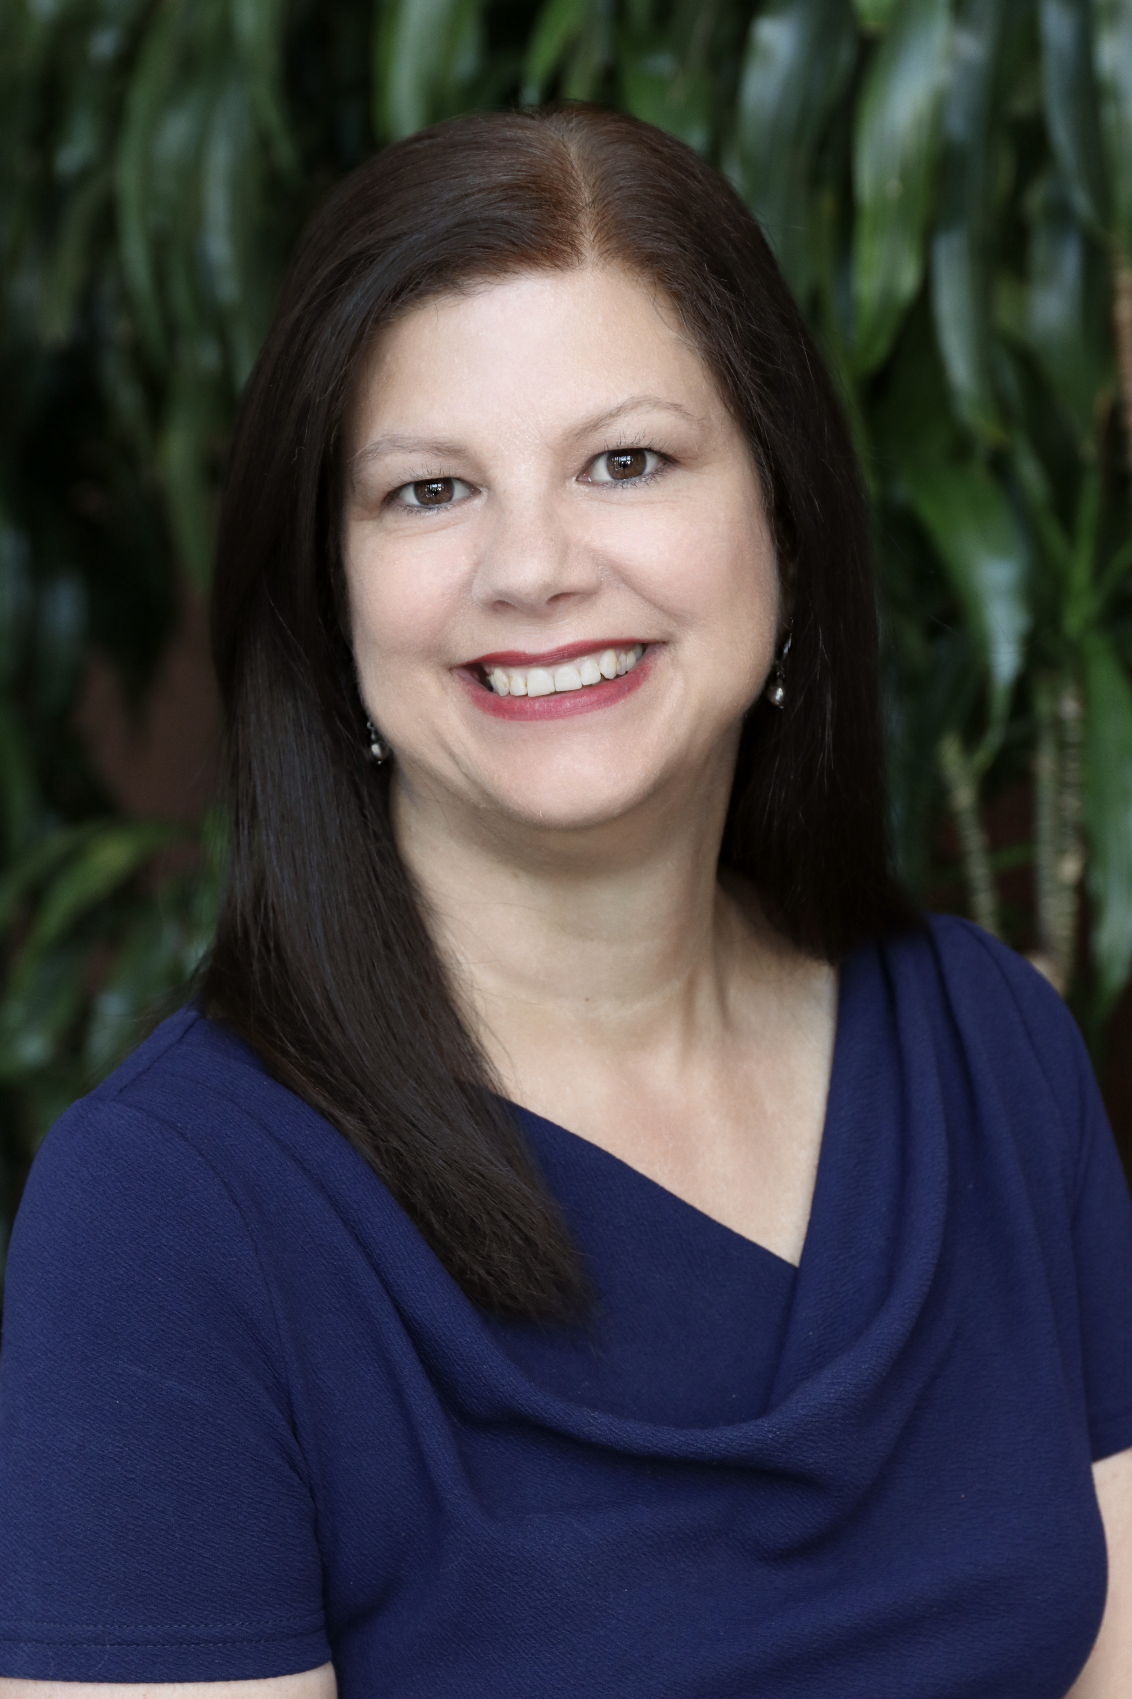
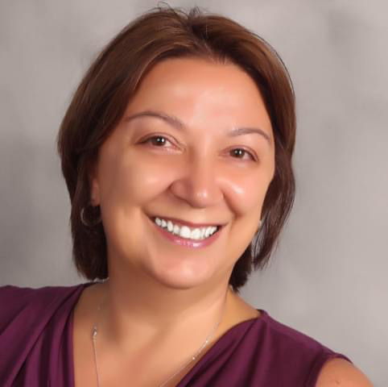
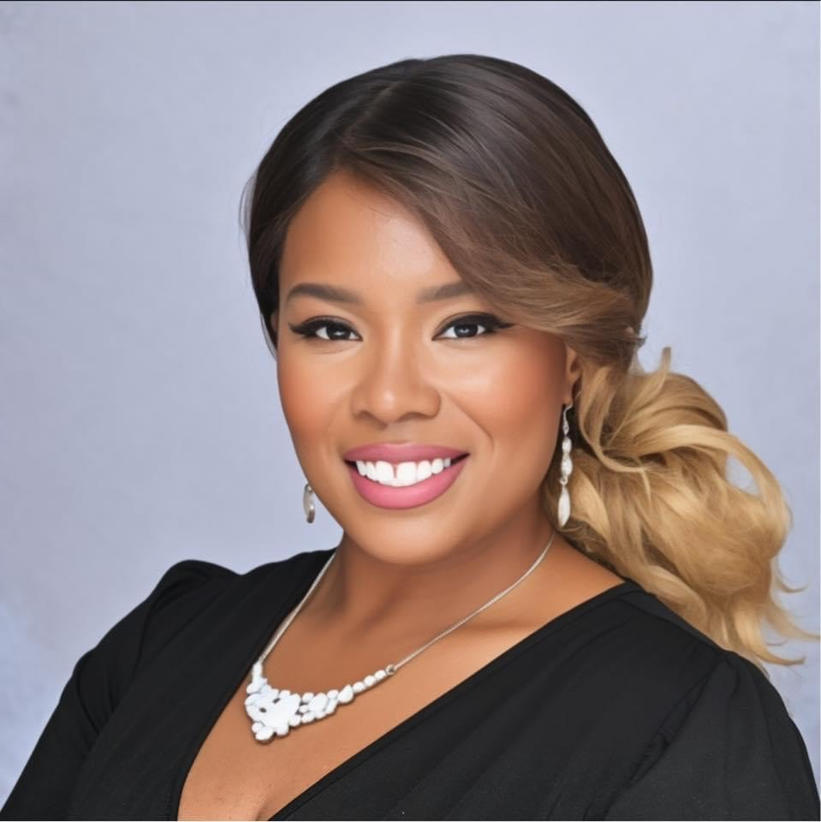
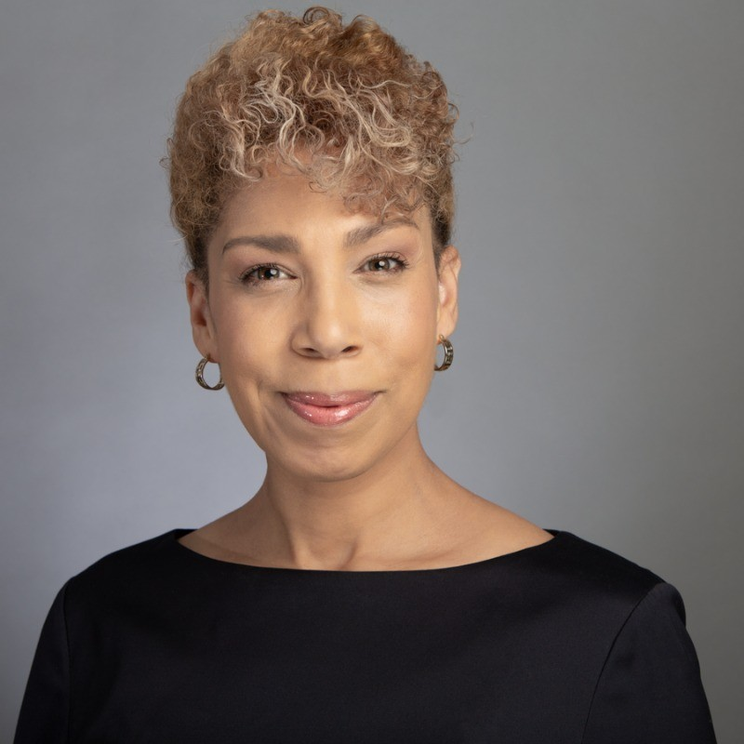
Introducing the Moderator & Presenters
“TableTalk: Central Florida Foundation’s
Civic Conversations and Action Strategy”
Bob Jones
Introduction
FCA Board Member
Sandi Vidal
Vice President of Community Strategies and Initiatives
Zeynep Portway, Executive Director, Samaritan Resource Center
Tiffany Jeffers Founder/President
The Black Empowerment Council
Dr. Bahiyyah Maroon
President/CEO
Polis Institute

Slide 9
“TableTalk: Central Florida Foundation’s Civic Conversations and Action Strategy”
What do you want to Learn From Today’s Webinar?
Who: Central Florida Foundation, Florida Civic Advance
What: Interested in the action strategy Case study examples of applied civic engagement. What language resonated in this challenging political climate. Great community engagement on climate resilience especially focused on under-resourced communities. Data to practice insights.
How: How TableTalk has influenced CFF's approach to investment strategy and community engagement across the region? How it has amplified the voices of the most marginalized communities within the area? How widely table talk opportunities have been used and by whom? How do you make sure that those residents who have been historically excluded from such conversations are robustly engaged?

Slide 11
What is TableTalk?
TableTalk is a candid conversation taking place in small groups all across Central Florida on October 19th.
We get ideas flowing about all the different ways – big and small – each of us can make Central Florida a better place.
We’ll encourage each other, create connections
and build community.
It doesn’t stop with TableTalk, but rather begins.
Notes:
Allie

Slide 12
There’s been…
How do we get our voices heard?
How do we create a safe space for all to talk openly?
a lot of questions.
What’s in it for me?
What’s the point?
How can we get started to make the changes we would like to see?
Notes:
Allie

Slide 13
The point is…
Some more thoughts…
Meet new people
A chance to be a part of a positive community experience
The world feels polarized. Let’s be the leader in how communities grow stronger out of a divisive period.
We have a chance to show the world that Central Florida is a functional community built on the idea that we create community through conversation.
Have your voice heard
Being a part of something bigger than yourself
Try new ideas
Submit ideas for table talk grants
Notes:
Allie

Slide 14
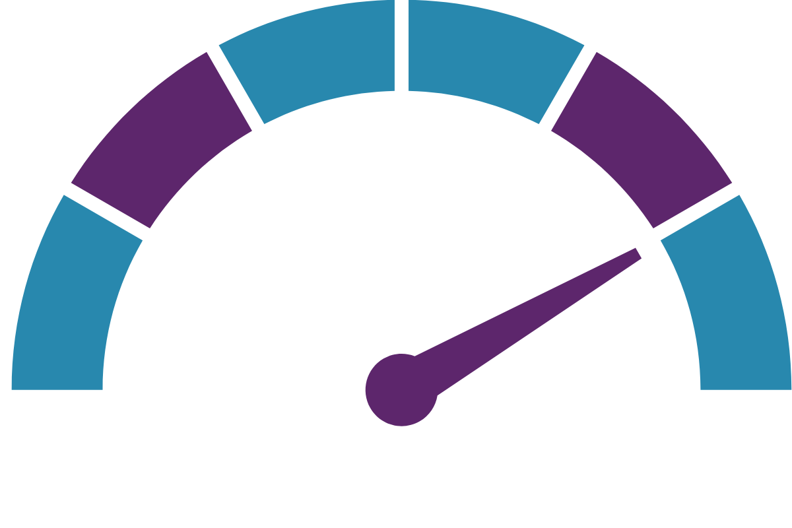
What Happens Next?
1
4
We will send a Communal Letter to City and County Leaders
State of the Region followed by Recommendations
Have your
conversation
2
5
Come up with solutions
Apply for a microgrant to support ideas
Must be through a nonprofit or in partnership with one.
3
Take a survey
Moving the Needle
Notes:
Allie

Slide 15
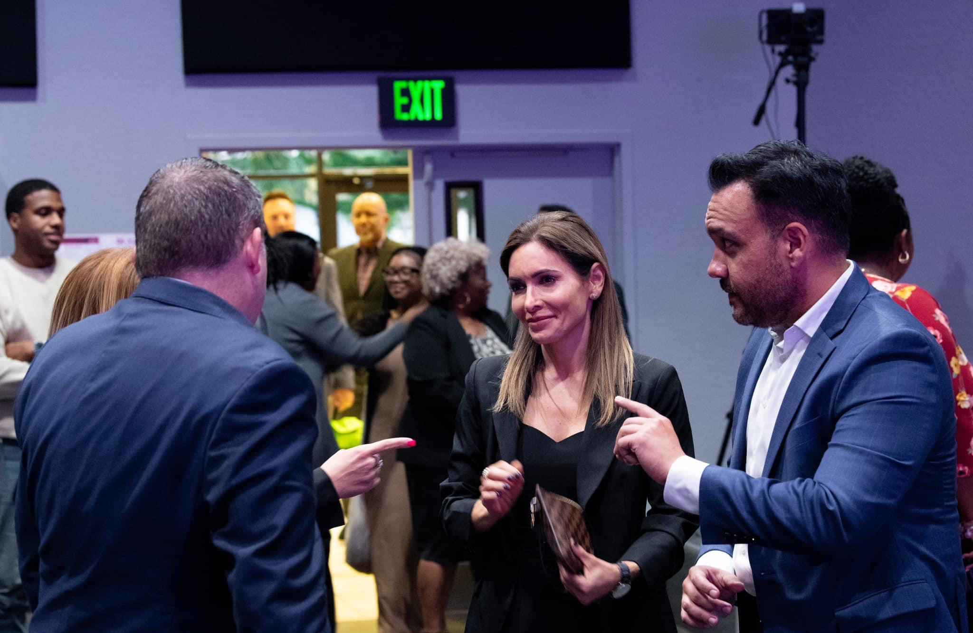
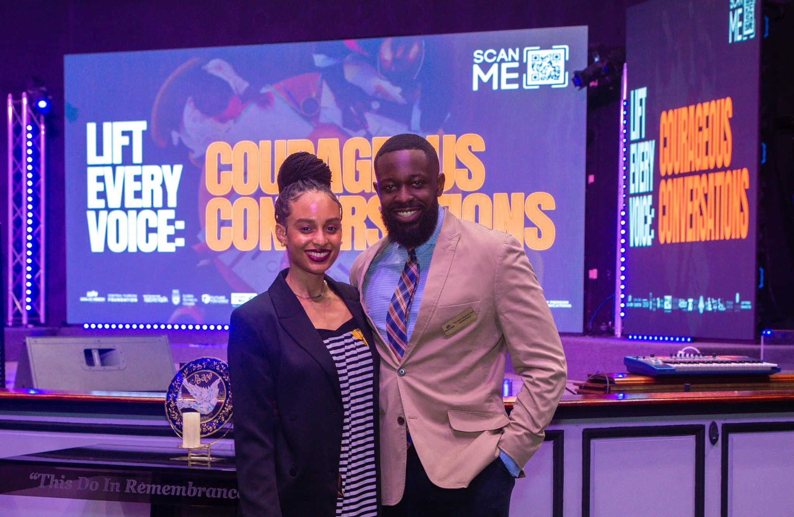
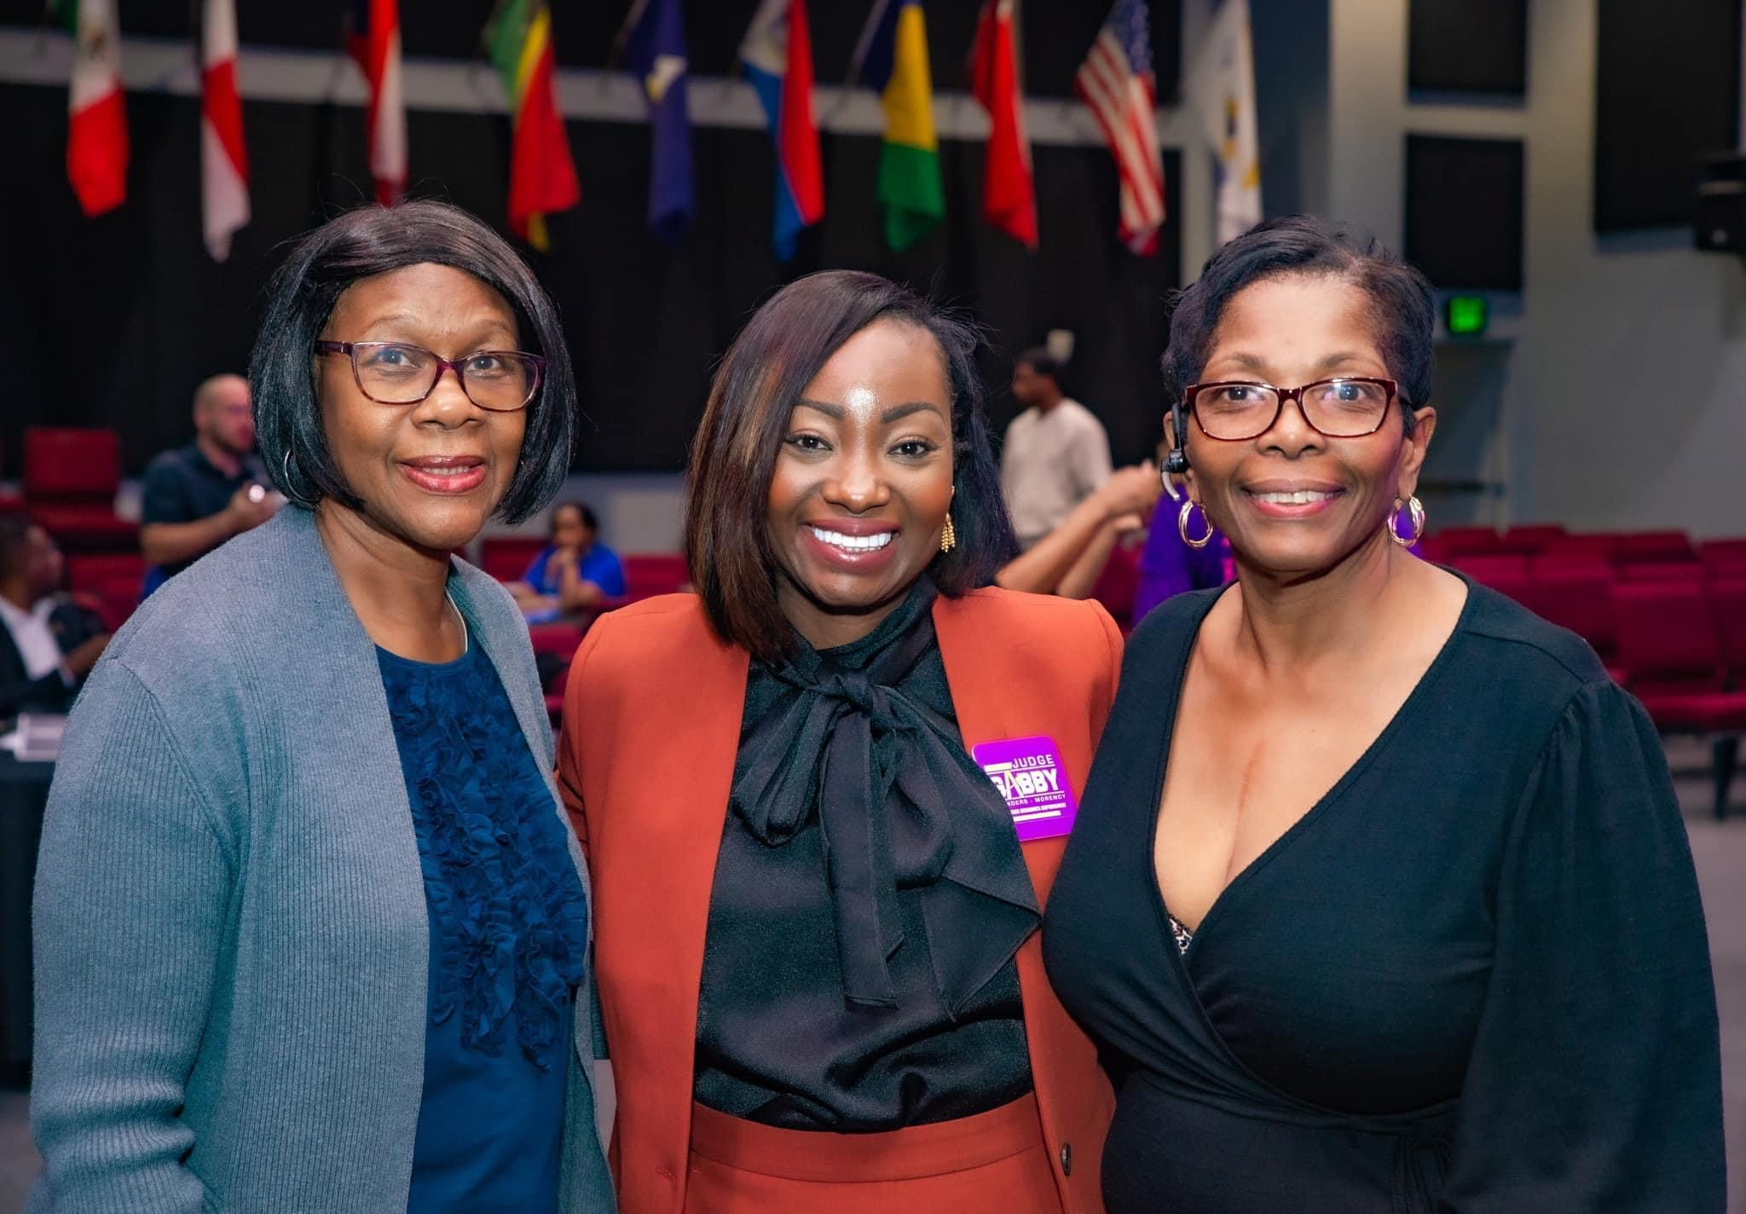
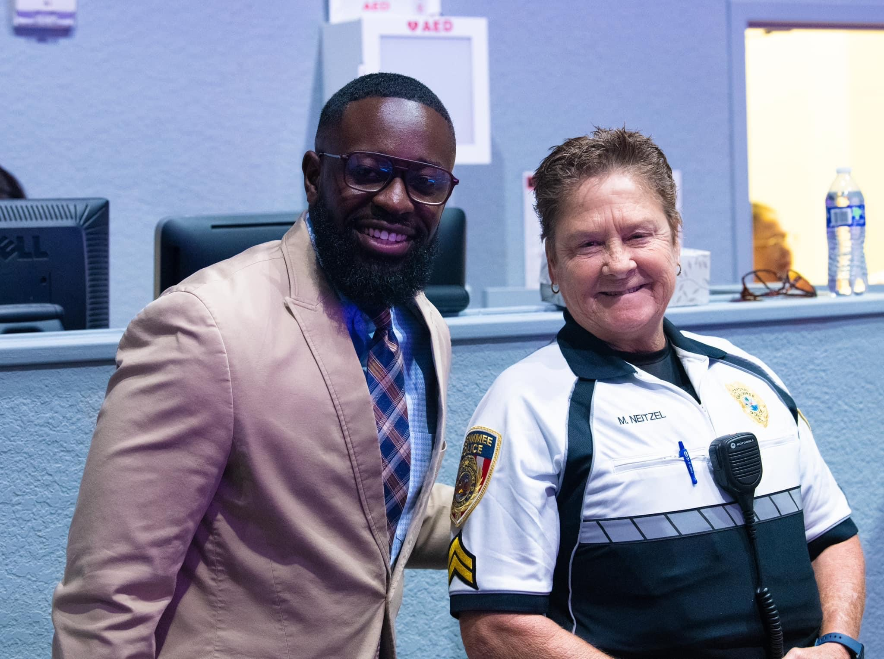
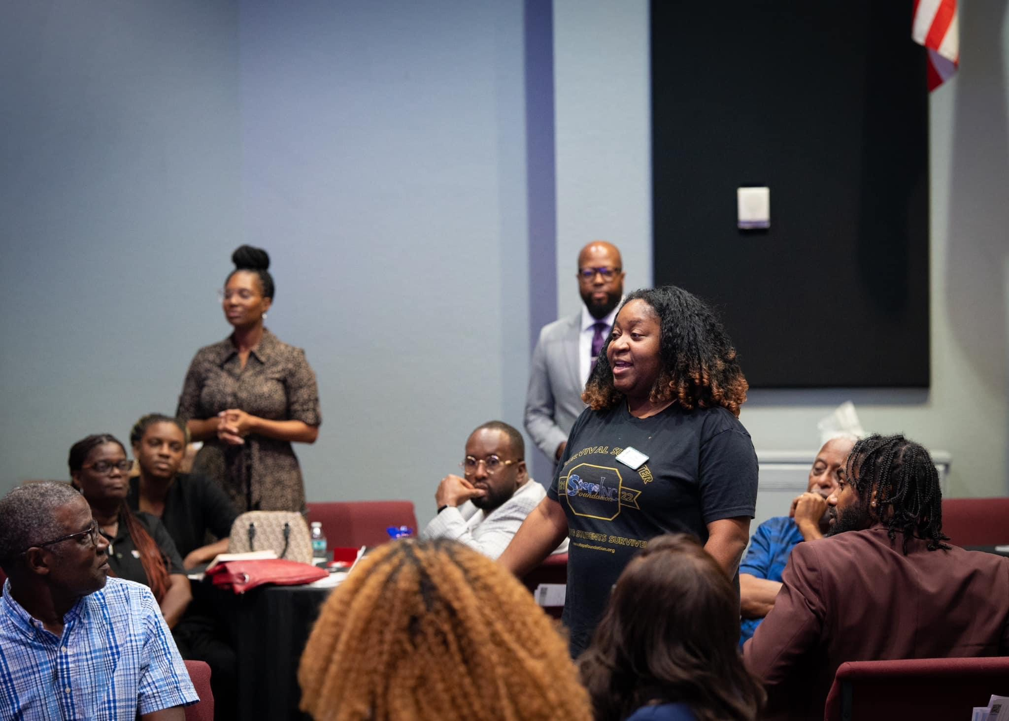

Slide 16
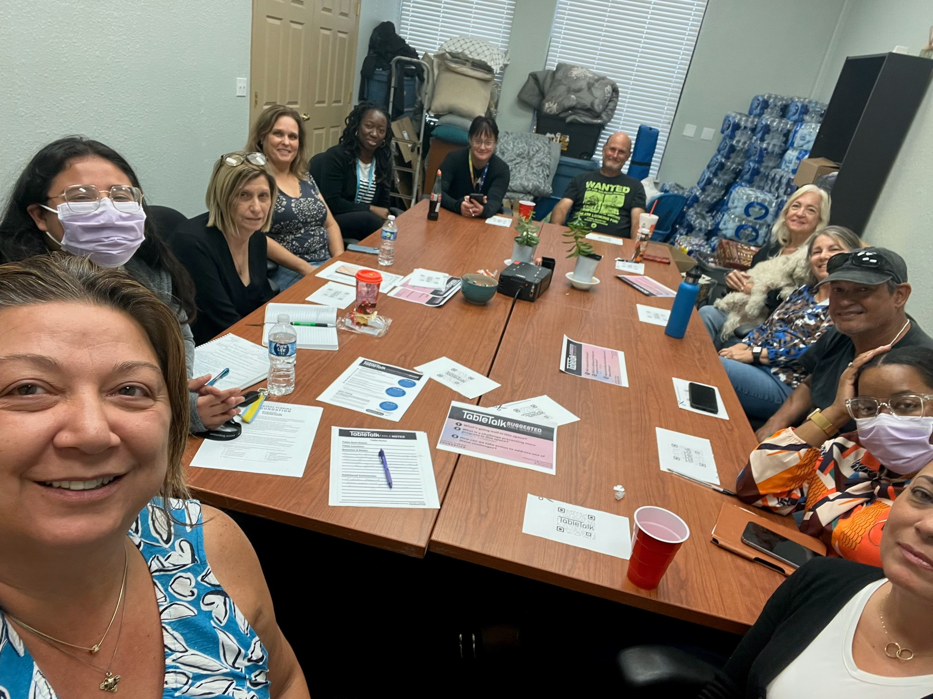
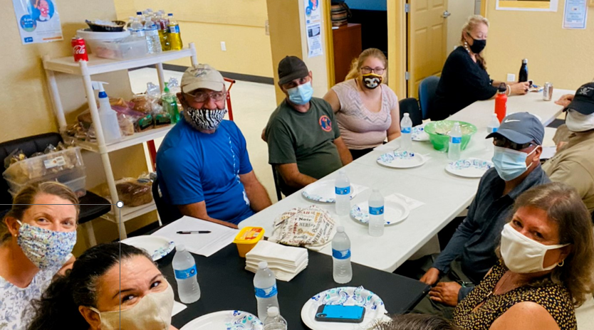
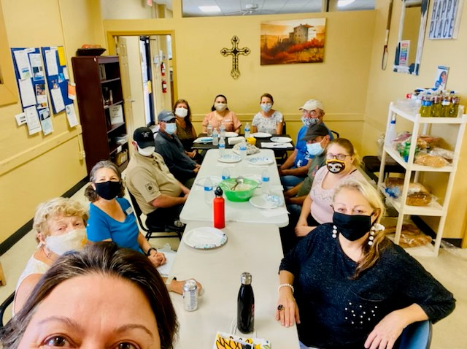

Slide 17
Takeaways
Dr. Bahiyyah Maroon

Slide 18
Discover Answers
Uncover Ideas

Slide 19
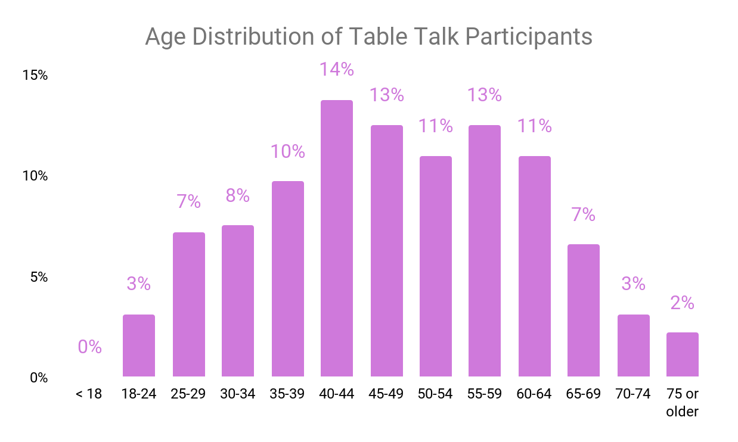
Demographics
*numbers have been rounded to the nearest whole number

Slide 20
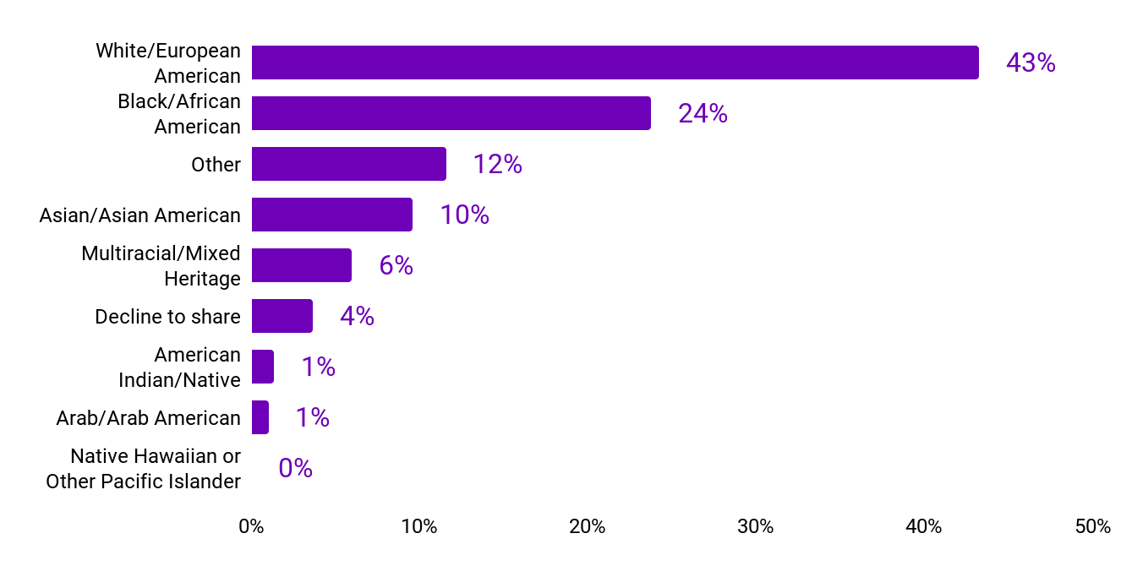
Demographics
8% of participants identified as Hispanic or Latino

Slide 21
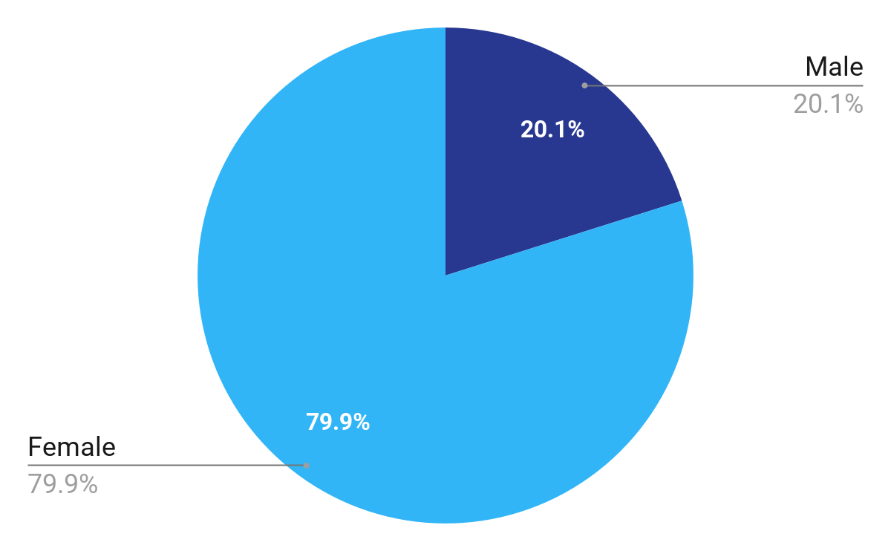
Demographics
29%
Gender
39% of participants are parents
*numbers have been rounded to the nearest whole number

Slide 22
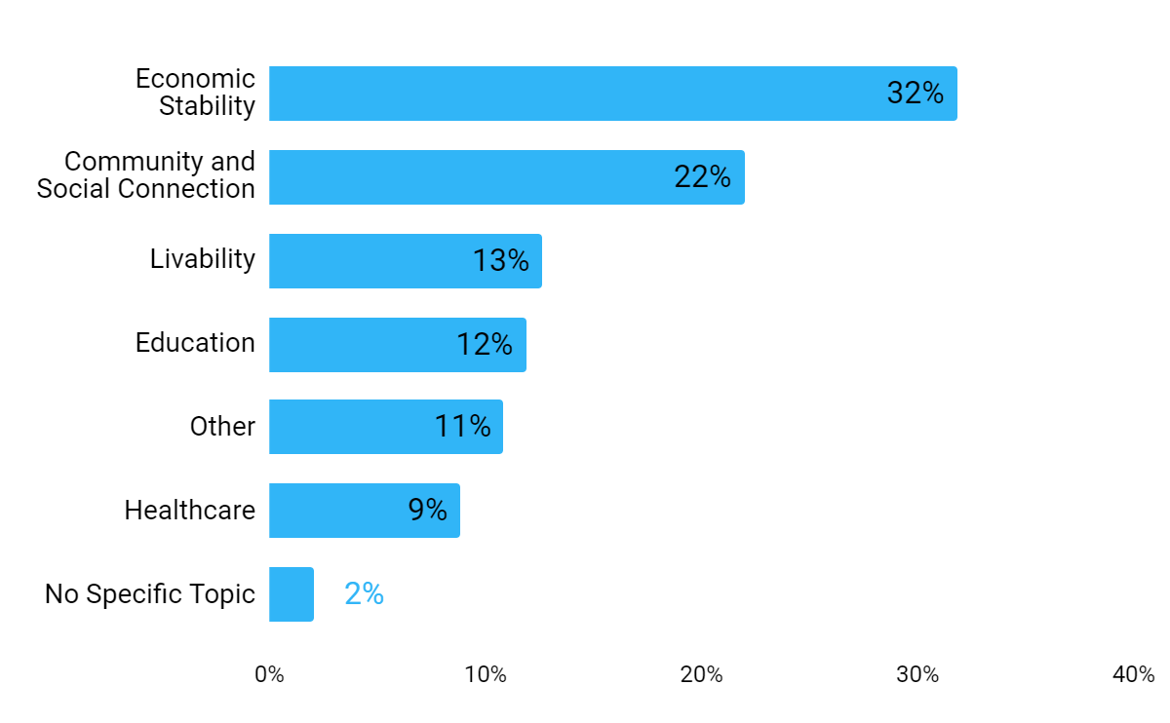
Table Talk Topics Discussed
The top issues discussed at tables in 2023 were:
Economic Stability
Includes jobs, poverty, housing, businesses
Community and Social Connection
Includes civic engagement and voting, and social justice
*numbers have been rounded to the nearest whole number

Slide 23
Community Outlook
Participants were asked if they felt more worried or more hopeful about the future, and asked to explain why. Most (76%) felt more hopeful. Major themes to open ended responses for each group are summarized here.
More Hopeful | More Worried
Unity and Shared Goals Community Issue Awareness Community Engagement and Collaboration Change Is Inevitable Passion and Dedication Knowledgeable Community Strong Leadership | Large Social Issues Political Division Lack of Community Collaboration Lack of Resources Systemic Issues Lack of Knowledge and Awareness Change is Slow
As seen in prior surveys, being more or less hopeful has a clear link to how people perceive and prioritize key issues in communities.

Slide 24
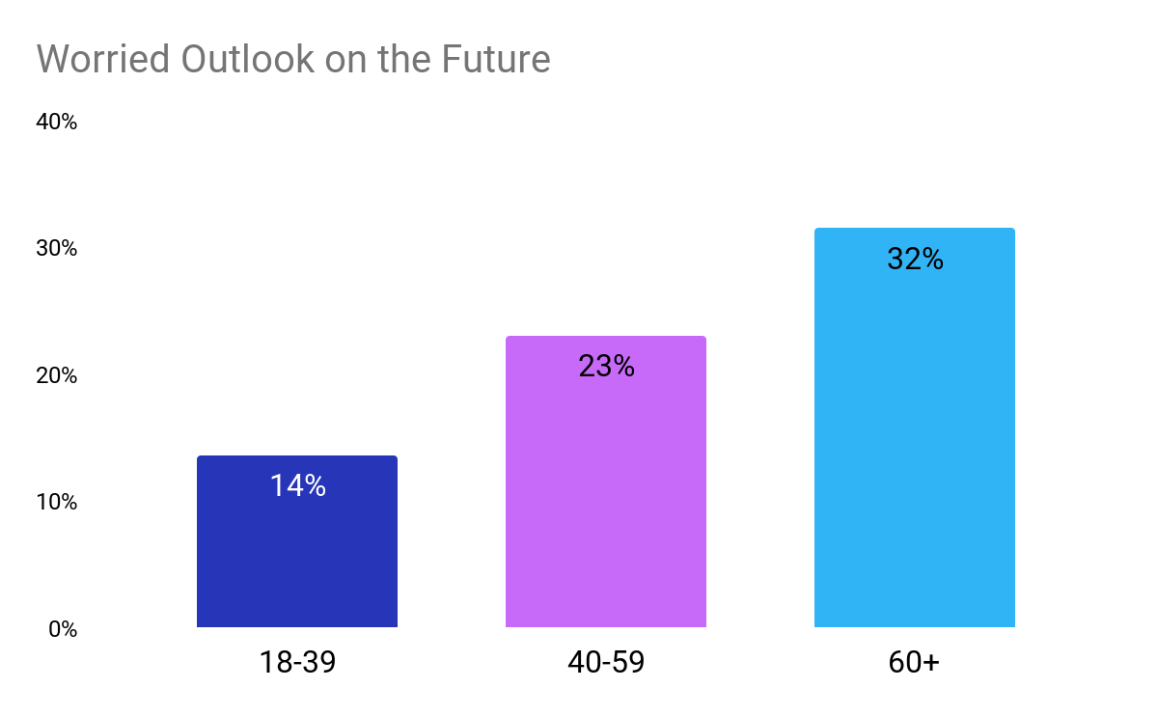
Participants with worried outlooks on the future increased by age, with those 60 and older most worried, and those 18-39 least worried.
How could this information shape senior care in our region?

Slide 25
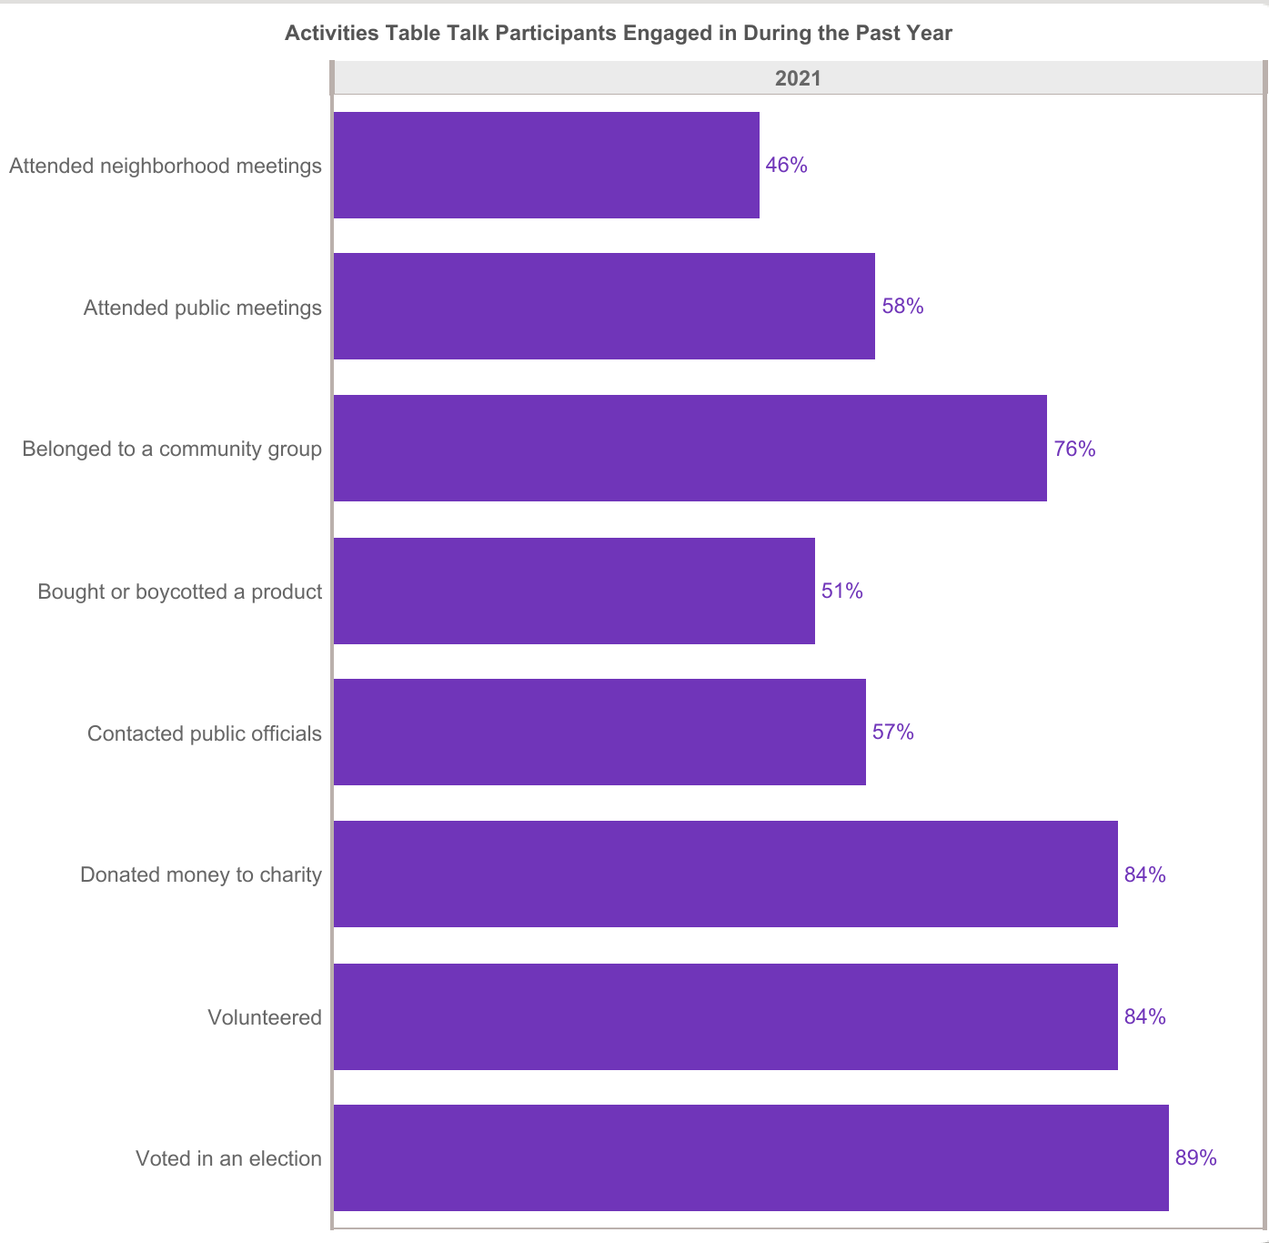

Slide 26
Activities Table Talk Participants Engaged In
Attend neighborhood meetings
Attend public meetings
Belong to a community group
Bought or boycotted a product
Contacted public officials
Donated Money to Charity
Volunteered
Voted in an election
Gen Z
Gen Y
Gen X

Slide 27
Activities Table Talk Participants Engaged In
Attend neighborhood meetings
Attend public meetings
Belong to a community group
Bought or boycotted a product
Contacted public officials
Donated Money to Charity
Volunteered
Voted in an election
Boomers
Silent Generation

Slide 28
Top Areas Participants Believe Central Florida Should Address
Economic Stability
85%
65%
65%
Community Social Connection
48%
60%
49%
Education
44%
49%
49%
Livability
33%
37%
40%
Healthcare
44%
35%
41%
Other
7%
7%
Hispanic/Latino
Black/African American
White

Slide 29
Top Areas Participants Believe Their Community Should Address
Housing issues
81%
59%
59%
Poverty, economic security, economic mobility
58%
65%
50%
Good-paying jobs and economic development
27%
19%
32%
Education
19%
31%
32%
Social justice issues
15%
28%
32%
Hispanic/Latino
Black/African American
White

Slide 30
Entities People Feel are Having a Greater Impact on Making Communities Better Places to Live
Nonprofits and community organizations
57%
71%
79%
Local government
14%
28%
37%
Residents in your community
43%
43%
34%
Employers and the business community
14%
24%
33%
Public school teachers and leaders
43%
26%
37%
Churches, synagogues, mosques, and faith communities
43%
37%
30%
Youth in your community
14%
16%
11%
News media
14%
16%
17%
Neighborhood Centers
43%
26%
16%
Hispanic/Latino
Black/African American
White

Slide 31
KNOWING
Who is Talking About What
HELPS EVERYONE

Slide 36
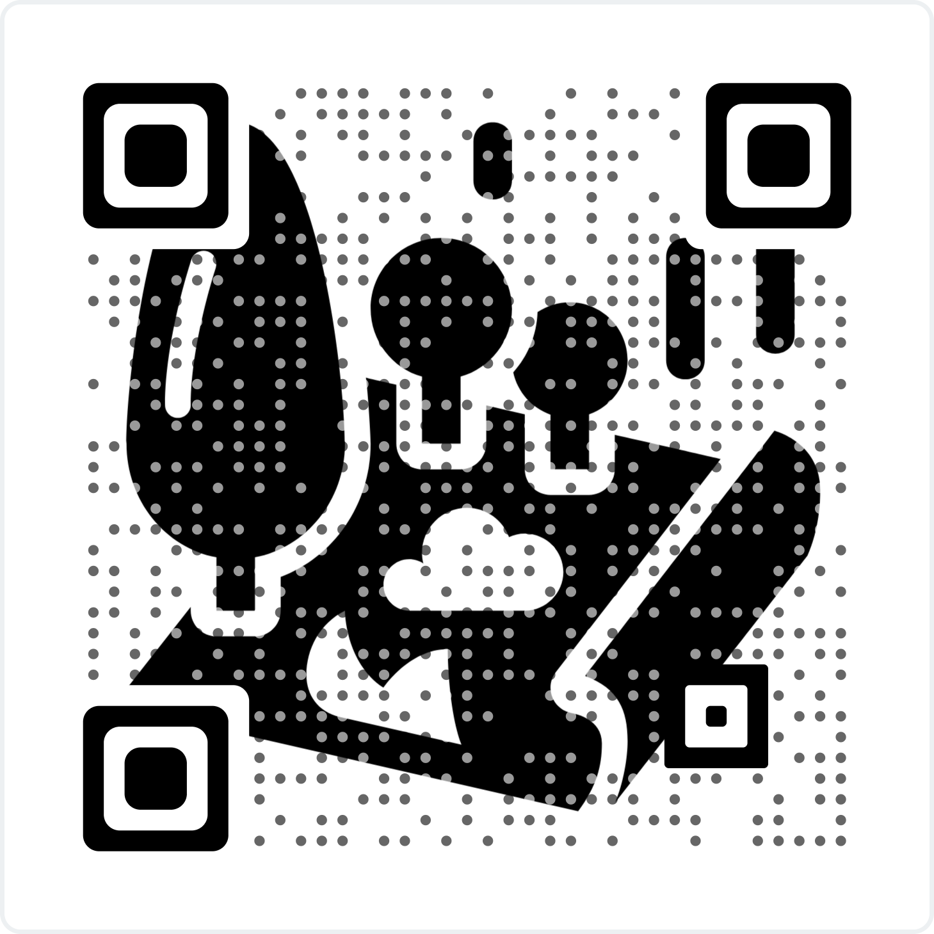

Slide 37
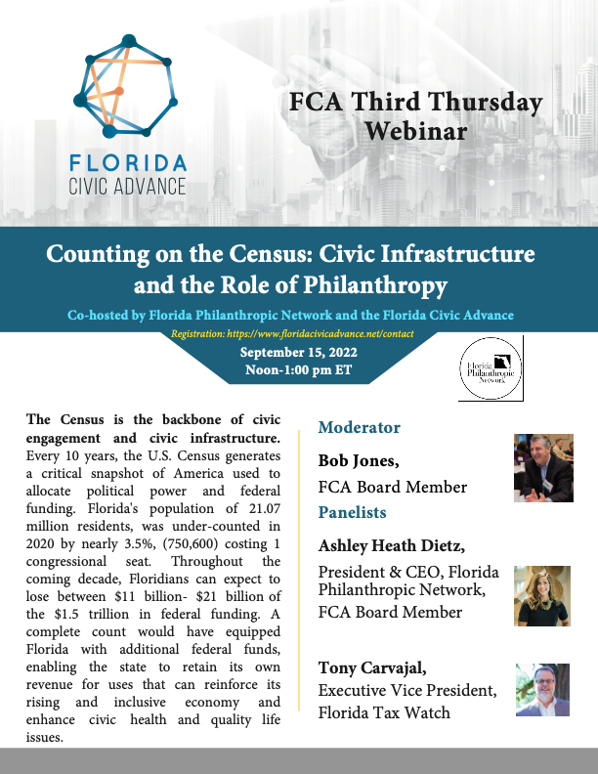
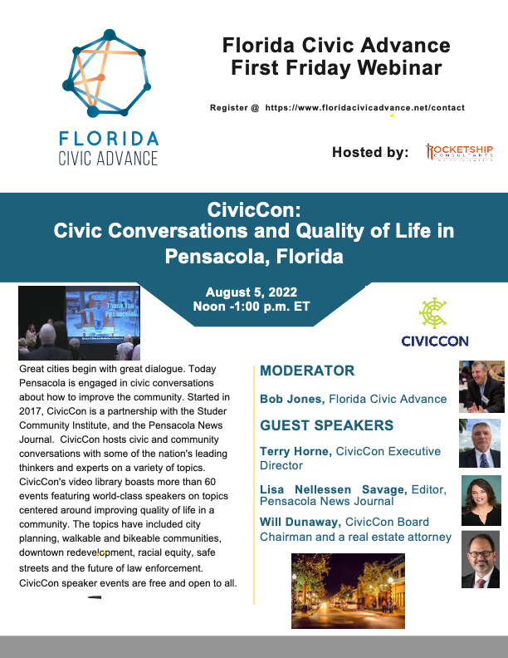
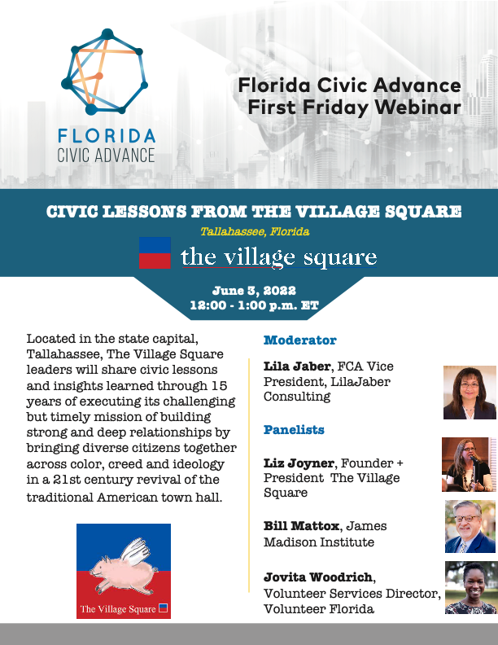
Florida Civic Advance Advancing Civic Excellence in Florida’s Communities
In Case You Missed Past FCA Civic Excellence Webinars
Visit our website: https://www.floridacivicadvance.net

Slide 38
Florida Civic Advance Advancing Civic Health in Florida’s Communities
Join us in advancing civic health in Florida’s communities!
Florida Civic Advance Membership
We welcome organizations and individuals to join as FCA members to build together a new nonprofit membership network dedicated to increasing civic practices and advancing civic health in Florida’s communities
https://floridacivicadvance.com/membership/

Slide 39
Florida Civic Advance Advancing Civic Excellence in Florida’s Communities
FCA Website
https://www.floridacivicadvance.com
Membership Benefits and Application
https://floridacivicadvance.com/membership/

Slide 40
Florida Civic Advance Advancing Civic Health in Florida’s Communities
https://www.floridacivicadvance.com

